Slide 1
Recursion

Slide 2
Recursion Versus Iteration
There are similarities between recursion and iteration
In iteration, a loop repetition condition determines whether to repeat the loop body or exit from the loop
In recursion, the condition usually tests for a base case
You can always write an iterative solution to a problem that is solvable by recursion (& vice-versa)
A recursive algorithm may be simpler than an iterative algorithm and thus easier to write, code, debug, and read

Slide 3
Efficiency of Recursion
Recursive methods often have slower execution times relative to their iterative counterparts
The overhead for loop repetition is smaller than the overhead for a method call and return
If it is easier to conceptualize an algorithm using recursion, then you should code it as a recursive method
The reduction in efficiency usually does not outweigh the advantage of readable code that is easy to debug

Slide 4
Problem Solving with Recursion

Slide 5
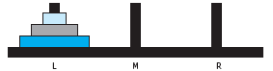
Towers of Hanoi
The Towers of Hanoi is a mathematical puzzle invented by the mathematician Édouard Lucas in the 19th century
Move the three disks to a different peg, maintaining their order (largest disk on bottom, smallest on top, etc.)
  Only the top disk on a peg can be moved to another peg
  A larger disk cannot be placed on top of a smaller disk

Slide 6
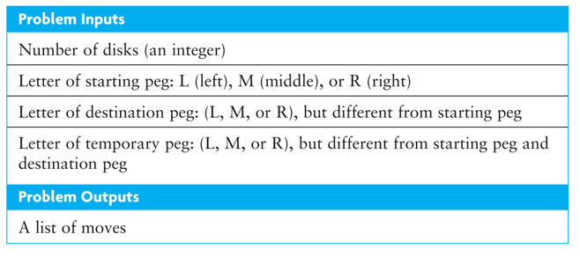
Towers of Hanoi

Slide 7
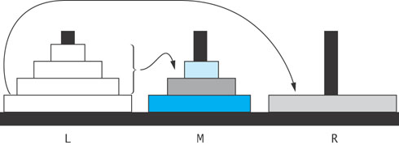
Algorithm for Towers of Hanoi (cont.)
Solution to Four-Disk Problem: Move Four Disks from Peg L to Peg R
1. Move the top three disks from peg L to peg M.
2. Move the bottom disk from peg L to peg R.
3. Move the top three disks from peg M to peg R.

Slide 8
Recursive Algorithm for Towers of Hanoi
Recursive Algorithm for n -Disk Problem: Move n Disks from the Starting Peg to the Destination Peg
if n is 1
move disk 1 (the smallest disk) from the starting peg to the destination peg
else
move the top n – 1 disks from the starting peg to the temporary peg
(neither starting nor destination peg)
move disk n (the disk at the bottom) from the starting peg to the
destination peg
move the top n – 1 disks from the temporary peg to the destination peg

Slide 9
Implementation of Recursive Towers of Hanoi
public static void hanoi(int n, char from, char to, char temp) {
if( n == 1 )
System.out.println("Move disk from " + from +
" to " + to);
else {
hanoi(n – 1, from, temp, to);
hanoi(1, from, to, temp);
hanoi(n – 1, temp, to, from);
}
}

Slide 10
Lessons from Tower of Hanoi
The recursion is pretty interesting
You can prove that there's no faster way to do it than the given approach
But it's very slow!
64 disks would take longer than the Universe has been in existence, even on the faster modern computers
How can we understand how long recursion takes?
Take COMP 4500 to find out!

Slide 11
Recursive Data Structures

Slide 12
Recursive Data Structures
Computer scientists often encounter data structures that are defined recursively – each with another version of itself as a component
Linked lists and trees can be defined as recursive data structures
Recursive methods provide a natural mechanism for processing recursive data structures
The first language developed for artificial intelligence research was a recursive language called LISP

Slide 13
Recursive Definition of a Linked List
A linked list is a collection of nodes such that each node references another linked list consisting of the nodes that follow it in the list
The last node references an empty list
A linked list is empty, or it contains a node, called the list head, that stores data and a reference to a linked list

Slide 14
Node definition
private class Node<E> {
E data;
Node<E> next;
}

Slide 15
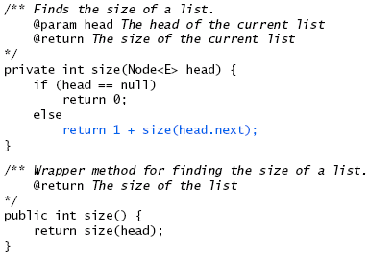
Recursive size Method

Slide 16
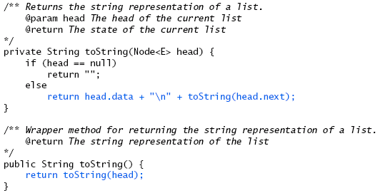
Recursive toString Method

Slide 17
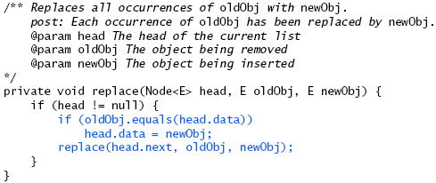
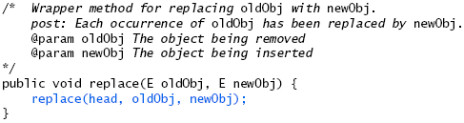
Recursive replace Method

Slide 18
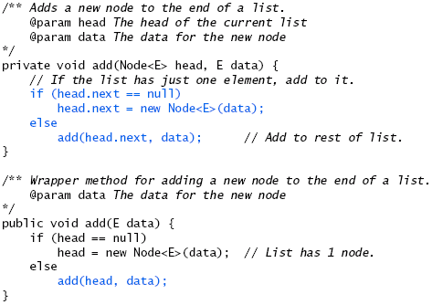
Recursive add Method

Slide 19
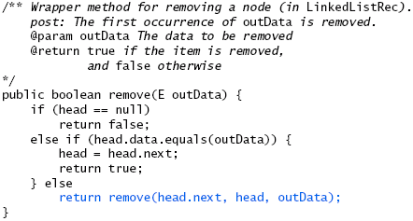
Recursive remove Method (cont.)

Slide 20
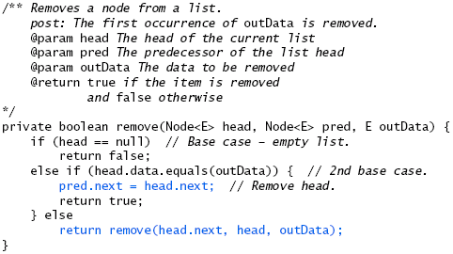
Recursive remove Method

Slide 21
Backtracking

Slide 22
Backtracking
Backtracking is an approach to implementing a systematic trial and error search for a solution
An example is finding a path through a maze
If you are attempting to walk through a maze, you will probably walk down a path as far as you can go
  Eventually, you will reach your destination or you won’t be able to go any farther
  If you can’t go any farther, you will need to consider alternative paths
Backtracking is a systematic, nonrepetitive approach to trying alternative paths and eliminating them if they don’t work

Slide 23
Backtracking (cont.)
If you never try the same path more than once, you will eventually find a solution path if one exists
Problems that are solved by backtracking can be described as a set of choices made by some method
Recursion allows you to implement backtracking in a relatively straightforward manner
  Each activation frame is used to remember the choice that was made at that particular decision point
A program that plays chess may involve some kind of backtracking algorithm

Slide 24
A Framework for Backtracking
We will develop a generic solution for backtracking that can be used in the context of any problem for which backtracking is a viable approach
In this framework, the Application interface and the Backtrack class make up the primary abstractions.
They can be used without modification for any backtracking project.

Slide 25
Application
import java.util.*;
public interface Application {
// isOK returns true if pos is a legal position
// and not a dead end
boolean isOK (Position pos);
// markAsPossible marks pos as possibly being on
// a path to a goal position
void markAsPossible (Position pos);
// isGoal returns true if pos is a goal position
boolean isGoal (Position pos);
// markAsDeadEnd marks pos as not being on a path
// to a goal position.
void markAsDeadEnd (Position pos);
// toString returns a string version of this Application.
String toString();
// iterator returns an iterator over the position
// directly accessible from pos.
Iterator<Position> iterator (Position pos);
}

Slide 26
Position Iterator
In any class that implements the Application interface, there will be an embedded iterator class with the usual methods: hasNext( ) and next( ).

Slide 27
Backtrack
import java.util.*;
public class BackTrack {
Application app;
// stores reference to application in state variable
public BackTrack (Application app) {
this.app = app;
}
// returns true if a solution can be found from pos
public boolean tryToReachGoal(Position pos) {
//implementation developed on next slides
}
}

Slide 28
tryToReachGoal(pos)
The tryToReachGoal method:
  First construct an iterator from pos of all positions immediately accessible from pos.
  Then loop until success has been achieved or no more iterations are possible.
Each loop iteration considers several possibilities for the new position, nextpos, generated by the iterator
  nextpos is a goal: return true
  Might be on path to goal: mark nextpos as possible, and then see if a goal can be reached from nextpos
    Yes? return true
    No? mark nextpos as dead end; (more) ? iterate : return false

Slide 29
public boolean tryToReachGoal (Position pos) {
boolean success = false;
Iterator<Position> itr = app.iterator (pos);
while (!success && itr.hasNext()) {
nextpos = itr.next();
if (app.isOK (nextpos)) {
app.markAsPossible (nextpos);
if (app.isGoal (nextpos))
success = true;
else {
success = tryToReachGoal (nextpos);
if (!success) {
app.markAsDeadEnd (nextpos);
}
}
}
}
return success;
}

Slide 30
Summary
The user of the Backtracking Framework needs to
  Provide a specific application that implements the Application interface
  Provide a class that defines what a position is in the current application
  A way to iterate from the current position to all of the possible next positions

Slide 31
Finding a Path through a Maze
Problem
  Use backtracking to find a display the path through a maze
  From each point in a maze you can move to the next cell in a horizontal or vertical direction if the cell is not blocked

Slide 32
Finding a Path through a Maze (cont.)
Analysis
  The maze will consist of a grid of colored cells
  The starting point is at the top left corner (0,0)
  The exit point is at the bottom right corner (getNCols() – 1, getNRow -1)
  All unexplored cells will be CORRIDOR color
  All cells that represent barriers will be WALL color
  Cells that we have visited will be DEAD_END color
  If we find a path, all cells on the path will be set to PATH color

Slide 33
Representation
Maze searching: 1 = Corridor 0 = Wall
start 1 1 1 0 1 1 0 0 0 1 1 1 1
1 0 1 1 1 0 1 1 1 1 1 0 1
1 0 0 0 1 0 1 0 1 0 1 0 1
1 0 0 0 1 1 1 0 1 0 1 1 1
1 1 1 1 1 0 0 0 0 1 0 0 0
0 0 0 0 1 0 0 0 0 0 0 0 0
0 0 0 0 1 1 1 1 1 1 1 1 1 finish
Iterator choices: north, west, south, east
Marked as possible = 9; dead end = 2

Slide 34
Representation

Slide 35
Solution

Slide 36
Representation
Maze searching: 1 = Corridor 0 = Wall
start 9 2 2 0 2 2 0 0 0 2 2 2 2
9 0 2 2 2 0 2 2 2 2 2 0 2
9 0 0 0 2 0 2 0 2 0 2 0 2
9 0 0 0 2 2 2 0 2 0 2 2 2
9 9 9 9 9 0 0 0 0 1 0 0 0
0 0 0 0 9 0 0 0 0 0 0 0 0
0 0 0 0 9 9 9 9 9 9 9 9 9 finish
Iterator choices: north, west, south, east
Marked as possible = 9; dead end = 2

Slide 37
Maze Position
public class Position {
protected int row, column;
public Position(int r, int c) {
row = r;
column = c;
}
public int getRow() { return row; }
public int getCol() { return column; }
}

Slide 38
Maze.java
public class Maze implements Application {
protected final byte WALL = 0;
protected final byte CORRIDOR = 1;
protected final byte PATH = 9;
protected final byte DEAD_END = 2;
protected Position finish;
protected byte[][] grid;

Slide 39
Maze.java
public boolean isOK(Position pos) {
if (pos.getRow() >= 0 &&
pos.getRow() < grid.length &&
pos.getCol() >= 0 &&
pos.getCol() < grid[0].length &&
grid[pos.getRow()][pos.getCol()] ==
CORRIDOR) {
return true;
} else {
return false;
}
}

Slide 40
MazeIterator.java
public class MazeIterator implements Iterator {
private static final MAX_MOVES = 4;
private int row, col, count;
public MazeIterator(Position pos) {
row = pos.getRow();
col = pos.getCol();
count = 0;
}
public boolean hasNext() {
return count < MAX_MOVES;
}

Slide 41
MazeIterator.java
public Position next() {
Position pos = new Position();
switch (count++) {
case 0: pos = new Position(row-1, col);
break; //NORTH
case 1: pos = new Position(row, col-1);
break; //WEST
case 2: pos = new Position(row+1, col);
break; //SOUTH
case 3: pos = new Position(row, col+1);
break; //EAST
}
}

Slide 43
Recursive Algorithm for Finding Maze Path
Recursive Algorithm for findMazePath(x, y)
if the current cell is outside the maze
return false (you are out of bounds)
else if the current cell is part of the barrier or has been visited already
return false (you are off the path or in a cycle)
else if the current cell is the maze exit
recolor it to the path color and return true (you have successfully
completed the maze)
else // Try to find a path from the current path to the exit:
mark the current cell as on the path by recoloring it to the path color
for each neighbor of the current cell
if a path exists from the neighbor to the maze exit
return true
// No neighbor of the current cell is on the path
recolor the current cell to the temporary color (visited) and return
false

