Slide 1
Recursion
A programming technique
A design pattern
A way of thinking!

Slide 2
Recursion
A problem solving strategy that is applied to problems which are “self-similar” in structure.
  Recurrence Relations
  Fractal images
  Manipulation of “recursive” data structures
The larger problem is composed of instances of smaller problems of the same kind.

Slide 3
Top-Down Design
1. Decompose the problem into smaller problems.
2. Solve each smaller problem (perhaps by way of top-down design).
3. Combine the solutions for these smaller problems to obtain a solution for the original problem.

Slide 4
Recursion
A recursive method solves an instance of a problem that is represented by its parameters and return value.
A special form of top-down design can be described in terms of operations on these parameters and return values.

Slide 5
Recursion
1. From incoming parameter values, extract smaller values of the same kind.
2. Apply the method (recursively) to each of the smaller values to obtain solutions for the smaller values.
3. Use the solutions for these smaller values to obtain a solution for the original incoming parameter values.

Slide 6
Recursion
It is important to separate the client view from the implementation view, even with recursion!
Client View: If I had access to an operation that provided solutions to each of the smaller values, would this help me obtain a solution for the original incoming value?
I.e., what does the combination step look like?

Slide 7
Recursion Example
Given a String object, construct a new String that is the reverse of the original.
public String reverseString (String t) {
//! requires: true
//! ensures: result == REVERSE (t)
//! preserves: t
//! produces: result
// precondition: none
// postcondition: returns a String that
// is the reverse of the value of t

Slide 8
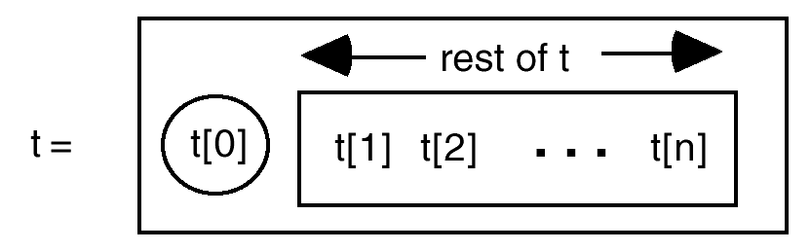
Reverse String
Problem Decomposition

Slide 9
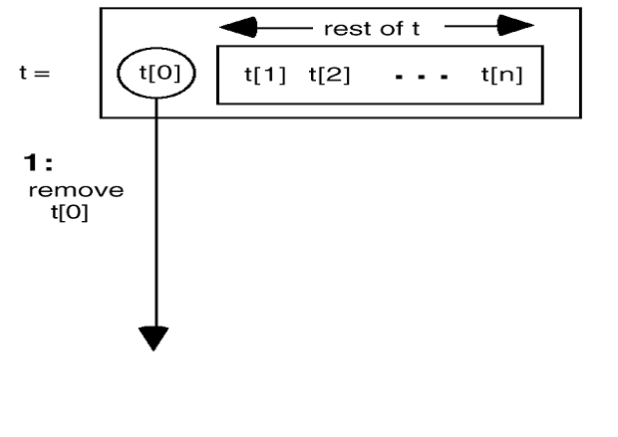
Reverse String
Combination Step

Slide 10
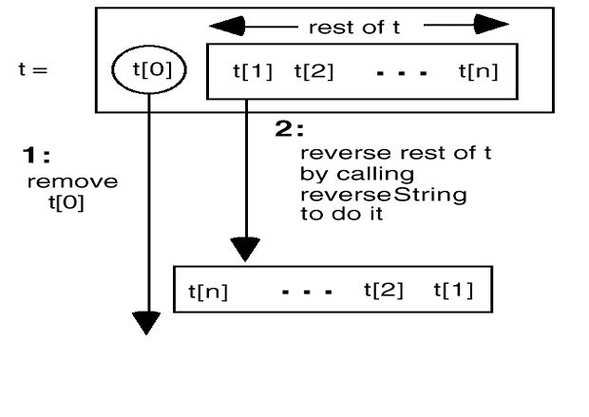
Reverse String
Combination Step

Slide 11
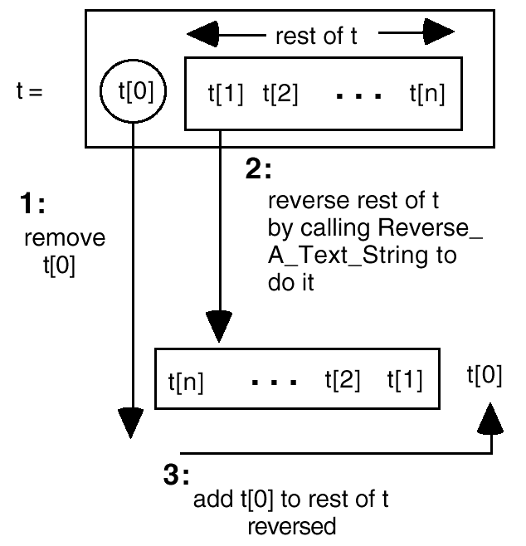
Reverse String
Combination Step

Slide 12
reverseString Solution
public String reverseString (String t) {
String s = t;
if (s.length() != 0) {
char ch = s.charAt (0);
s = t.substring (1);
s = reverseString (s);
s += ch;
}
return s;
}

Slide 13
Why it Works
Recursion is based on inductive reasoning.
  Base case: there is no smaller problem
  Non-base case: there is a smaller problem
Mathematical Induction
If we are convinced that there will eventually be a smallest problem, then we can make an (mathematically) inductive argument.

Slide 14
Inductive Reasoning

Slide 15
Inductive Reasoning

Slide 16
Inductive Reasoning

Slide 17
Inductive Reasoning

Slide 18
Inductive Reasoning

Slide 19
Inductive Reasoning

Slide 20
The Domino Effect
Does it work in the base case (t.length == 0)?
Does it work if t.length == 1?
Does it work if t.length == 2?
If it works for t.length == k, will it always work for t.length == k+1?

Slide 21
Base Cases Are Essential
My friend liked to claim, “I’m ²/3 Cherokee.”
Until someone would challenge him, “²/3? You mean ½, or ¾, or maybe ⁵/8—how on earth can you be ²/3 of anything?”
“It’s easy,” he said, “both my parents are ²/3”

