Slide 1
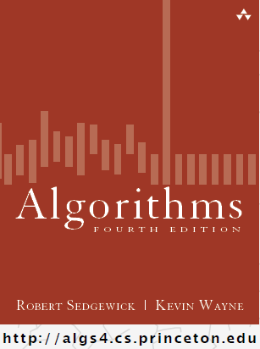
Union-Find Improvements
COMP 2100
Otterbein University

Slide 2
Alerts
HW 2 due today
Project 1 due today
HW 3 available: due next Friday

Slide 3
Quick-Union: Analysis
This is where we left off...
Trees can become tall chains. It still takes N² array accesses to process a sequence of N union operations on N objects.
Let's look at the Java again...

Slide 4
Quick-Union in Java

Slide 5
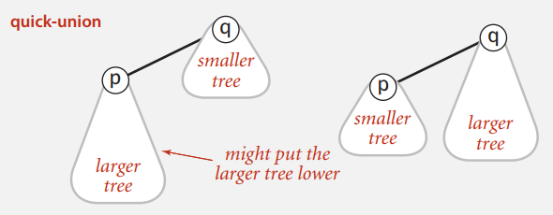
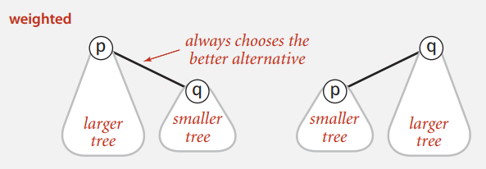
Quick-Union: tweak #1
Weighted quick-union
Goal: to avoid trees that are unnecessarily tall
Add representation to keep track of number of objects in each tree
Balance tree by always inserting smaller tree below larger tree

Slide 6
Quick-Union: tweak #1

Slide 7
Quick-Union: tweak #1
Data Representation
Same parent array as before, plus
Array sz[i] to count number of objects in tree rooted at i
Find/Connected: same as quick-union
Union: use sz to add smaller tree below larger then update sz[] array

Slide 8
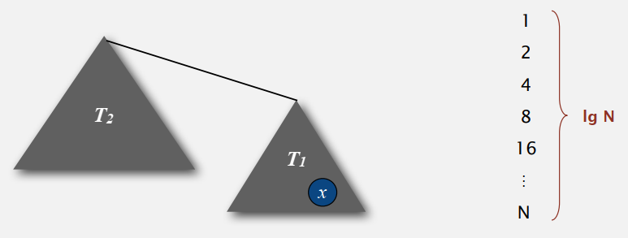
Quick-Union: tweak #1
Analysis
Find(p) takes time proportional to depth of p in tree
Union(p,q) takes constant time, plus cost of Find(p) and Find(q)
So what is the max depth?
How could we figure this out?
Consider some object p. What causes its depth to increase?
How much does it increase?
How big is the resulting tree?
How many times can this happen?

Slide 9
Quick-Union: tweak #1
Comparison
So is this good enough? Happy?
Nope!

Slide 10
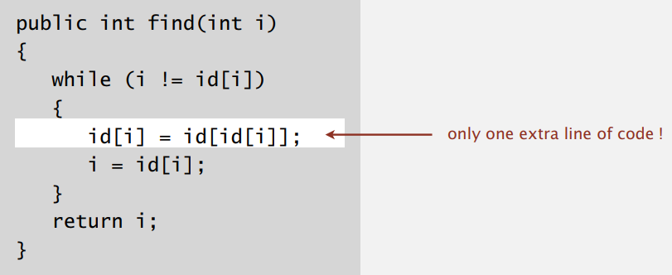
Quick-Union: tweak #2
Path Compression
Goal: to surgically reduce the height of trees when it won't cost much
Find(p) has to walk the path from p to the root anyway, so along the way make all the nodes direct children of the root

Slide 11
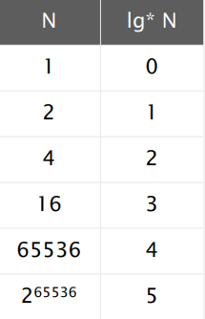
Quick-Union: tweak #2
Analysis
According to Hopcroft-Ulman & Tarjan, starting from a new created UF object with N objects, any sequence of M union-find operations requires less than or equal to O(N + M lg*N) array accesses
This can be improved to O(N + M α(M,N)), where α is the inverse of Ackermann's function.
The short explanation is that lg*N and α(M,N) are not constant, but so close to constant that we can treat them as such

Slide 12
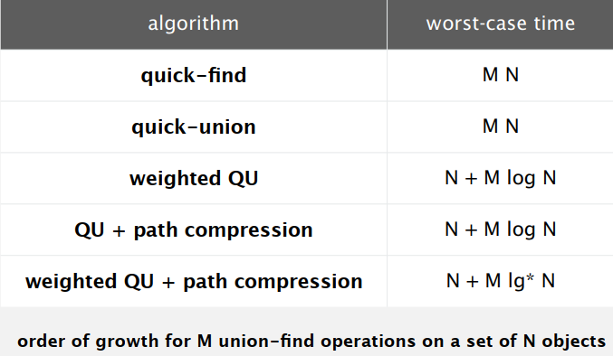
Quick-Union Final Assessment
WQUPC reduces time from 30 years to 6 seconds on a billion objects!

