Slide 1
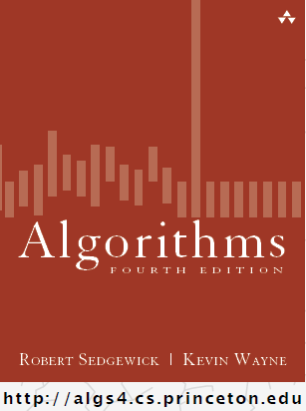
Bags, Queues, & Stacks Array and API based implementations
COMP 2100
Otterbein University

Slide 2
Alerts
Keep reading 1.3
HW 1 due today
Lab 4 due next Tuesday
Project 1 due next Friday!!

Slide 3
Implementing Stack
Strategy
Choose a representation
Implement constructor and methods to satisfy contract specifications
Approach I
Let’s cheat a little...
Representation: A List
Must be has-a rather than is-a WHY??
https://docs.oracle.com/javase/8/docs/api/
Implementation: all methods are one-liners!
public interface Stack<Item> {
public Stack()
public void push(Item item)
public Item pop()
public Item peek()
public boolean isEmpty()
public int size()
}

Slide 4
Stack has-a List
import java.util.*;
public class ListStack<Item> implements Stack<Item>{
private List elements;
public Stack() { //could have been LinkedList... elements = new ArrayList<Item>(); }
public void push(Item item) { elements.add(item); }
public Item pop() { return elements.remove(elements.size() – 1); }
public Item peek() { return elements.get(elements.size() – 1); }
public boolean isEmpty() { return size() == 0; }
public int size() { return element.size(); }
}

Slide 5
Implementing Stack
Approach II
Representation:
an array
a size counter why?
Issues
Overflow
We will adopt a strategy of re-sizing the array when it becomes full
Loitering
What’s that?
Holding a reference to an object when it is no longer needed. For example, when an item is deleted, we should be careful to not leave reference debris laying around.
public interface Stack<Item> {
public Stack()
public void push(Item item)
public Item pop()
public Item peek()
public boolean isEmpty()
public int size()
}

Slide 6
Stack has-an array, take one
public class ArrayStack<Item> implements Stack<Item>{
private Item[] elements; private int count; private static final int capacity = 10;
public Stack() { elements = new Item[capacity]; }
public void push(Item item) { //what’s wrong here? elements[count++] = item; }
public Item pop() { //how about here? return elements[--count]; }
public Item peek() { return elements[count]; }
public boolean isEmpty() { return size() == 0; }
public int size() { return count; }
}

Slide 7
Implementing Stack
Approach IIb (||!2B)
We need to fix push & pop
recall our two issues?
public Item pop() {
Item item = elements[--count]; elements[count] = null; return item;
}
public void push(Item item) {
if (count == elements.length) { resize(2 * elements.length); } //JCF ArrayList uses 1.5 elements[count++] = item;
}

Slide 8
Implementing Stack
Method resize
private void resize(int newcap) { Item[] copy = new Item[newcap]; for(int i = 0; i < count; i++) { copy[i] = elements[i]; } elements = copy; }
If you can resize up, then you should also...
public Item pop() { Item item = elements[--count]; elements[count] = null; if (count > 0 && count == elements.length/4) { resize(elements.length/2); } return item; }

Slide 9
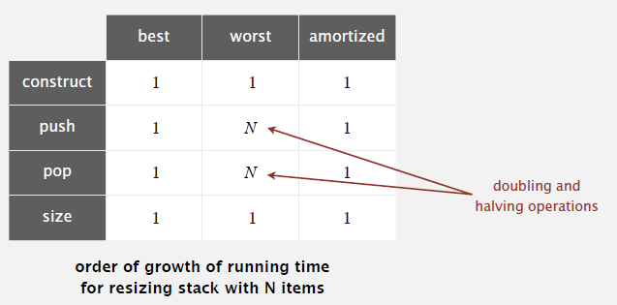
Analysis
How do arrays measure up?
Most operations are O(1)
M calls to push is O(M)

Slide 10
Implementing Queue
Problem Solving
Queues are tricky compared to Stacks...
What’s the problem?
the ends move
Ooph, that’s tuff
Ideas?
Treat array as circular, rather than linear structure by computing the index modulo the capacity
public interface Queue<Item> {
public Queue()
public void enqueue(Item item)
public Item dequeue()
public Item peek()
public boolean isEmpty()
public int size()
}

Slide 11
Queue has-an array
public class ArrayQueue<Item> implements Queue<Item>{
private Item[] elements; private int count; private int front; private int back; private static final int capacity = 10;
public Queue() { elements = new Item[capacity]; front = 0; back = 0; }
public void enqueue(Item item) // see next slide public Item dequeue() // see next slide public Item peek() { return elements[front]; }
public boolean isEmpty() { return size() == 0; }
public int size() { return count; }
}

Slide 12
Queuing it up
public void enqueue(Item item) {
if (count == elements.length) { resize(2 * elements.length); } elements[back] = item; back = (back + 1) % capacity; count++;
}

Slide 13
Queuing it down
public Item dequeue() {
Item item = elements[front]; elements[front] = null;
front = (front + 1) % capacity;
if (count > 0 && count == elements.length/4) { resize(elements.length/2); }
count--; return item;
}

Slide 14
Bagging It
Honestly, the simplest way to implement a bag is to use a List (like when we cheated)

