Slide 1
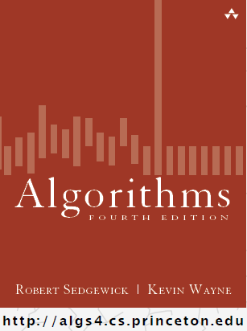
Introduction to Containers Bags, Queues, & Stacks
COMP 2100
Otterbein University

Slide 2
There are two ways of constructing
a software design: One way is
to make it so simple that there are
obviously no deficiencies and
the other way is to make it so
complicated that there are
no obvious deficiencies.
The first method is far more difficult.
<C.A.R. Hoare>

Slide 3
Alerts
Read 1.3
Lab 4 available tomorrow
HW 1 due Friday
Project 1 due next week!!

Slide 4
Containers
What is an array?
Sequential / Linear
Indexed
Contiguous in memory
Statically sized
Homogenous
Built-in primitive in the Java language
What is a list?
An interface that abstracts the beneficial aspects of arrays while allowing other physical representations that perform better in some cases

Slide 5
Lists
A List is a Collection that:
Has zero or more elements
Contains homogenous elements
Is indexed
Allows duplicate elements
Is unbounded in size
What implementations have you seen?
ArrayList
LinkedList
Others?

Slide 6
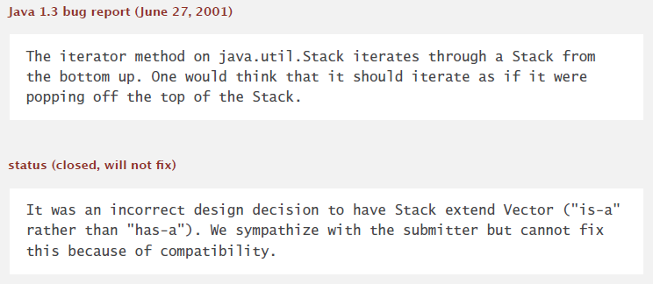
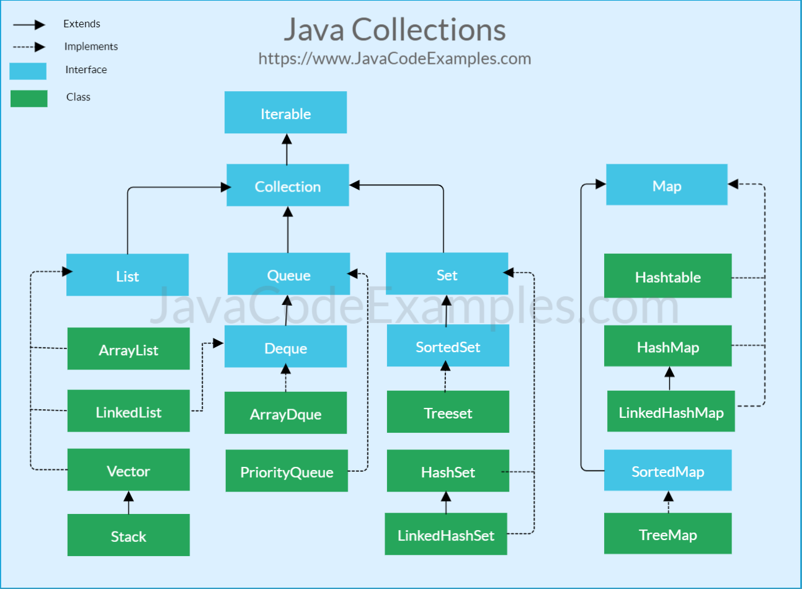
The Java Collections Framework
In COMP 2000 you were introduced to most of the JCF:

Slide 7
Generics (added in Java 5)
Allows container element type to be parameterized in the container declaration
Provides a compile-time enforcement of homogeneity
e.g., passing an object of the wrong element type to add() is a compiler error
Only supports reference types (objects)
Autoboxing is provided for primitive types
List<Double> gpa = new ArrayList<Double>();
gpa.add(3.14);
sum += gpa.get(0);

Slide 8
Limited Access Containers
A Stack is a Collection that:
That is accessible only at the ‘top’
Has a last-in-first-out (LIFO) semantics
It is possible to iterate over its elements
Operations
void push(Item item)
Item pop()
Item peek()
boolean isEmpty()
int size()
Contract?

Slide 9
Limited Access Containers
A Queue is a Collection that:
That is accessible only at the ‘back’ for insertion
That is accessible only at the ‘front’ for deletion
Has a first-in-first-out (FIFO) semantics
It is possible to iterate over its elements
Operations
void enqueue(Item item)
Item dequeue()
Item peek()
boolean isEmpty()
int size()
Contract?

Slide 10
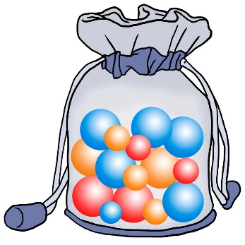
Limited Access Containers
A Bag is a Collection that:
That supports insertion, but not deletion
Has no order to its elements (not indexed)
It is possible to iterate over its elements
Operations
void add(Item item)
boolean isEmpty()
int size()
Contract?

Slide 11
Application: Stacks
Evaluating Arithmetic Expressions
Two-stack algorithm (E. W. Dijkstra)
Values are pushed onto the value stack
Operators are pushed onto the operator stack
Left parens are ignored
Right parens: pop an operator and the appropriate number of operands; apply the operator and push the result on the value stack
Assume a fully parenthesized container of tokens as input

Slide 12
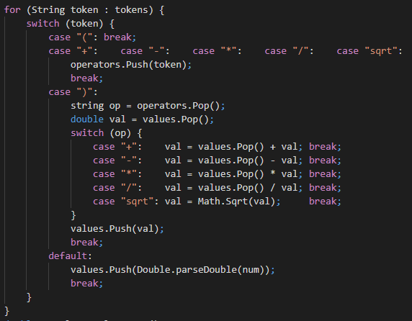
Application: Stacks
Demo

