Slide 1
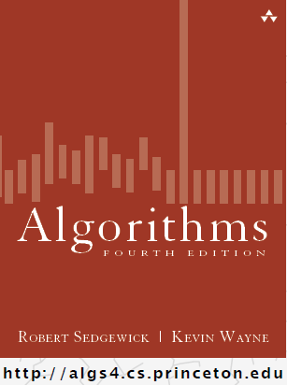
Analysis of Algorithms
COMP 2100
Otterbein University

Slide 2
Alerts
Read1.3 for next week
HW 0 due today
Lab 3 due next Tuesday by end of lab
HW 1 due Friday 9/9
Project 1 due 9/16

Slide 3
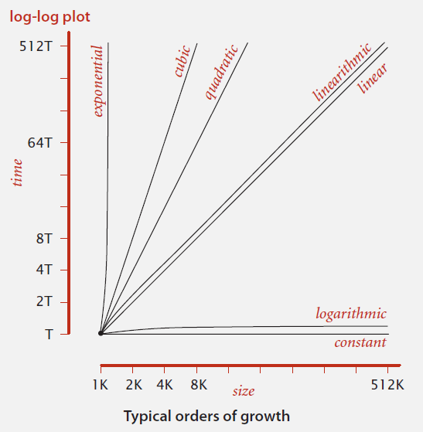
Big-Oh: O()
Most common algorithms can be characterized by one of these simple functions:
1
log N
N
N log N
N²
N³
2^{N}

Slide 4

Mathematical Analysis
Donald Knuth (Turing award, 1974)
A formula that counts the number of primitive operations performed by an algorithm as a function of the problem size N is, in principle, possible to
determine for any algorithm.

Slide 5
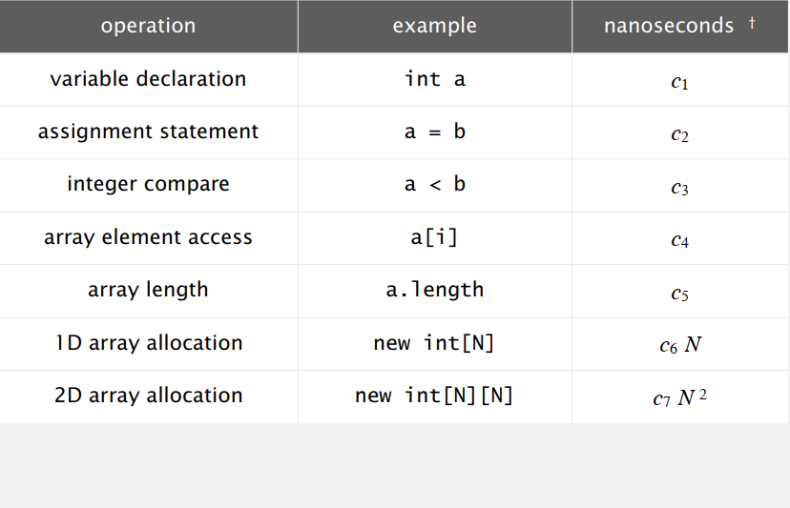
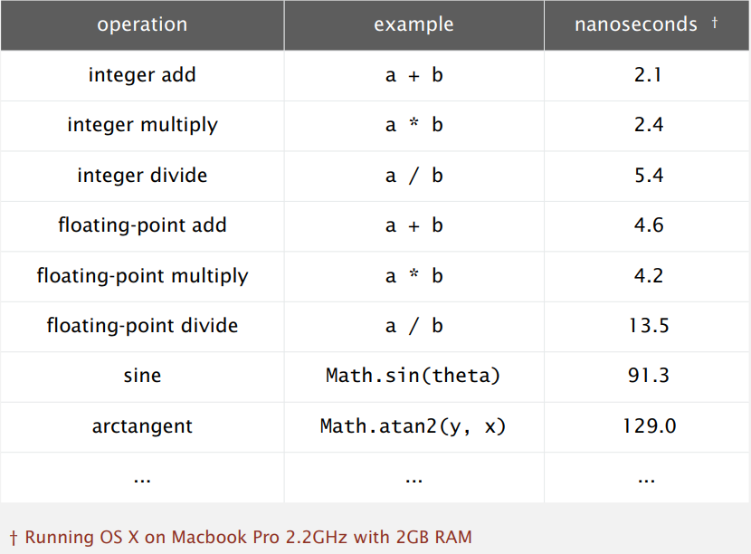
Primitive Operations
How would you measure the cost
of a primitive operation?
Notice the footnote
Most primitive operations take a constant amount of time

Slide 6
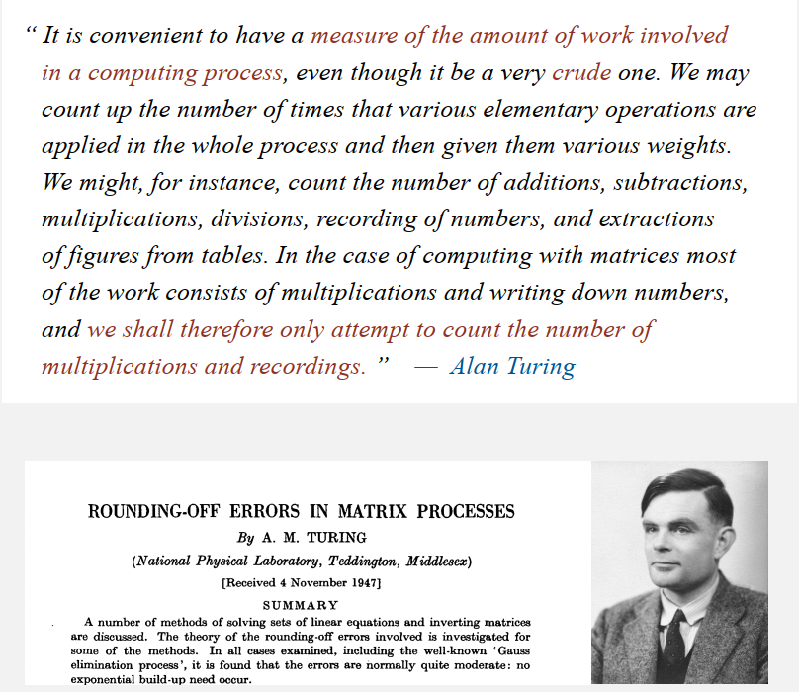
Simplify
Not all primitive operations matter when analyzing algortihms

Slide 7
Example: Binary Search
What is it?
  Goal: Given a sorted array and a search key, find the index of the key in the array (if it exists in the array)
  Strategy: Compare key to middle element
    Key too large: look to the right
    Key too small: look to the left
    Key is "just right": return index of middle
  Example
  3 10 12 19 24 25 28 38 51 60 64 89 93 96 99
    Find 51
    Find 15

Slide 8
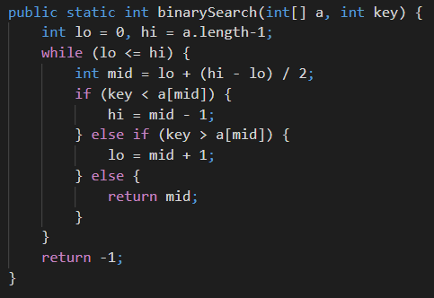
Example: Binary Search
Trivial to implement? What do you think?
  First published in 1946
  First bug-free version published in 1962
  Java Arrays.binarySearch() introduced in v1.2 in 1997
  Bug in Java source found in 2006
Here is a working version
  Invariant: as long as key in in a
  a[lo] ≤ a ≤ a[hi]
How do we analyze this?

Slide 9
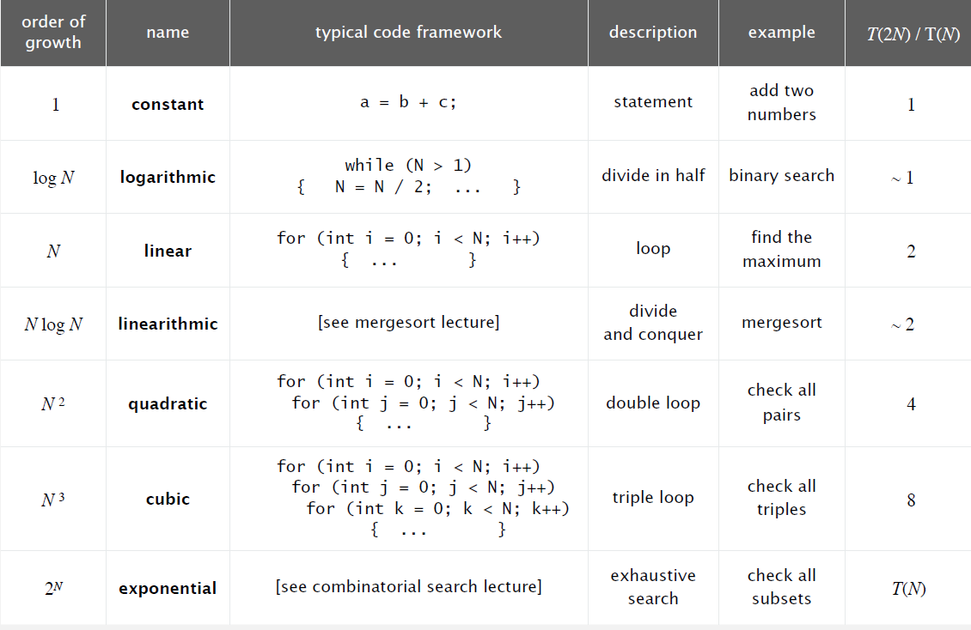
Common Orders of Growth

Slide 10
Turning the crank: summary
Empirical analysis.
Execute program to perform experiments.
Assume power law and formulate a hypothesis for running time.
Model enables us to make predictions.
Mathematical analysis.
Analyze algorithm to count frequency of operations.
Use tilde notation to simplify analysis.
Model enables us to explain behavior.
Scientific method.
Mathematical model is independent of a particular system; applies to machines not yet built.
Empirical analysis is necessary to validate mathematical models and to make predictions.

