Slide 1
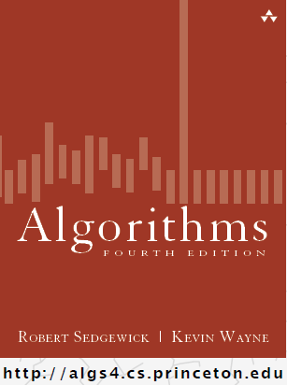
Analysis of Algorithms
COMP 2100
Otterbein University

Slide 2
Alerts
There has been a lot of reading in the first week. This wil slow down after this week!
In 1.4 you only need to read the following:
  pp. 173-188
  pp. 197-199
  p. 205
HW 0 due friday
Lab 3 will be available tomorrow
Project 1 due Friday 9/16

Slide 3
Running time
“As soon as an Analytic Engine exists, it will necessarily guide the future course of the science. Whenever any result is sought by its aid, the question will arise—By what course of calculation can these results be arrived at by the machine in the shortest time?” — Charles Babbage (1864)
how many times do you have to turn the crank?
Analytic Engine

Slide 4
Reasons to analyze algorithms
Predict performance.
Compare algorithms.
Provide guarantees.
Understand theoretical basis.
Primary practical reason: avoid performance bugs.
clients get poor performance because programmers did not understand performance characteristics
COMP 2100 & COMP 4500 are both interested in these outcomes

Slide 5
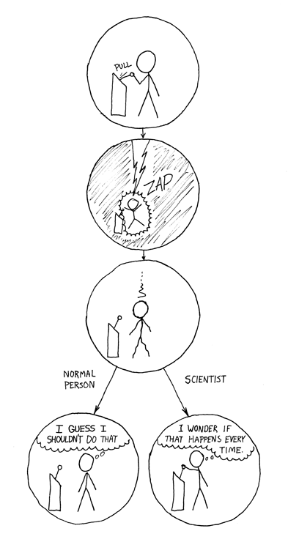
The Scientiﬁc method
A framework for predicting performance and comparing algorithms.
Scientific method:
Observe some feature of the natural world.
Hypothesize a model that is consistent with the observations.
Predict events using the hypothesis.
Verify the predictions by making further observations.
Validate by repeating until the hypothesis and observations agree.
Principles:
Experiments must be reproducible.
Hypotheses must be falsifiable.
Feature of the natural world. Computer itself.

Slide 6
Empirical Analysis
3-Sum
for (int i = 0; i < N; i++)
for (int j = i+1; j < N; j++)
for (int k = j+1; k < N; k++)
if (a[i] + a[j] + a[k] == 0)
count++;
a: 30 -40 -20 -10 40 0 10 5
30 -40 -20 -10 40 0 10 5
30 -40 -20 -10 40 0 10 5
30 -40 -20 -10 40 0 10 5
30 -40 -20 -10 40 0 10 5
N | Time (s)
250 | 0.0
500 | 0.0
1000 | 0.1
2000 | 0.8
4000 | 6.4
8000 | 51.1
16000 | ?

Slide 7
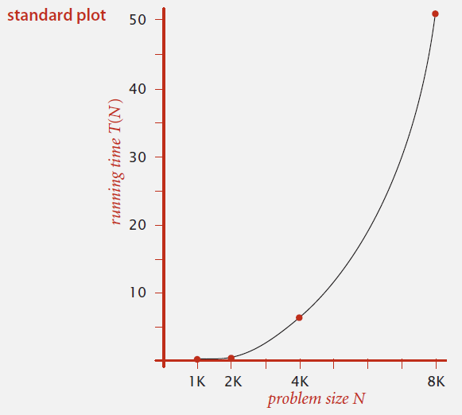
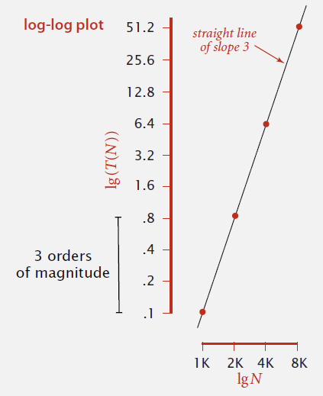
Data Analysis
What kind of a curve is this?
lg(T (N)) = b lg N + c
T (N) = a N^{b}, where a = 2^{c}
b = 3
So, T (N) ~ N³

Slide 8
Prediction and validation
If T(N) = N³, T(2N) = (2N)³ = 2³N³ = 8N³
So, doubling the size of the input will increase the time by a factor of 8
Measured: T(8000) = 51.1
Predicted: T(16000) = 51.1 * 8 = 408.8
Measured: T(16000) = 409.3
So, is our hypothesis validated?

Slide 9
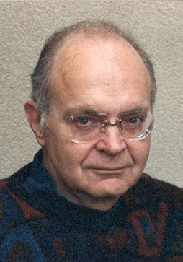
Mathematical Analysis
Donald Knuth (Turing award, 1974)
A formula that counts the number of primitive operations performed by an algorithm as a function of the problem size N is, in principle, possible to
determine for any algorithm.

Slide 10
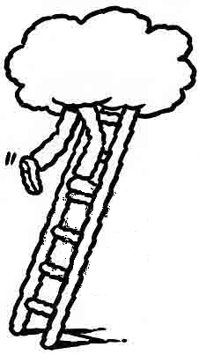
Mathematical models
In principle, accurate mathematical models are available.
In practice,
  Formulas can be complicated.
  Advanced mathematics might be required.
  Exact models best left for experts.
Bottom line: We use approximate models in this course

Slide 11
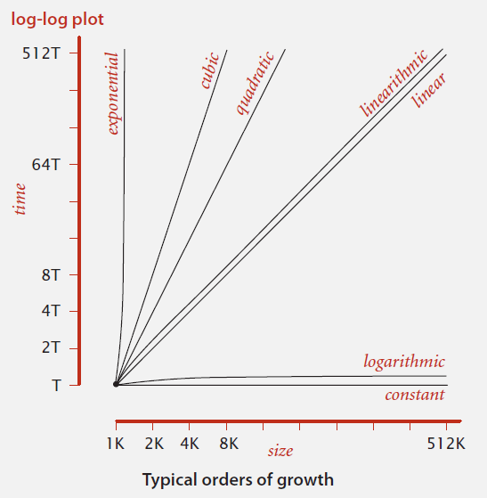
Big-Oh: O()
Most common algorithms can be characterized by one of these simple functions:
1
log N
N
N log N
N²
N³
2^{N}

Slide 12
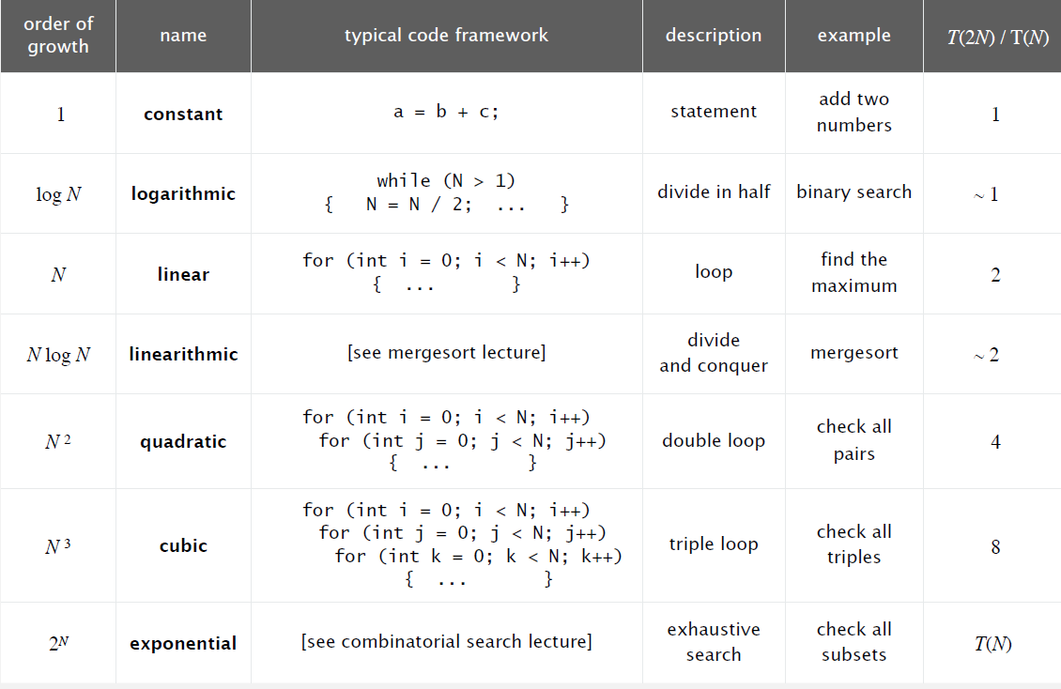
Common Orders of Growth

Slide 13
Turning the crank: summary
Empirical analysis.
Execute program to perform experiments.
Assume power law and formulate a hypothesis for running time.
Model enables us to make predictions.
Mathematical analysis.
Analyze algorithm to count frequency of operations.
Use tilde notation to simplify analysis.
Model enables us to explain behavior.
Scientific method.
Mathematical model is independent of a particular system; applies to machines not yet built.
Empirical analysis is necessary to validate mathematical models and to make predictions.

