Slide 1
The Object Oriented Paradigm
COMP 2100
Otterbein University

Slide 2
Alerts
Read 1.2
Two articles on OO to read on website
Lab 2 due Tuesday by the end of Lab
Questions?
HW 0 is available
Project Information available
P1 will be available on Monday

Slide 3
Java Review
More questions from 1.1?
Other Java questions?

Slide 4
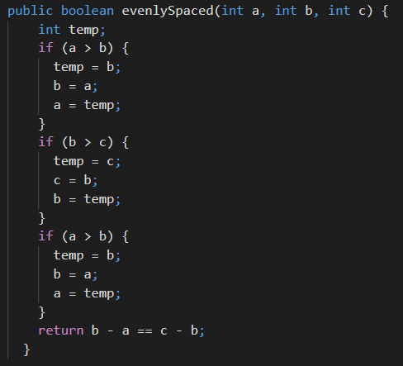
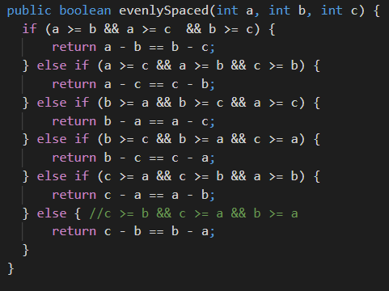
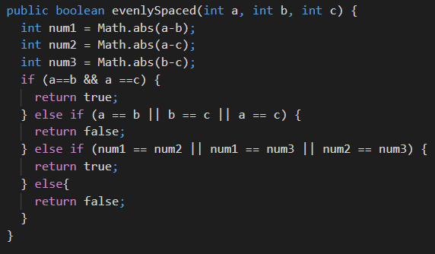
Java Review

Slide 5
Objects
What is an object?
Identity
Who am I, really?
Not referential, or denotational, or qualitative
State
Value of all attributes, properties, and components
At an instant of time
Behavior
What does it know?
What can it do?

Slide 6
Objects
What is an object?
Identity
A block of memory (or the address of its 1st byte)
State
Value of all attributes, properties, and components
At an instant of time
Behavior
What does it know?
What can it do?

Slide 7
Objects
What is an object?
Identity
A block of memory (or the address of its 1st byte)
State
Instance variables
Behavior
What does it know?
What can it do?

Slide 8
Objects
What is an object?
Identity
A block of memory (or the address of its 1st byte)
State
Instance variables
Behavior
Methods

Slide 9
Classes
Object Factories
A class is a blueprint or template specification of a particular kind of object
Classes are intangible, whereas objects are concrete
A class is to an object what a script is to the production of a play. Both may be called Othello, but context usually makes it clear. “Iqbal Khan's Othello was the first at the Royal Shakespeare Company to cast a black Iago”
Objects are instances of classes

Slide 10
The OO Metaphor
Everything is an object
Objects interact by sending messages
Programs are collections of interacting objects
Java is NOT a pure object oriented language
Why not?

Slide 11
Abstraction
What does it mean?
OED: Considered or understood without reference to particular instances or concrete examples; representing the intrinsic, general properties of something in isolation from the peculiar properties of any specific instance or example; (esp. in early use) spec. constituting an ideal form or hypothetical perfect version.
Plato...
Data Abstraction
Algorithmic Abstraction

Slide 12
Data Abstraction
Platonic Domains
How we represent data values should be independent from the operations that can be performed on them
The implementations, however, can not!
Representation determines algorithm
Containers
Collections of objects
Interfaces
Modeling the world...!

