Slide 1
COMP 2100
Data Structures
Prof. Stucki

Slide 2
ALERTS
  Read 1.2 from Sedgewick/Wayne
  Lab 1 due by end of lab tomorrow
  Lab 2 will be available tomorrow at the beginning of lab
  Questions?
    Syllabus?

Slide 3
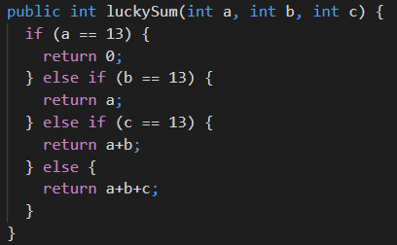
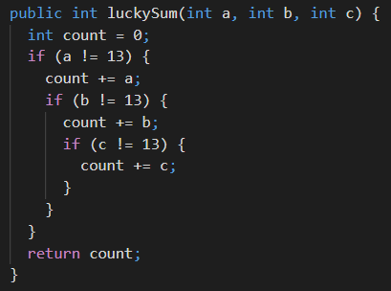
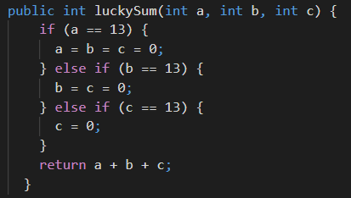
Lab 1 Debrief (luckySum)

Slide 4
Java Review
What questions do you have about Java?
Textbook 1.1?

Slide 5
Design by Contract: Review
The designer creates the contract, which is a binding agreement between the client and the implementor.
Both parties to a contract have obligations and benefits. These exist in a symmetric relationship.
The obligations and benefits are informally described in Java comments as preconditions and postconditions on methods, where
  preconditions are the obligation of the client
  postconditions are the obligation of the implementor

Slide 6
Review: Obligations & Benefits
 | Obligation | Benefit
Client | requires Before call is made the requirements should be verified | ensures When call is completed the ensures can be assumed
Implementer | ensures The algorithm must guarantee the ensures is satisfied | requires The algorithm does not need logic that checks requirements

Slide 7
Formal vs. Informal
Sometimes the contract is expressed informally. In this case I will label the elements of the contract preconditions and postconditions, as we've discussed.
At other times the contract is expressed formally (using mathematics or logic). In this case I will label the elements of the contract as requires and ensures
In order for a contract to be fulfilled, the client must make sure that the required preconditions are met and the implementor must make sure that the ensured postconditions are met.

Slide 8
How do the Benefits work?
If the obligations of the implementor are the benefit to the client, what does that mean for the client code?
  The client gets to assume that what was ensured actually happened, and therefore shouldn't have to check to make sure
If the obligations of the client are the benefit to the implementor, what does that mean for the implementor code?
  The implementor gets to assume that what was required actually happened, and therefore shouldn't have to check to make sure
This reduces redundancy in the code!!

Slide 9
Example
Consider this example function:
Suppose that for myFunction to work properly the parameter x must be passed a value between 1 and 4, inclusive. If the implementor of myFunction coded logic that checked for this, then it would execute that logic even for the following call to myFunction:
But for this call, neither the client nor the implementor should have to check!!!
public int myFunction (int x) {...}
int result = myFunction (3);

Slide 10

Example
Consider this example function:
What should the requires clause of the specification look like?
  requires: $1 ≤ x ≤ 4$
public int myFunction (int x) {...}

Slide 11
Example (which is better?)
// pre-condition: value is not negative
// post-condition: method will return
// largest integer whose square
// is less than or equal to value
public static int squareRoot(int value)
{
int root = 0;
while(root*root <= value) {
root++;
}
return root - 1;
}
public static int squareRoot(int value)
{
if (value < 0)
throw new
NegSqrtException("Negative");
int root = 0;
while(root*root <= value) {
root++;
}
return root - 1;
}

Slide 12

Your Turn...
Write a suitable requires clause for the factorial function below:
Since the maximum value that can be expressed in a long variable is
9,223,372,036,854,775,807
and 20! = 2,432,902,008,176,640,000
but 21! = 51,090,942,171,709,440,000
requires: $0 ≤n ≤20$
public long factorial (byte n) {...}

Slide 13
Another Example
Consider a method that performs binary search in order to determine if an item is in a list
  Pre-condition: that the list is sorted
  Post-consition: returns true if the item is in the array and false otherwise
Why should the method NOT check the pre-condition?
It would take linear time to check that the array is sorted, whereas the binary search algorithm only needs logarithmic time to perform the search.
In other words, the checking is more expensive that the operation itself!!

Slide 14

Your Turn Again...
Function compute is going to access the array a at location index and do some computation. Write a suitable requires clause.
requires: $a !=null \&\& 0 ≤ index < a.length$
public int compute (int[] a, int index) {...}

Slide 15
Last Observation
In general, requires clauses avoid unnecessary code in the implementation and improve efficiency
However, end users may not understand responsibilities such as requires clauses (or may not have access to the software specifications), so error checking user input still should be included in methods that interact with humans.

Slide 16
Your Turn One Last Time...
Which of the following statements are true?
  The requires clause is the responsibility of the implementer
  The ensures clause is assumed by the implementer before execution of the method
  The ensures clause is the responsibility of the caller
  The requires clause is assumed by the caller after the call is completed

Slide 17
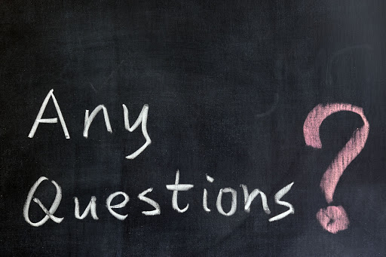
Q & A

Slide 18
Next Time...
The object-oriented paradigm

