Slide 1
COMP 2100 Data Structures
Prof. Stucki

Slide 2
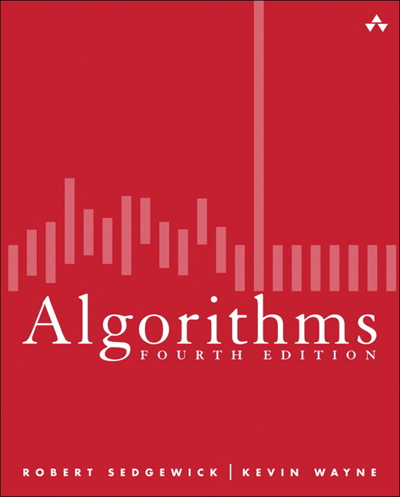
COMP 2100
David J Stucki
Lecture: MWF 10:20-11:15 (Towers 239)
Lab: TR 9:55-11:15 (Towers 127)
Welcome Back!
Syllabus
Web Sites
Software
Q & A
Java Review

Slide 3
Welcome Back!
Summer work and/or travel?
Current TV binge?
Most recent new hobby?

Slide 4
Syllabus & Online Resources
Course Web Site: http://faculty.otterbein.edu/dstucki/COMP2100
Textbook Companion Site: https://algs4.cs.princeton.edu/home/
Discrete Mathematics (Math 1230)

Slide 5
Software
Java 16/17/18 JDK (use release 17.0.4 if possible)
I’ve placed a copy of the installer on ochome if you don’t want to have to create an Oracle account in order to download it.
ftp://ochome.otterbein.edu/class/COMP/2100/Common/
IDE
In 1600 and 2000 you used IntelliJ. That will remain the default IDE this year.
Alternate options are
Visual Studio Code: https://code.visualstudio.com/
jGrasp: http://jgrasp.org

Slide 6
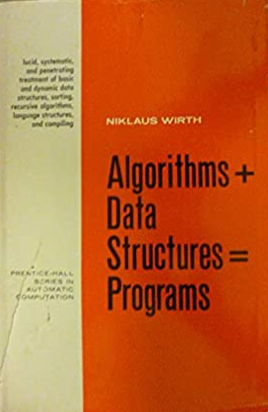
Course Topics
Java expertise
Computational complexity
Recursion
Sorting
Graph algorithms
Data structures
Stacks
Queues
Binary trees
Hash tables
Undirected graphs
Directed graphs
Priority queues

Slide 7
Q & A

Slide 8
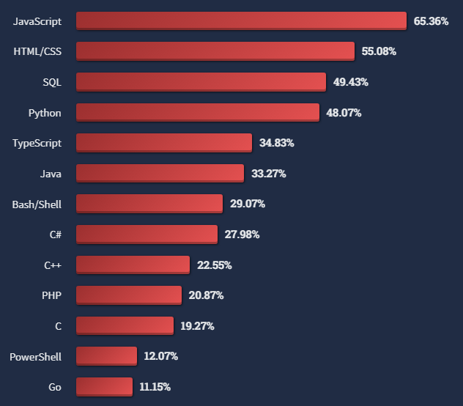
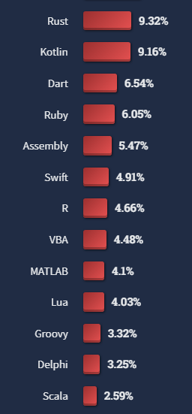
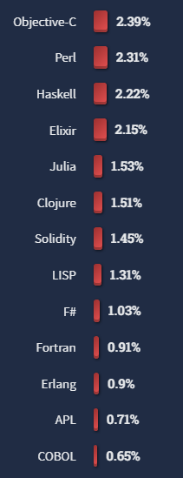
Stack Overflow Developer Survey 2022 Most Popular Programming Languages

Slide 9
Java 17
Reading assignment: Sedgewick/Wayne, pp. 3-53
Read this slowly and carefully... Why??
I will assume that you know all this unless you ask questions on Wednesday
Reading the book is an expectation in this course and is mandatory if you want to succeed (i.e., get a good grade, learn the material, complete the assignments, etc.)
Puzzler: Is Java a static language or a dynamic language?
Dynamic languages can be interpreted directly, which means that the actual text of the program — the source code — is used while the program is running
A static language is executed in two phases: first the program is translated from source code to binary code, and then the binary code is interpreted
It was a trick question: Most execution engines do both translation and interpretation!
Static refers to what the translator does
Dynamic refers to what the interpreter does

Slide 10
Java: A Compiled and Interpreted Language
“In the Java programming language, all source code is first written in plain text files ending with the .java extension.
“Those source files are then compiled into .class files by the javac compiler.
“A .class file does not contain code that is native to your processor;
“it instead contains bytecodes — the machine language of the Java Virtual Machine (Java VM).
“The java launcher tool then runs your application [by interpreting its bytecode on] an instance of the Java Virtual Machine.”
Source: http://docs.oracle.com/javase/tutorial/getStarted/intro/definition.html

Slide 11
More Review: Design by Contract
Any time that two objects are interacting in a piece of software, there should be 'rules of engagement' that specify the protocols for the interaction.
What are the expectations of the client?
What services does the supplier offer?
Are there conditions or restrictions on either party?
Who benefits from the exchange?
The idea behind DBC is that there should be a 'legal contract' that establishes answers to all of these questions.

Slide 12
More Review: Design by Contract
Recall the metaphor of wearing different hats
Designer, Implementor, Client
What are each of these responsible for?
In the DBC model, each of these takes on a specific role with respect to the contract
The Designer is the Lawyer: creates the contract that binds the other two parties
The Client and the Implementors are each party to the contract and therefore each have obligations and benefits

Slide 13
More Review: Design by Contract
Generally speaking, when two parties enter into a contractual relationship the obligations of Party A are viewed as a benefit by Party B, and the obligations of Party B are viewed as a benefit by Party A.
It is with respect to the method signatures that the contract must be written, since that is what forms the interface between the objects.
What does a client need to know?
What does a client NOT need to know?
What does an implementor need to know?
What does an implementor NOT need to know?

Slide 14
DBC Example
Here's the integer square root method again (just the signature):
What could go wrong?
How can we guard against all of these?
Write a contract
public static int squareRoot(int value) {

Slide 15
DBC Example
// pre-condition: value is not negative
// post-condition: method will return largest integer whose
// square is less than or equal to value
public static int squareRoot(int value) {
How does this help?
What is the obligation of the client?
What is the obligation of the implementor?
What happens if the contract is broken?

