Slide 1

High Level Programming Languages

Slide 2
ALERT
Assignment 6 is due today
Assignment 7 is available on Brightspace and is due Friday after break

Slide 3
Languages
Assembly language improves on machine language
But assembly language is not a perfect solution...
What is wrong with assembly language?
Programmer must manage movement of data among memory locations and registers (too close to hardware)
Microscopic view of task (tedious)
Machine specific languages (not portable)
Far from natural language (not abstract enough)

Slide 4
Languages
High-level programming languages improve on assembly language
Goals:
Programmer need not manage data in memory
Memory is abstracted to variables from addresses
Macroscopic view of tasks (e.g., “add B and C”)
Programs portable from one machine to another
Program statements closer to natural language and mathematical notation
Problem & domain oriented primitives

Slide 5
Languages
Nothing comes without a cost!
Source code is not machine language, therefore computers can’t understand it
Unless it is translated to machine language
High-level languages are significantly more complex and difficult to translate than assembly
There are a wide variety of programming language features, idioms, cultures, and metaphors
Platform independence is difficult to achieve

Slide 6
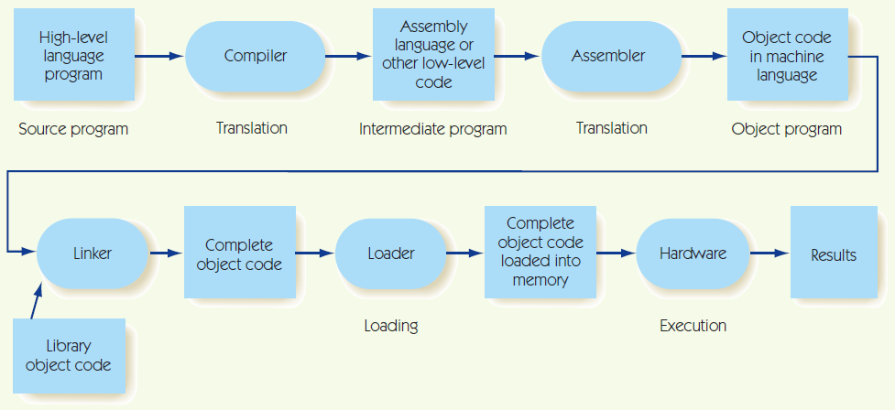
Language Translation

Slide 7
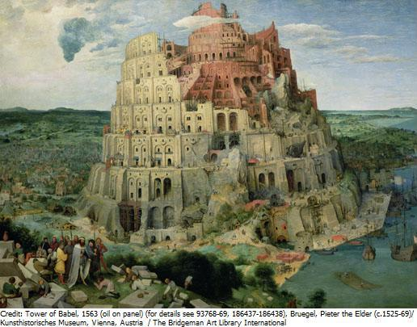

Babel
How many programming languages?
The language list!
Why so many???
Problem domains & primitives
History & Overview
Prezi

