Slide 1

Language Translation

Slide 2
ALERT
Assignment 6 is available on Brightspace and is due Friday

Slide 3
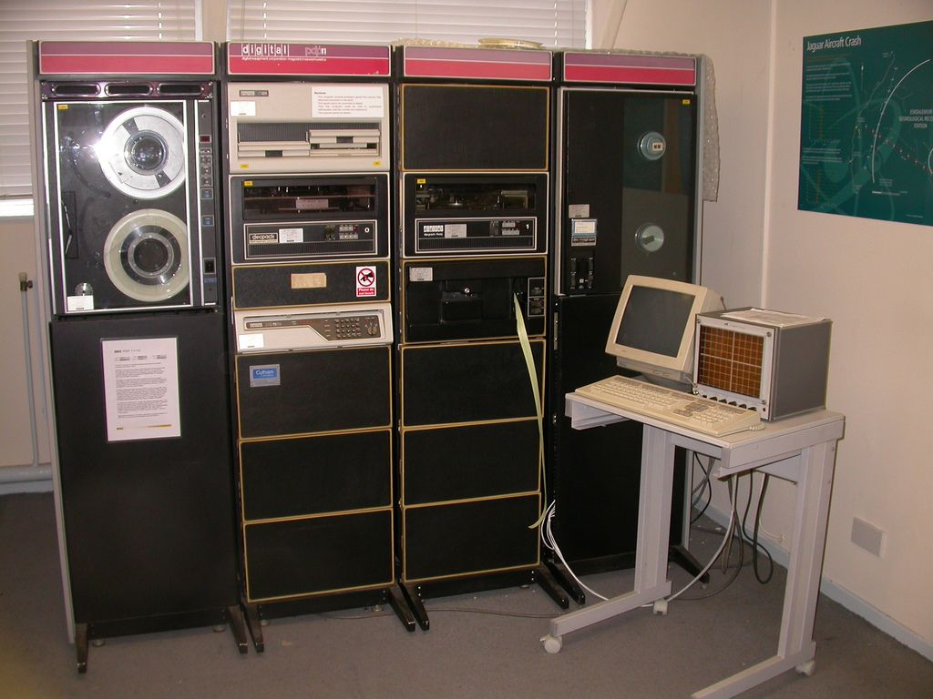
PdP-11
Part 1
Part 2
Part 3
Part 4

Slide 4
Introduction
A naked machine has no tools or programs to help the user
Write instructions in binary
Write data in binary
Load instructions into memory one cell at a time
Initiate program run
Too difficult for humans to do
We must build an interface to hide the details and make the computer easier to build

Slide 5
Assemblers and Assembly Language
Assembly language
Instructions map one-to-one to machine language
Symbolic op codes (not binary)
Symbolic addresses for instructions and data
Pseudo-ops for data generation and more (data in human-friendly terms)
Assembly = a low-level programming language
Java, C, Python = high-level programming languages

Slide 6
Assemblers and Assembly Language
Example Assembly language:
NEXT: LOAD X -- Put X into R
label: opcode address field -- comment
Label is optional name for this instruction’s location
Op code mnemonic and address field translate to machine language
Comments are ignored by assembler, just for human use

Slide 7
Assemblers and Assembly Language
Translation and loading:
Assembler translates to machine language
Convert symbolic op codes to binary equivalents
Convert symbolic labels to memory addresses
Perform pseudo-op actions
Write object file containing machine instructions
Loader gets program ready to run
Places instructions in memory
Triggers the hardware to run the program

Slide 8
Assemblers and Assembly Language
Converting symbolic op codes to binary ones
Assembler maintains a table
Assembler looks up symbolic op codes in the table and substitutes the binary analogue
Use binary search to optimize table lookups
Operation | Binary Value
ADD | 0011
CLEAR | 0010
COMPARE | 0111
DECREMENT | 0110
HALT | 1111
... | ...
STORE | 0001
SUBTRACT | 0101

Slide 9
Assemblers and Assembly Language
Converting symbolic labels to memory addresses
Assembler needs two passes
looks over assembly code two times
First pass:
Keep a count of instructions from the start
Collect symbolic labels and add to symbol table along with location counter

Slide 10
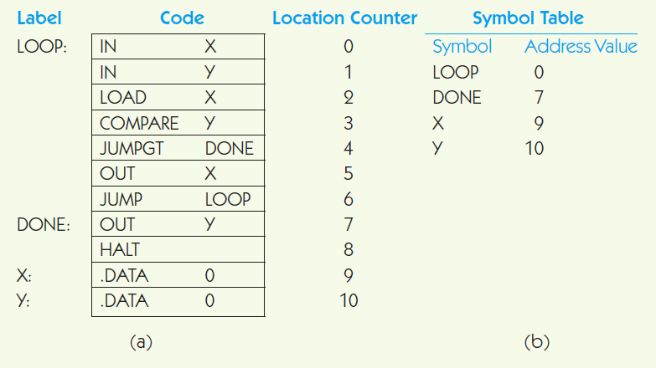
Assemblers and Assembly Language

Slide 11
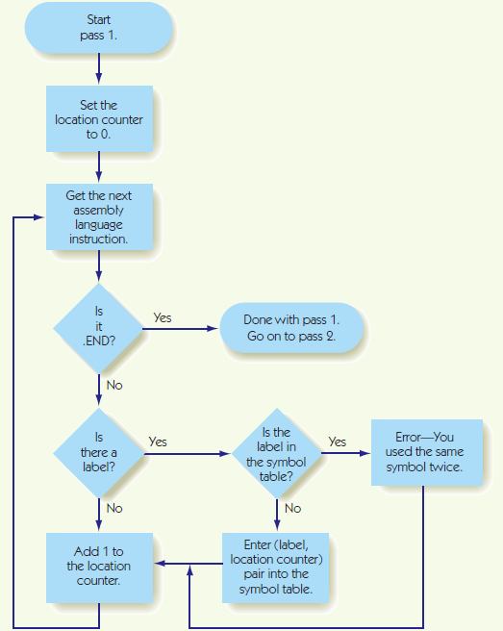
Assembler: PASS 1

Slide 12
Assemblers and Assembly Language
Second pass:
Look up and replace op codes
Substitute label references with location from symbol table
Set up .DATA pseudo-ops with location and binary value
Write instructions to object file

Slide 13
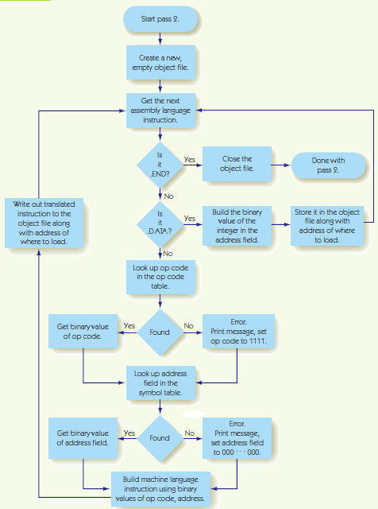
Assembler: PASS 2

