Slide 1
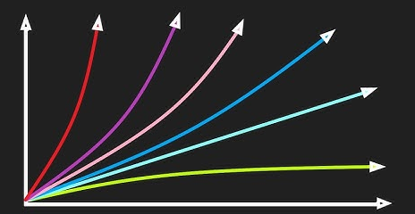
Algorithmic Efficiency

Slide 2
ALERT
Exam I is Friday, Chapters 1-4
Questions?

Slide 3
Sorting
There are many standard approaches to sorting a list of data
Bubble Sort
Insertion Sort
Selection Sort
Merge Sort
Quicksort
Heap Sort
etc.
Visualizations (more)...
How efficient is the resulting algorithm? How can we know?

Slide 4
qUESTIONS
How do we know if our algorithms are correct?
How do we know if our algorithms are good?
What do we mean by “good”?
Given multiple algorithms for solving a problem, which one should we choose?
Correctness (required)
Elegance (what’s that?)
Efficiency
Simplicity
Extendability
Maintenance
Others?

Slide 5
Resources
Given a problem, how do we determine the resources necessary to its solution?
This is a very hard question!! Why?
For each problem there are many algorithms that solve it
e.g., As we observed regarding sorting: bubble, selection, heap, quick, merge, etc.
For each algorithm there are many ways to implement it
e.g., Bubble sort: wikipedia.com
For each implementation there are many platforms on which to execute it (both in terms of hardware and software)
e.g., Java, Python, Windows, MacOS, Linux, iOS, Android
For each platform there are many environmental factors that can influence performance
e.g., memory, clock speed, OS load, other running programs

Slide 6
Efficiency
What does efficiency mean?
Judicious use of resources
Not at all costs!
What resources?
Space: Random Access Memory (RAM)
Time: CPU cycles
Which is more important?
Time!!!
Why?

Slide 7
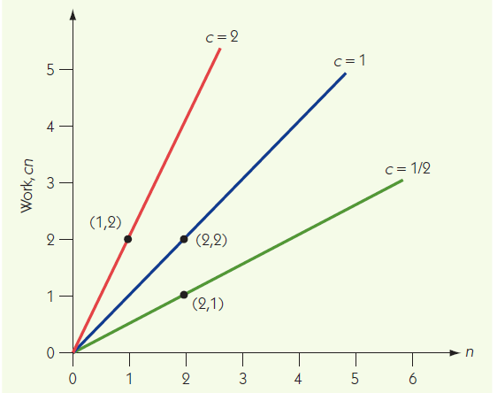
Measuring Efficiency: Order of Magnitude
We will adopt a concept of order of magnitude that groups functions into families based on their shapes and how quickly they grow.
For example, all of the functions pictured in this graph are linear, which means that the functions grow in a fashion that is directly proportional to the value of n.
We refer to the family of linear functions as Θ(n)

Slide 8
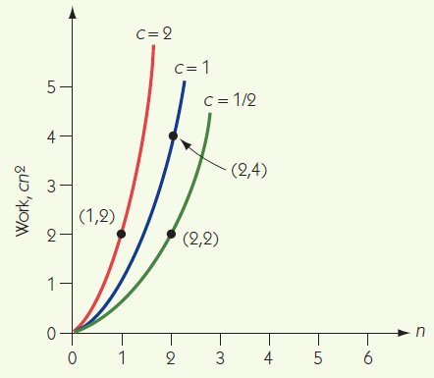
Measuring Efficiency: Order of Magnitude
Similarly, all of the functions pictured in this graph are quadratic, which means that the functions grow in a fashion that is proportional to the square of the value of n.
This family of functions is referred to as Θ(n²)

Slide 9
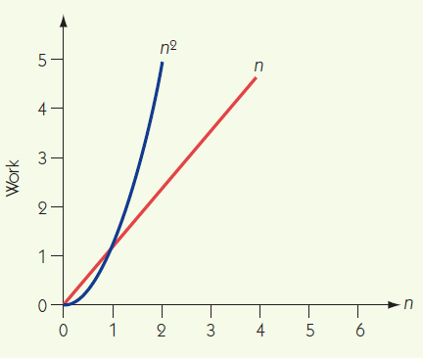
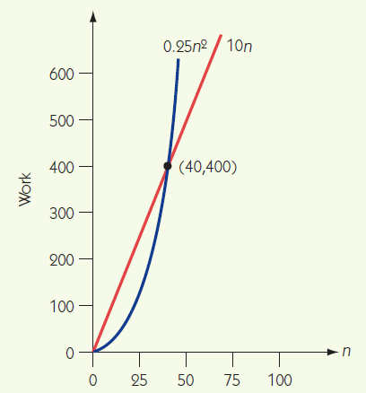
Measuring Efficiency: Comparisons
Eventually, every function with order n² has greater values than any function with order n
This is independent of which specific linear and quadratic functions are being compared

Slide 10
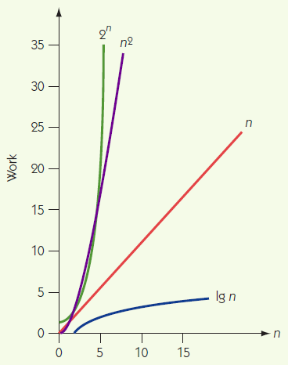
Measuring Efficiency: Other Families
There are a handful of important such families of functions:
Logarithmic Θ(lg n)
Linear Θ(n)
Quadratic Θ(n²)
Exponential Θ(2^{n})
Also, (not pictured)
Linearithmic Θ (n lg n)
Cubic Θ(n³)
Factorial Θ(n!)

Slide 11
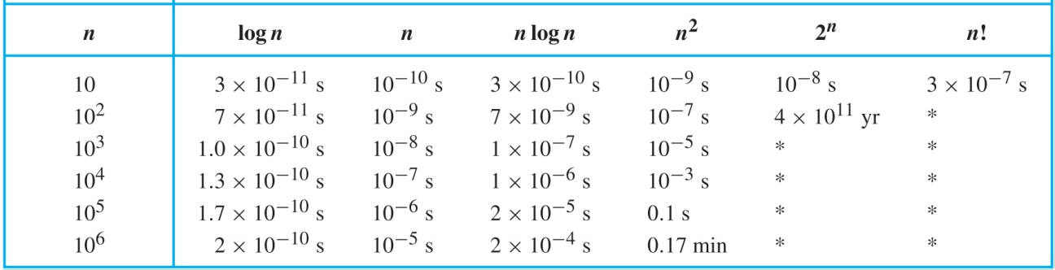
So What?
Suppose that a computer could perform 10¹¹ steps per second. Given algorithms with run times described by each of the six function families below, the table shows the total run time.

Slide 12
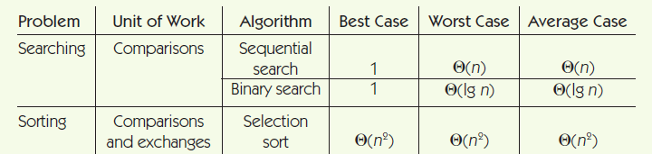
Searching & Sorting

