Slide 1

Algorithms: Representation, Discovery, & Design

Slide 2
ALERT
Make sure you’re keeping up with reading the textbook. You should be finished with the first four chapters by the end of this week.
Please read the article by Jeanette Wing about Computational Thinking that is on the course web page.
Assignment 5 is due this Friday

Slide 3
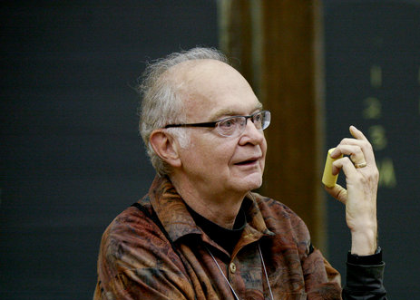
Donald Knuth
“A person well-trained in computer science knows how to deal with algorithms: how to construct them, manipulate them, understand them, analyze them. This knowledge is preparation for much more than writing good computer programs; it is a general-purpose mental tool that will be a definite aid to the understanding of other subjects, whether they be chemistry, linguistics, or music, etc.
The reason for this may be understood in the following way: It has often been said that a person does not really understand something until after teaching it to someone else. Actually, a person does not really understand something until after teaching it to a computer, i.e., expressing it as an algorithm . . . An attempt to formalize things as algorithms leads to a much deeper understanding than if we simply try to comprehend things in the traditional way.”

Slide 4
Elementary Issues
How to represent and communicate algorithms?
What strategies are available for discovering & designing algorithms?

Slide 5
Representation
Claim #1:
English is not a good choice!
Why? or Why not?

Slide 6
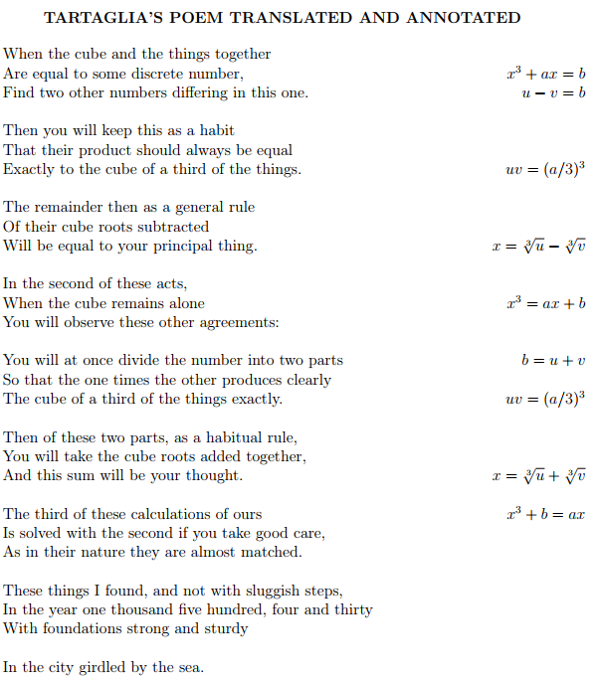
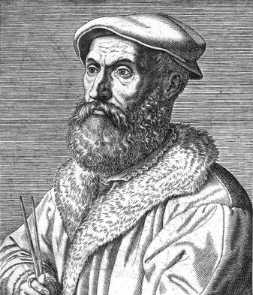
Nicolo Tartaglia (1499-1557) Solving the Cubic Annotated poem

Slide 7
Nicolo Tartaglia (1499-1557) Solving the Cubic Annotated poem

Slide 8
Representation
Claim #1:
English is not a good choice!
Why? or Why not?
Claim #2
Mathematical Equations are not a good choice!
Why? or Why not?
Claim #3
Java/C#/Python/Etc. are not a good choice!
Why? or Why not?

Slide 9
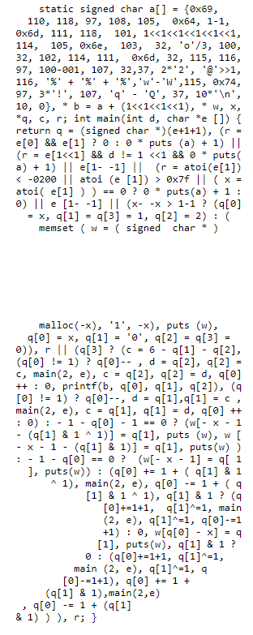
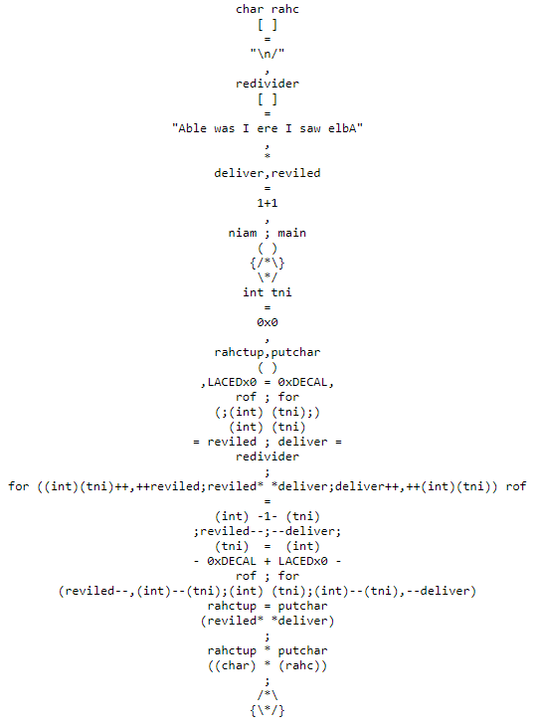
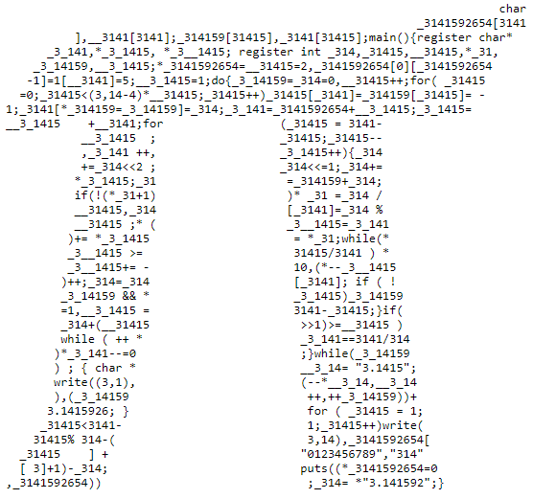
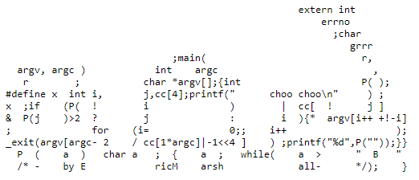
IOCCC: International Obfuscated C Code Contest

Slide 10
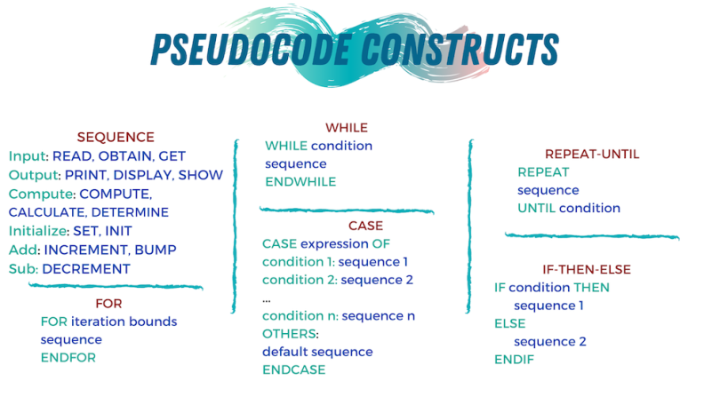
Pseudocode
A structured subset of English with programming language syntax and notations.
Establishes a consistent yet flexible informal notation for each of the three control structure types (Turing’s building blocks).
Focus is on essence of computational structure without the burden of syntactic precision

Slide 11
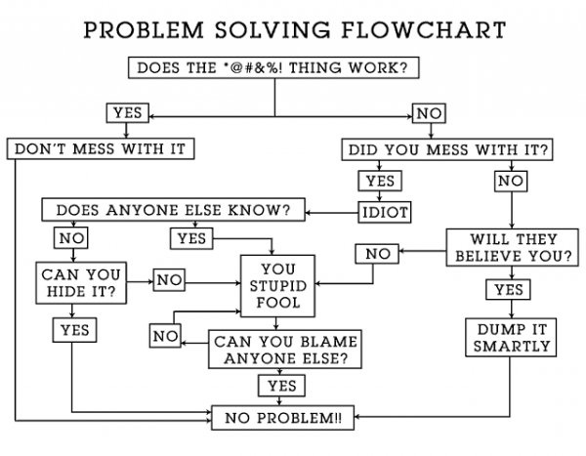
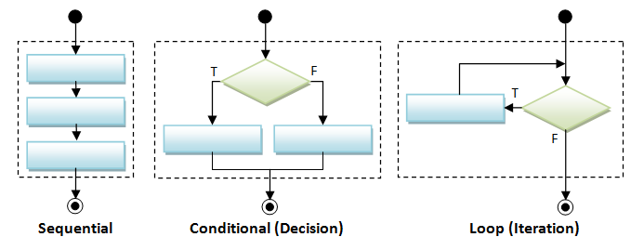
Flow Chart Depictions of Control Constructs

Slide 12
Pseudocode Example: Multiply by Repeated addition
Get values for a and b
If either a = 0 or b = 0 Then
Set the value of product to 0
Else
Set the value of count to 0
Set the value of product to 0
While count < b Do
Set the value of product to product + a
Set the value of count to count + 1
End While
Print product
Halt

Slide 13
Pseudocode Example: Sequential Search
Get values for key, N₁, ..., N₁₀₀₀ and P₁, ..., P₁₀₀₀
Set the value of i to 1 and set the value of Found to No
While Found = No and i < 1001 Do
If key = N_{i} Then # is the key in the ith position of the list?
Print P_{i}, the phone number of person N_{i}
Set the value of Found to Yes
Else # key is not in the ith position
Set the value of i to i + 1
End While
If Found = No Then
Print the message 'That key is not found in the list'
Halt

Slide 14
Pseudocode Example: Find the Smallest
Get values for n # the size of the list
Get the values of A₁, ..., A_{n}
Set the value of smallest to A₁
Set the value of location to 1 and set the value of i to 2
While i ≤ n Do
If A_{i} < smallest Then # we found something smaller
Set smallest to A_{i} # remember the new smallest
Set location to i # remember where we found it
Set i to i + 1
End While
Print the values of smallest and location
Halt

