Slide 1
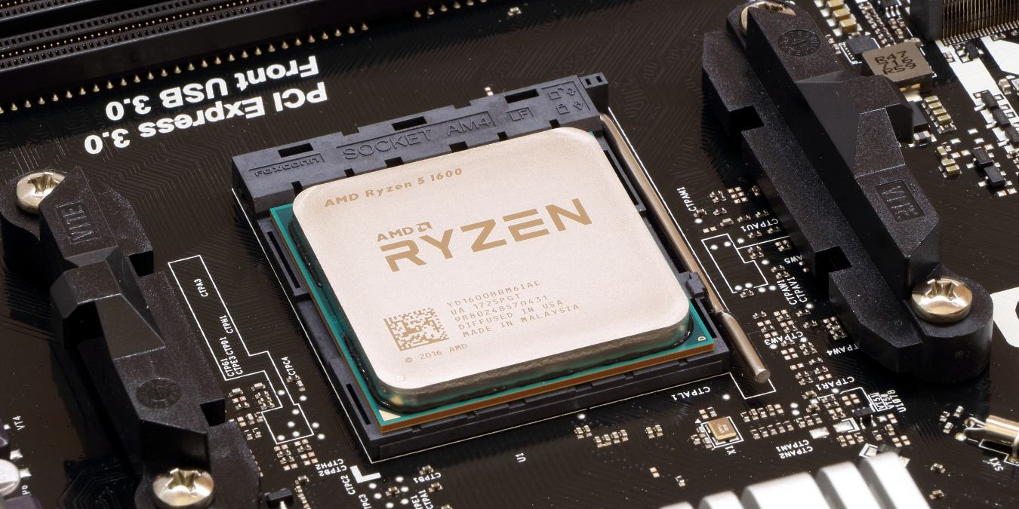
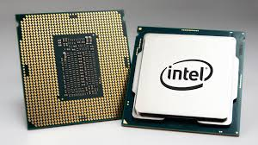
The CPU
(ALU & CU)

Slide 2
ALERT
Assignment 5 is available on Brightspace. It is due 2/13.
Read Chapter 4

Slide 3
Putting the Pieces Together The Von Neumann Architecture
In chapter 3 of the textbook you were introduced to a Toy Computer that was a very simplified model of a Von Neumann machine
Today we will be starting to look at a slightly more complex model, one that has 16 operations rather than 8, and that uses a single data register
This will mean that the binary opcodes we need will be 4-bit sequences
Why?
16 = 2⁴, so to select one of 16 operations requires a multiplexor with 4 selectors
In order to understand how these operations are performed by the CPU we will first need to adopt a notation

Slide 4
Putting the Pieces Together The Von Neumann Architecture
Notation for computer’s behavior:
CON(A) | Contents of memory cell A
A → B | Send value in register A to register B (special registers: PC, MAR, MDR, IR_{addr}, ALU, R, GT, EQ, LT, +1)
FETCH | Initiate a memory fetch operation
STORE | Initiate a memory store operation
ADD | Instruct the ALU to select the output of the adder circuit
SUBTRACT | Instruct the ALU to select the output of the subtract circuit
... | ...
<OP> | Instruct the ALU to select the output of the <OP> circuit

Slide 5
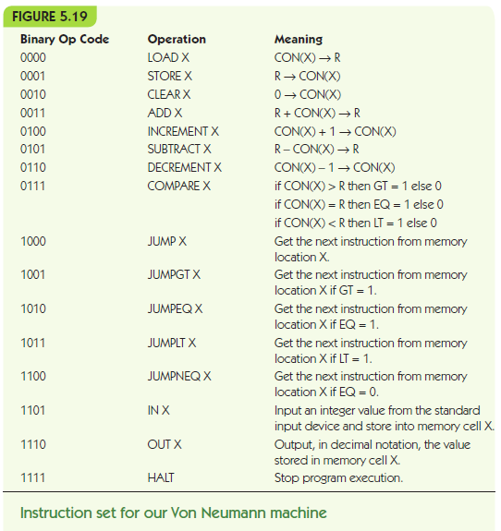
Instruction Set for Von Neumann Machine

Slide 6
Instruction Set for Von Neumann Machine

Slide 7
Putting the Pieces Together The Von Neumann Architecture
LOAD X meaning CON(X) → R
IR_{addr} → MAR Send address X to MAR
FETCH Initiate Fetch, data to MDR
MDR → R Move data in MDR to R
STORE X meaning R → CON(X)
IR_{addr} → MAR Send address X to MAR
R → MDR Send data in R to MDR
STORE Initiate store of MDR to X

Slide 8
Putting the Pieces Together The Von Neumann Architecture
ADD X meaning R + CON(X) → R
IR_{addr} → MAR Send address X to MAR
FETCH Initiate Fetch, data to MDR
MDR → ALU Send data in MDR to ALU
R → ALU Send data in R to ALU
ADD Select ADD circuit as result
ALU → R Copy selected result to R
JUMP X meaning get next instruction from X
IR_{addr} → PC Send address X to PC

Slide 9
Putting the Pieces Together The Von Neumann Architecture
COMPARE X meaning:
if CON(X) > R then GT = 1 else 0
if CON(X) = R then EQ = 1 else 0
if CON(X) < R then LT = 1 else 0
IR_{addr} → MAR Send address X to MAR
FETCH Initiate Fetch, data to MDR
MDR → ALU Send data in MDR to ALU
R → ALU Send data in R to ALU
SUBTRACT Evaluate CON(X) – R
Sets EQ, GT, and LT

Slide 10
Putting the Pieces Together The Von Neumann Architecture
JUMPGT X meaning:
if GT = 1 then jump to X
else continue to next instruction
IF GT = 1 THEN IR_{addr} → PC

Slide 11
Putting the Pieces Together The CPU
In reality, CPUs will have scores to hundreds of primitive operations (so opcodes may be as long as 8 or 10 bits) and dozens of data registers
Operations often also have more than a single operand, perhaps as many as 4
So real machine language instructions can be up to 8 bytes (32 bits) in length
In a few weeks you will have a chance to write some simple programs in the machine language for the MIPs processor (originally introduced in 1985)

Slide 12
Putting the Pieces Together Real CPUs
There are several other ways in which our simplified model doesn't accurately reflect the complexities of modern CPUs
It is often the case that the processor actually begins to execute one operation before the previous one has been completed, thus overlapping the execution in time. This is called pipelining.
Modern processors are multi-core, meaning that they contain several duplicate copies of the ALU and CU circuitry, so that they can literally be performing several tasks at once.
Some processors (like the ones in laptops and phones) are designed to operate with less power at the expense of speed

Slide 13
Putting the Pieces Together Caching
Finally, it is standard for computers to have an additional form of memory called cache memory
"We are therefore forced to recognize the possibility of constructing a hierarchy of memories, each of which has greater capacity than the preceding but which is less quickly accessible." –Burks, Goldstine, & von Neumann
Why?
Recently used information is likely to be used again soon
Information near that which was recently used is likely to be used soon

Slide 14
Next Time
Software

