Slide 1
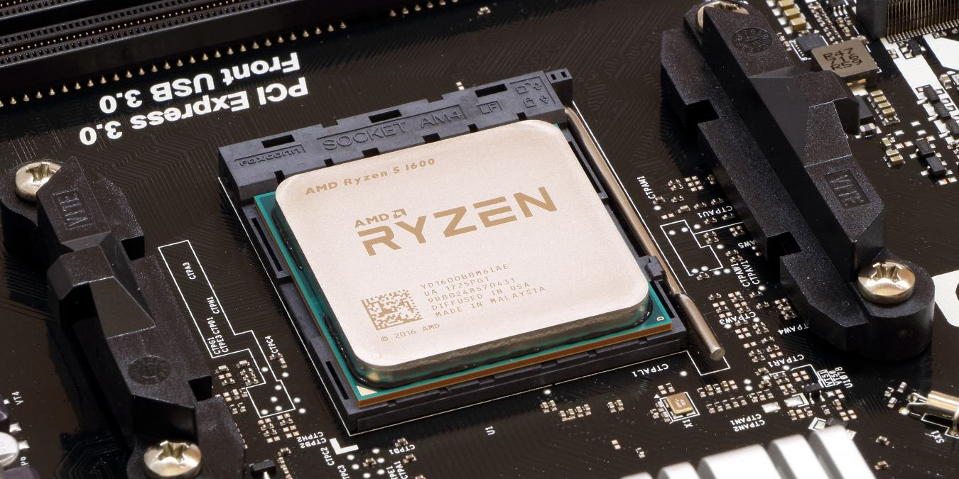
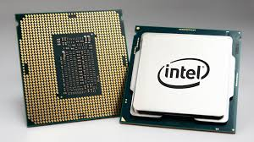
The
CPU
(ALU & CU)

Slide 2
ALERT
Assignment 4 is due today.
Read: Von Neumann Architecture: Tricking Rocks to Think

Slide 3
The Components of a Computer System
The Arithmetic/Logic Unit
The ALU is part of the processor
It contains circuits for arithmetic:
  addition, subtraction, multiplication, division
It contains circuits for comparison and logic:
  equality, and, or, not
It contains registers: super-fast, dedicated memory connected to circuits
It contains data paths: how information flows in ALU
  from registers to circuits
  from circuits back to registers

Slide 4
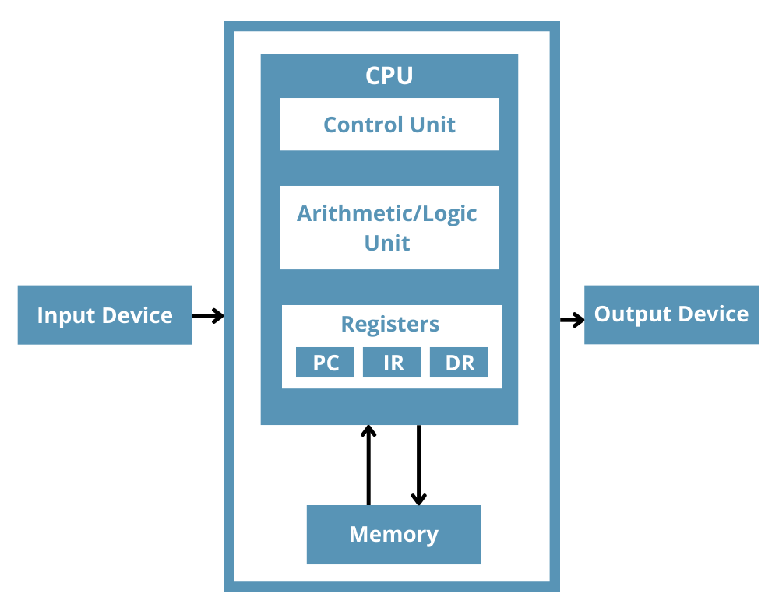
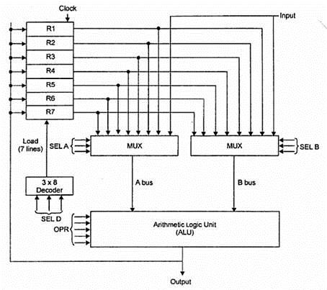
The Components of a Computer System
The Arithmetic/Logic Unit

Slide 5
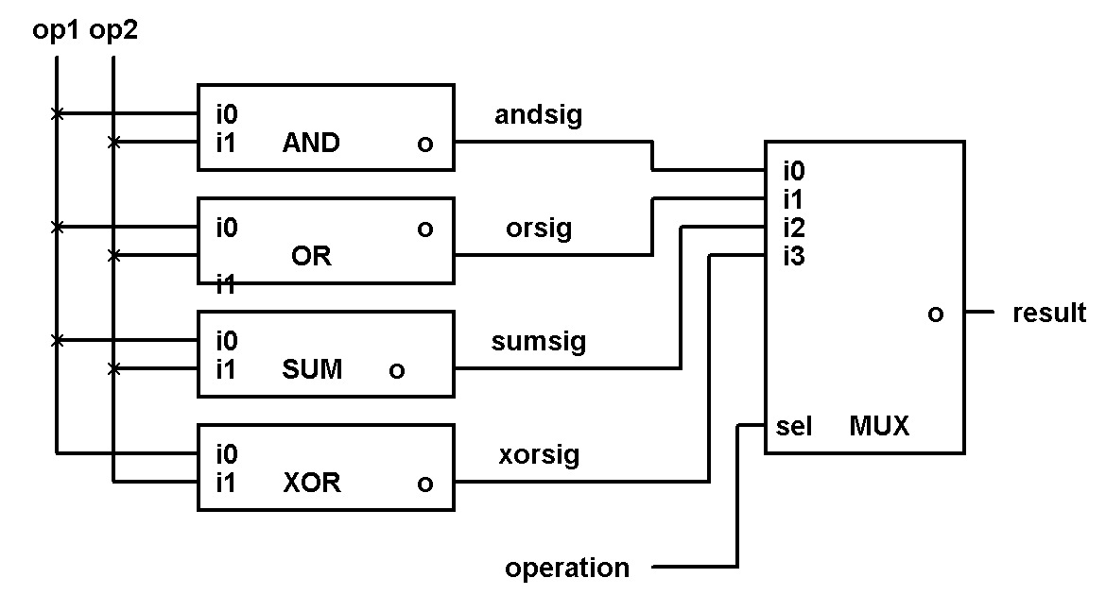
The Components of a Computer System
The ALU
How to choose which operation to perform?
  Option 1: decoder signals one circuit to run
  Option 2: run all circuits, multiplexor selects one output from all circuits
In practice, option 2 is usually chosen

Slide 6
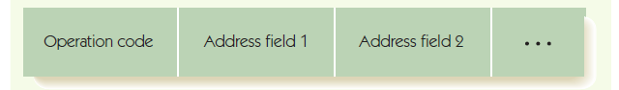
The Components of a Computer System
The Control Unit
Stored program characteristic:
  Programs are encoded in binary and stored in computer’s memory
Control unit fetches instructions from memory, decodes them, and executes them
Instructions encoded:
  Operation code (op code) tells which operation
  Addresses tell which memory addresses/registers to operate on

Slide 7
The Components of a Computer System
The Control Unit
Machine language:
  Binary strings that encode instructions
  Instructions can be carried out by hardware
  Sequences of instructions encode algorithms (are programs)
Instruction set:
  The instructions implemented by a particular chip
  Each kind of processor speaks a different language

Slide 8
The Components of a Computer System
The Control Unit
RISC machines and CISC machines
  Reduced instruction set computers:
    small instruction sets
    each instruction highly optimized
    easy to design hardware
  Complex instruction set computers:
    large instruction set
    single instruction can do a lot of work
    complex to design hardware
Modern hardware: some RISC and some CISC

Slide 9
The Components of a Computer System
The Control Unit
Kinds of instructions:
Data transfer, e.g., move data from memory to register
Arithmetic/Logic, e.g., add, and, etc.
Relational, e.g., compare two values
Branch, e.g., change to a non-sequential instruction
  Branching allows for conditional and loop forms
  E.g., "JUMPLT x " mean if previous comparison of A and B found A < B, then jump to instruction at address x

Slide 10
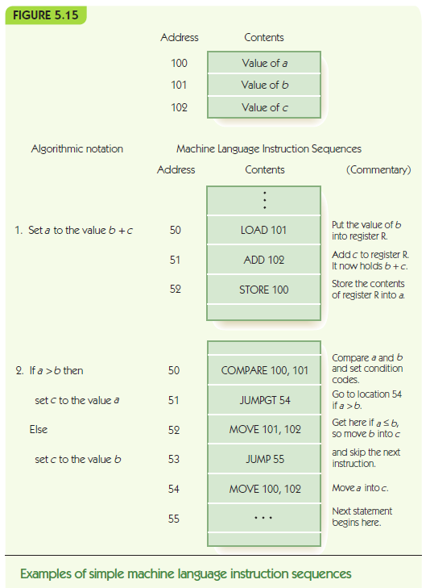
The Components of a Computer System
The Control Unit
Example:
Consider memory that is holding data in cells at addresses 100-102
The diagram pictured here shows how code stored in memory starting at address 50 could use and manipulate that data

Slide 11
The Components of a Computer System
The Control Unit
Control unit contains:
Program counter (PC) register: holds address of next instruction
Instruction register (IR): holds encoding of current instruction
Instruction decoder circuit
  Decodes op code of instruction, and signals helper circuits, one per instruction
    Helpers send addresses to proper circuits
    Helpers signal ALU, I/O controller, memory

Slide 12
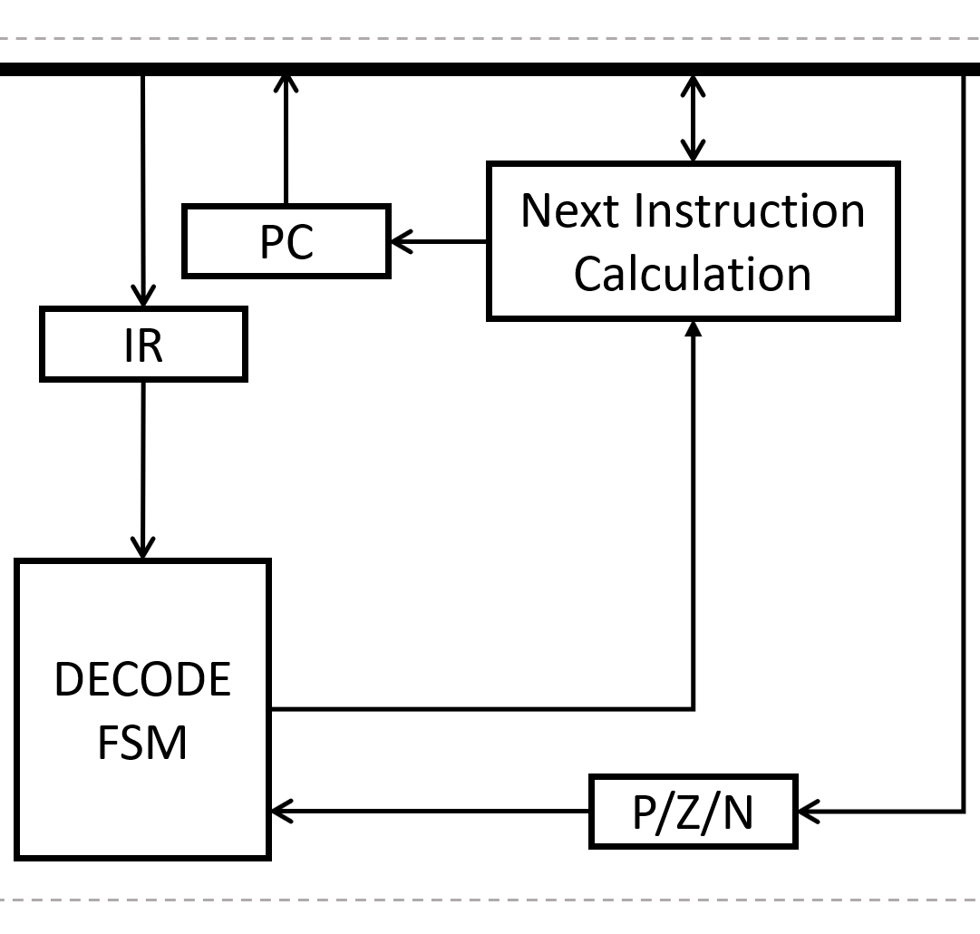
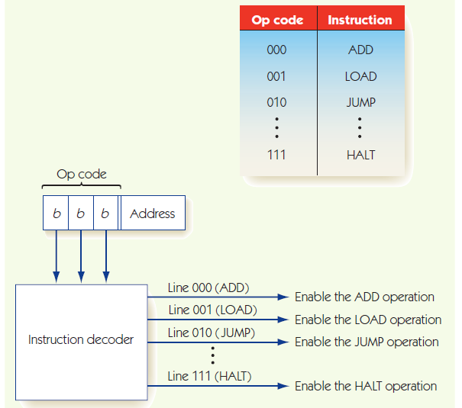
The Components of a Computer System
The Control Unit

Slide 13

Putting the Pieces Together
The Von Neumann Architecture
Combine previous pieces: Von Neumann machine

Slide 14
Putting the Pieces Together
The Von Neumann Architecture
Fetch-Execute Algorithm (what the CU does)
  Address in PC is copied to MAR
  Instruction is fetched into MDR
  MDR copied to IR
  PC++
  Opcode in IR is decoded
  Operands interpreted & ALU circuits activated
  Instruction executed
  Results updated (registers, memory, PC, etc.)

