Slide 1

Circuits & Functional Components

Slide 2
ALERTs
Assignment 4 is available on Brightspace and is due Friday (2/6)
The first midterm is Friday, February 27
  It will cover chapters 1-4

Slide 3
Building Computer Circuits
Full adder circuit
Input is two unsigned N-bit numbers
Output is one unsigned N-bit number, the result of adding inputs together
Example:
Start with one-bit adder (1-ADD)
 |  |  |  | 1
 | 0 | 0 | 1 | 0 | 1
+ | 0 | 1 | 0 | 0 | 1
 | 0 | 1 | 1 | 1 | 0

Slide 4
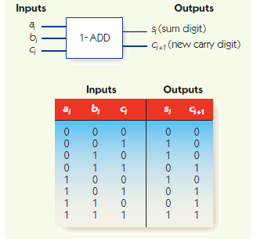
Single bit adder

Slide 5
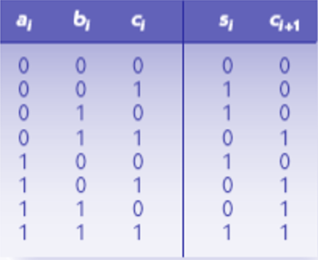
Building Computer Circuits
Sum digit, s_{i}, has Boolean expression:
  (~a_{i} • ~b_{i} • c_{i}) + (~a_{i} • b_{i} • ~c_{i}) + (a_{i} • ~b_{i} • ~c_{i}) + (a_{i} • b_{i} • c_{i})
Carry digit, c_{i+1}, has Boolean expression:
  (~a_{i} • b_{i} • c_{i}) + (a_{i} • ~b_{i} • c_{i}) + (a_{i} • b_{i} • ~c_{i}) + (a_{i} • b_{i} • c_{i})

Slide 6
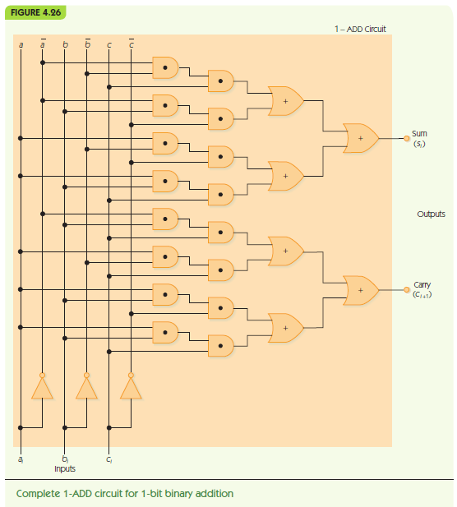
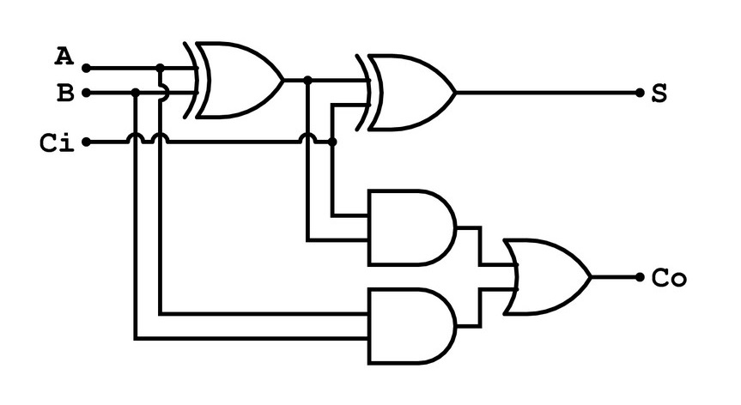
Single bit adder
s_{i} = (~a_{i} • ~b_{i} • c_{i}) + (~a_{i} • b_{i} • ~c_{i}) +
(a_{i} • ~b_{i} • ~c_{i}) + (a_{i} • b_{i} • c_{i})
c_{i+1} =(~a_{i} • b_{i} • c_{i}) + (a_{i} • ~b_{i} • c_{i}) +
(a_{i} • b_{i} • ~c_{i}) + (a_{i} • b_{i} • c_{i})

Slide 7
Building Computer Circuits
N-bit adder circuit
Input: a₀a₂…a_{n-1} and b₀b₂…b_{n-1}, where a_{i} and b_{i} are individual bits
a₀ and b₀ are least significant digits: ones place
Pair up corresponding bits: a₀ with b₀, a₁ with b₁, etc.
Run 1-ADD on a₀ and b₀, with fixed carry in c₀ = 0
Feed carry out c₁ to next 1-ADD and repeat

Slide 8
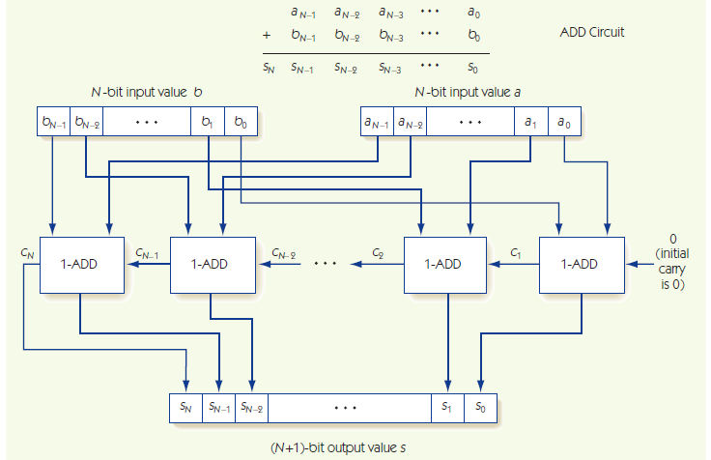
N-bit adder

Slide 9
Control Circuits
Control circuits make decisions, determine order of operations, select data values
Multiplexor selects one from among many inputs
  2^{N} input lines
  N selector lines
  1 output line
Each input line corresponds to a unique pattern on selector lines
That input value is passed to output

Slide 10
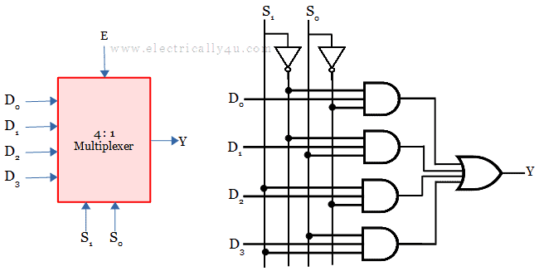
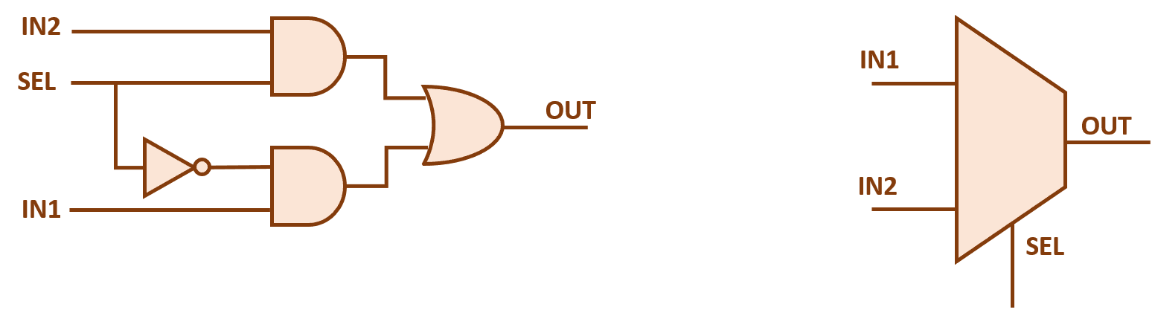
2-1 MUX & 4-1 MUX

Slide 11
Control Circuits
Decoder sends a signal out only one output, chosen by its input
  N input lines
  2^{N} output lines
Each output line corresponds to a unique pattern on input lines
Only the chosen output line produces 1, all others output 0

Slide 12
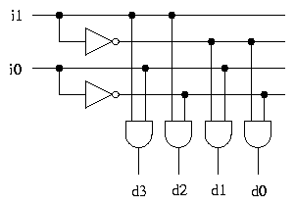
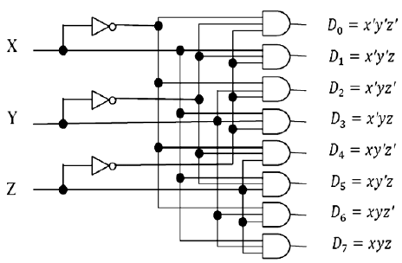
2-4 & 3-8 Decoders

Slide 13
Control Circuits
Decoder circuit uses
  To select a single arithmetic instruction, given a code for that instruction
  Code activates one output line, that line activates corresponding arithmetic circuit
Multiplexor circuit uses
  To choose one data value from among a set, based on selector pattern
  Many data values flow into the multiplexor, only the selected one comes out

Slide 15
Memory Circuits
The circuits we've seen so far have all be examples of what are called combinatorial circuits
  These perform computations that are functions of inputs to outputs
  These kinds of circuits can't be used to store data, since they are feeding signals in a forward path through the electronics
Sequential circuits are designed to store bits (0s and 1s) over time, so support operations that store and fetch
  Storing a 1 is called 'set'
  Storing a 0 is called 'reset'
  An SR-Flip Flop is a circuit that implements this idea

Slide 16
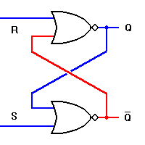
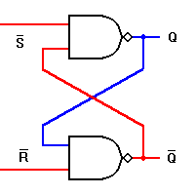
SR-Flip Flop
S R | Q Q’
0 0 1 0 0 1 1 1 | Q Q’ 0 0 1 0 0
SET
RESET
S R | Q Q’
1 1 0 1 1 0 0 0 | Q Q’ 0 0 1 1 1
SET
RESET

Slide 17
Memory Functions
Fetch: retrieve from memory (nondestructive)
Store: write to memory (destructive)
Memory access time
  time required to fetch/store
  Modern RAM requires 5-10 nanoseconds
MAR holds memory address to access
MDR receives data from fetch, holds data to be stored

Slide 18
Accessing Memory
Memory system circuits: decoder and fetch/store controller
Decoder converts MAR into signal to a specific memory cell
  One-dimensional versus two-dimensional memory organization
Fetch/Store controller = traffic cop for MDR
  Takes in a signal that indicates fetch or store
  Routes data flow to/from memory cells and MDR

Slide 19
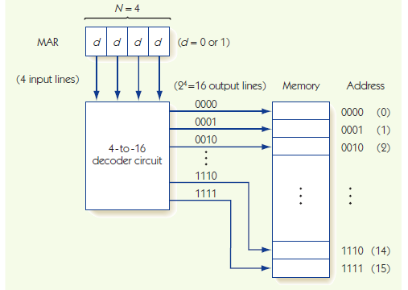
Decoding Memory Addresses

Slide 20
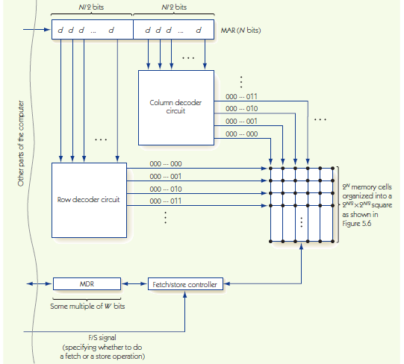
2D Memory
In practice it is more efficient to organize memory as a 2D grid rather than a 1D array
The memory addresses can then be split in half and independently fed to two decoders that will have significantly smaller logic circuits
Why is this the case?

