Slide 1

Logic, Gates,
& Circuits

Slide 2
ALERTs
Assignment 3 is due today
Assignment 4 is available on Brightspace. It is due next Friday (2/7)

Slide 3
What is Logic?
A logic statement is a sentence or assertion that can either be true or false
For example:
  "Abraham Lincoln was the last Czar of Russia"
  "I have three children"
  2 + 2 = 4
  x > 10
  t = "AATC" or (t = "TCCG" and s = "CTA")
  if mammal(X) then hasFur(X)
Statements can be combined by Boolean operators, like in the last two examples
Logic shows up in algorithms as the test conditions for if statements and while loops

Slide 4
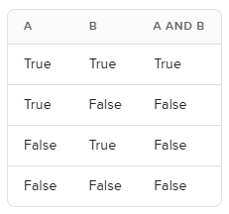
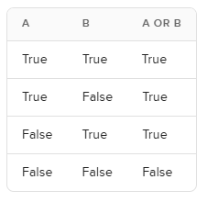
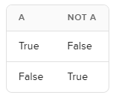
Truth Tables
The rules of logic define very carefully the
meaning of the connectives
AND means that both parts must be true
OR means at least one part is true
NOT means the opposite

Slide 5
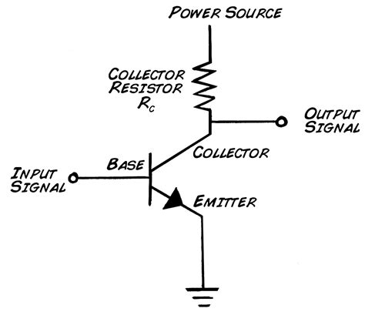
Physics Meets Logic
Transistors
  Solid-state switches
  Change on/off when given power on control line
  Extremely small (billions per chip)
  Enable computers that work with gigabytes of data

Slide 6
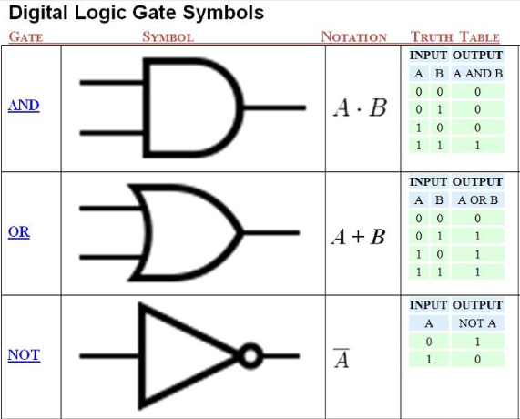
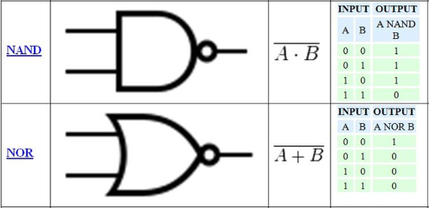
Boolean Logic and Gates
Gate: an electronic device that operates on inputs to produce outputs
Each gate corresponds to a Boolean operator

Slide 7
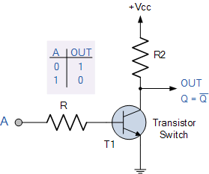
Boolean Logic and Gates
Gates are built from transistors
NOT gate: 1 transistor
NAND: 2 transistors
AND gate: 3 transistors
NOR: 2 transistors
OR gate: 3 transistors

Slide 8
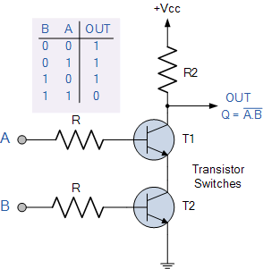
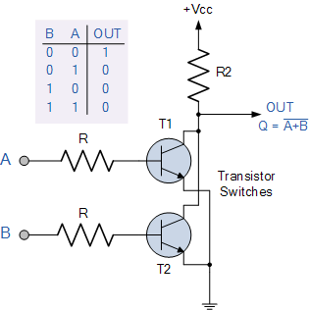
Boolean Logic and Gates

Slide 9
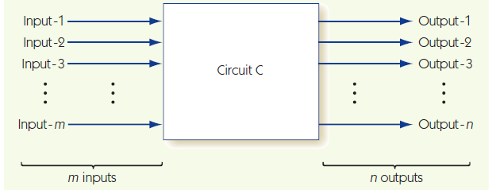
Building Computer Circuits
Circuit: has input wires, contains gates connected by wires, and has output wires
Outputs depend only on current inputs: no state

Slide 10
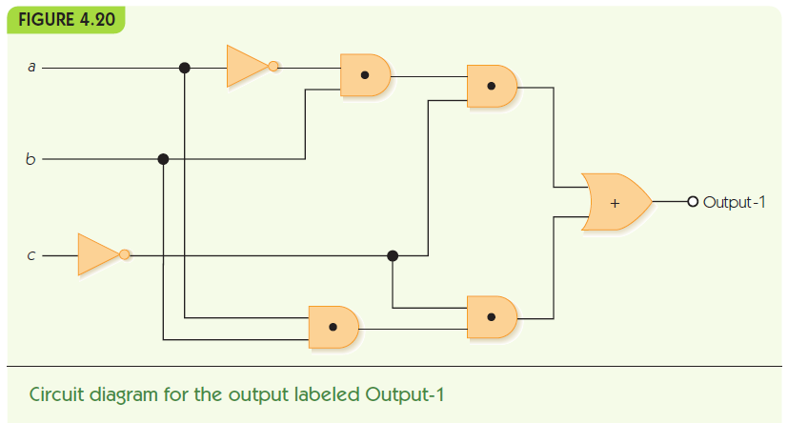
Building Computer Circuits

Slide 11
Building Computer Circuits
To convert a circuit to a Boolean expression:
  Start with output and work backwards
    Find next gate back, convert to Boolean operator
    Repeat for each input, filling in left and/or right side
To convert a Boolean expression to a circuit:
  Similar approach
To build a circuit from desired outcomes:
  Use standard circuit construction algorithm:
    e.g., sum-of-products algorithm

Slide 12
Building Computer Circuits
m
p
x
q
y
n
Output =
p • q + y
m • b • q + y
~a • b • ~c + n • q
x + y
~a • b • ~c + y
~a • b • ~c + a • b • ~c

Slide 13
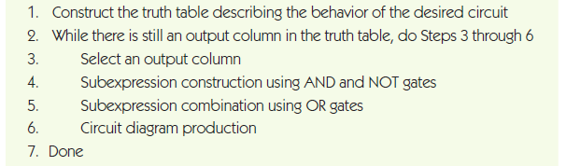
Building Computer Circuits

Slide 14
Building Computer Circuits
Build truth table:
a | b | c | Output1 | Output2
0 | 0 | 0 | 0 | 1
0 | 0 | 1 | 0 | 0
0 | 1 | 0 | 1 | 1
0 | 1 | 1 | 0 | 1
1 | 0 | 0 | 0 | 0
1 | 0 | 1 | 0 | 0
1 | 1 | 0 | 1 | 1
1 | 1 | 1 | 0 | 0

Slide 15
Building Computer Circuits
Find true rows for Output1
a | b | c | Output1 | Output2
0 | 0 | 0 | 0 | 1
0 | 0 | 1 | 0 | 0
0 | 1 | 0 | 1 | 1
0 | 1 | 1 | 0 | 1
1 | 0 | 0 | 0 | 0
1 | 0 | 1 | 0 | 0
1 | 1 | 0 | 1 | 1
1 | 1 | 1 | 0 | 0

Slide 16
Building Computer Circuits
For each true row AND inputs to make expression
  a = 0, b = 1, c = 0: (~a • b • ~c)
  a = 1, b = 1, c = 0: (a • b • ~c)
Combine row subexpressions with OR
  (~a • b • ~c) + (a • b • ~c)
Build circuit from expression
(and repeat for other output)

