Slide 1

Data: Number Representation

Slide 2
ALERTs
Assignment 3 is due Friday
There are some new things to look at on the course website

Slide 3
Positive Integers: Radix Notation
Binary Decimal Binary Decimal Binary Decimal
0 0 1011 11 10110 22
1 1 1100 12 10111 23
10 2 1101 13 11000 24
11 3 1110 14 11001 25
100 4 1111 15 11010 26
101 5 10000 16 11011 27
110 6 10001 17 11100 28
111 7 10010 18 11101 29
1000 8 10011 19 11110 30
1001 9 10100 20 11111 31
1010 10 10101 21 100000 32

Slide 4
What is Radix?
So if in decimal notation 3972 represents the number three thousand nine hundred seventy two, what does 101101 represent in binary?
Let's start with that first part:
3972 = 3 * 1000 + 9 * 100 + 7 * 10 + 2 * 1
= 3 * 10³ + 9 * 10² + 7 * 10¹ + 2 * 10⁰
Each digit is a multiple of a power of the base, which is 10
Ok, great. Then in binary, which is base-2, we get
101101 = 1 * 2⁵ + 0 * 2⁴ + 1 * 2³ + 1 * 2² + 0 * 2¹ + 1 * 2⁰
= 1 * 32 + 0 * 16 + 1 * 8 + 1 * 4 + 0 * 2 + 1 * 1
= 32 + 8 + 4 + 1
= 45

Slide 5
Powers of Two
n 2^{n} n 2^{n} n 2^{n}
0 1 11 2,048 22 4,194,304
1 2 12 4,096 23 8,388,608
2 4 13 8,192 24 16,777,216
3 8 14 16,384 25 33,554,432
4 16 15 32,768 26 67,108,864
5 32 16 65,536 27 134,217,728
6 64 17 131,072 28 268,435,456
7 128 18 262,144 29 536,870,912
8 256 19 524,288 30 1,073,741,824
9 512 20 1,048,576 31 2,147,483,648
10 1,024 21 2,097,152 32 4,294,967,296

Slide 6
Decimal Addition
What is 4256 + 981?
4256
+981
7
What is 6 + 1?
How do you know that?
Math facts are memorized!
What do we do with 5 + 8?
We need to carry the one...
1
1
2
5
3

Slide 7
Binary Addition
What is 1011 + 110?
1011
+110
1
What is 1 + 0?
What are the binary math facts?
0 + 0 = 0 0 + 1 = 1 1 + 0 = 1 1 + 1 = 10
1 + 1 + 1 = 11
What do we do with 1 + 1?
We still need to carry the one...
1
1
10
0
0

Slide 8
Signed Integers
What if we want to represent negative numbers?
Just add a minus sign out front? -6₁₀ = -110₂
No, since in a binary code we can only have two symbols...
Sign & Magnitude
add a sign bit to the left: 0 is positive, 1 is negative
0110 = 6 1110 = -6
One’s Complement
flip all the bits
0110 = 6 1001 = -6
Two’s Complement
flip all the bits and add one (weird...)
0110 = 6 1010 = -6

Slide 9
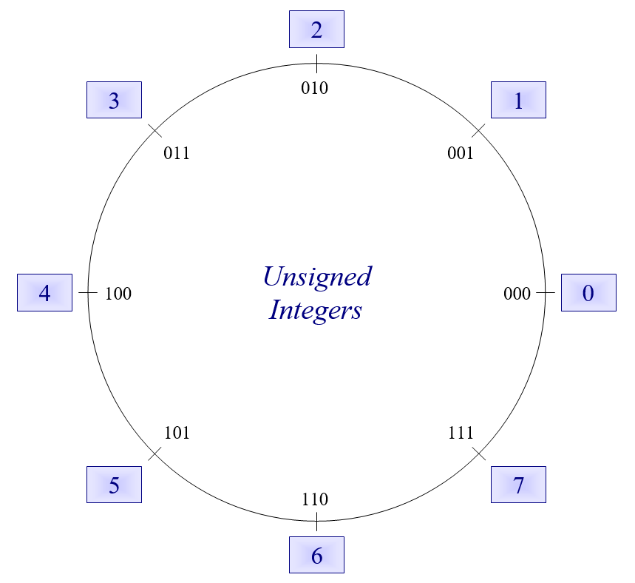

Slide 11
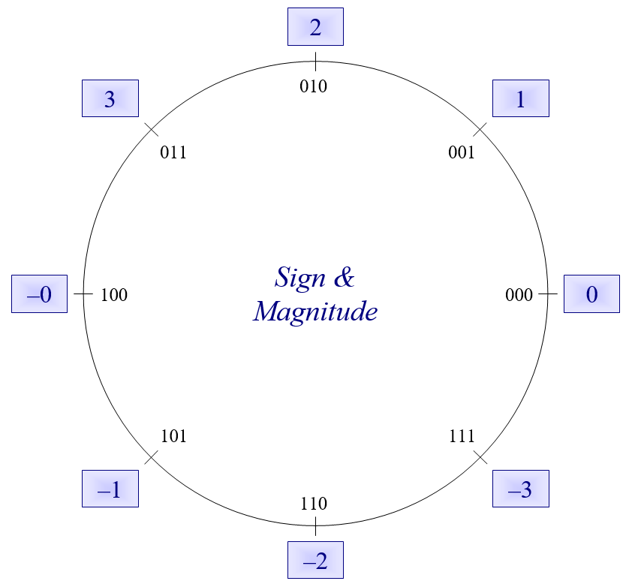

Slide 12
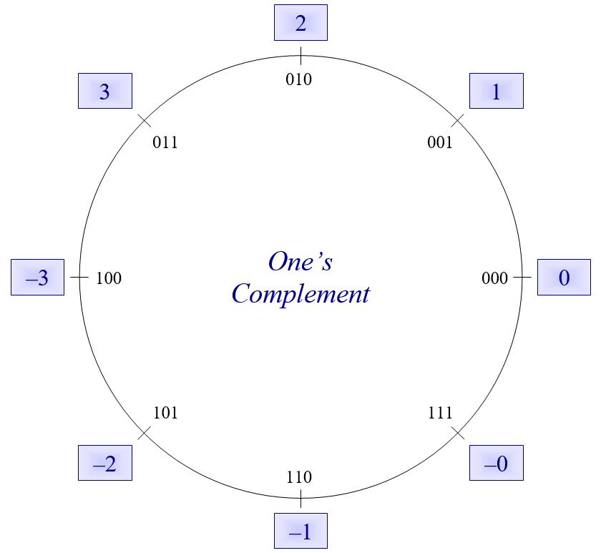

Slide 13
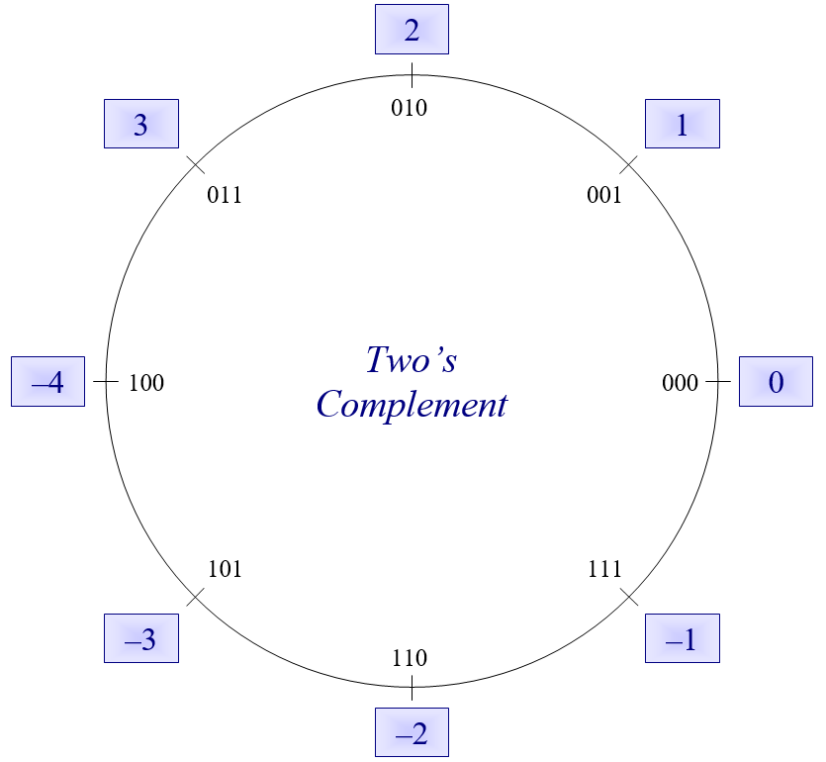

Slide 14
Real Numbers, well sort of...
IEEE 754 Standard for Floating Point Representation
Based on scientific notation
Avogadro's Number = 602,214,076,000,000,000,000,000 or six hundred two sextillion and some change
That's awkward to write and work with, so if we move the decimal point (i.e., floating point) to the left 23 spaces we can write the number as 6.02214076 x 10²³
Or even 6.022 x 10²³ if we want a more concise, but less precise way of saying it
The exponent on 10 indicates the number of positions the point was moved (positive for left, and negative for right)

Slide 15
Real Numbers, well sort of...
How does this relate to IEEE 754 and binary numbers?
We can something similar with binary, as long as we remember a few things
Just like decimal digits to the right of the decimal point continue to be powers of 10 (just negative powers),
458.367 = 4 * 10² + 5 * 10¹ + 8 * 10⁰ + 3 * 10⁻¹ + 6 * 10⁻² + 7 * 10⁻³
458.367 = 4.58367 x 10²
Binary digits to the right of the binary point continue to be powers of 2
1011.011 = 1 * 2³ + 0 * 2² + 1 * 2¹ + 1 * 2⁰ + 0 * 2-1 + 1 * 2⁻² + 1 * 2⁻³
= 8 + 2 + 1 + ¼ + 1/8 = 11 3/8
1011.011 = 1.011011 x 2³

Slide 16
Real Numbers, well sort of...
These scientific notation representations have four components
Decimal: 4.58367 x 10²
Binary: 1.011011 x 2³
Decimal Binary
A whole number: 4 1
A mantissa: .58367 .011011
A base: 10 2
An exponent: 2 3
Of these, we only have to worry about the last 3 in binary
Why?

Slide 17
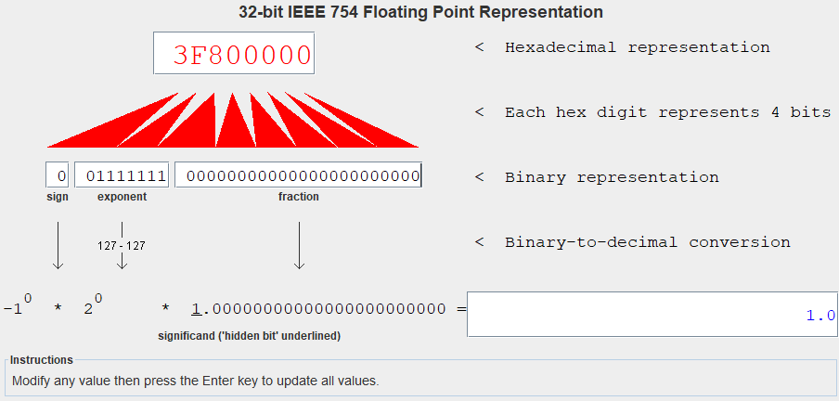
Mars Demo

