Slide 1
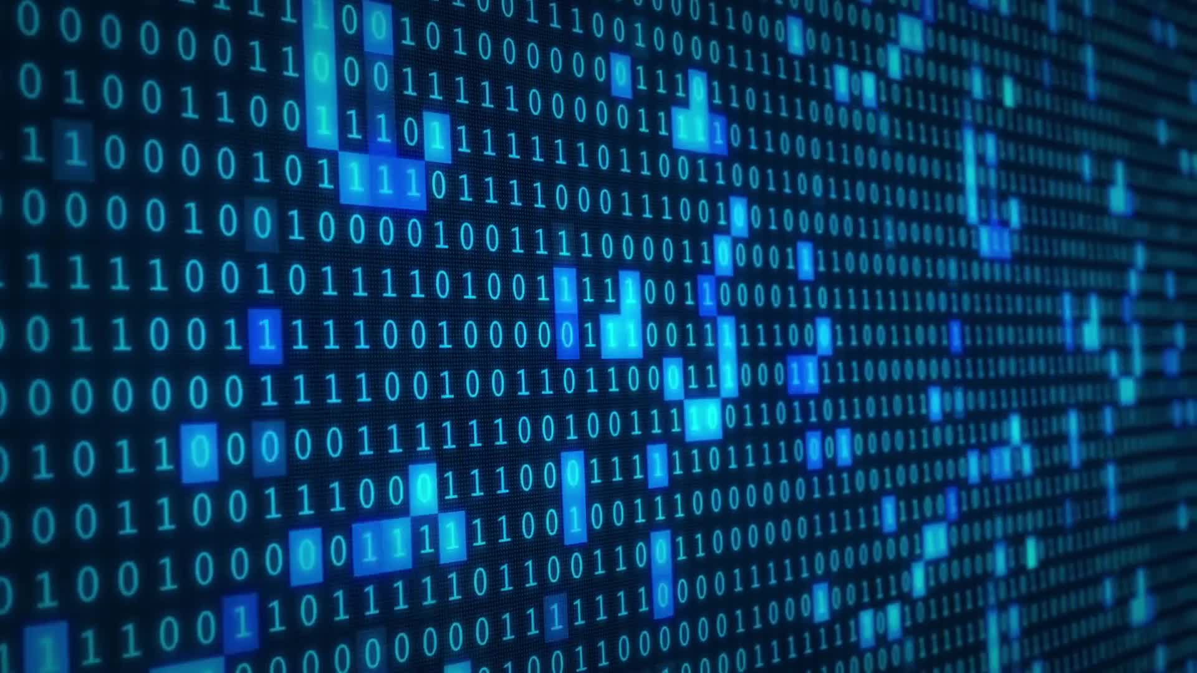
Data: Representation

Slide 2
ALERTs
Assignment 3 is due Friday

Slide 3
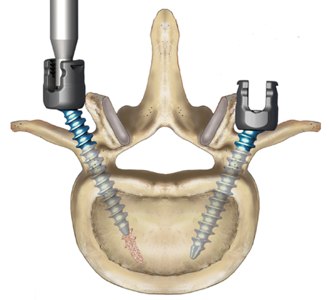

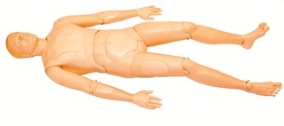
What does this mean?
10110001
Unsigned Integer: 177
Sign & Magnitude Integer: -49
2s-Complement Integer: -79
Extended ASCII Character: ±
Hexadecimal Number: B1
Denali Monoaxial/Polyaxial ATR™ Set Screw
Moose Racing Air Filter
Laerdal Medical ‘Extri Kelly’ trauma mannequin

Slide 4

Data Representation
Motivating Principles
Symbols have NO inherent meaning!!
They only mean what we choose them to mean
The representations that we choose often determine the algorithms available to us
Interpretation is key

Slide 5
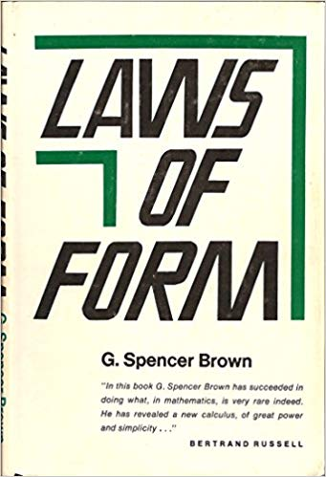
Digital Computers
Are built upon and operate by the simple concept of choice, or the ability to distinguish
And not only that, but the most primitive sort of choice or distinction: that between two alternatives
  on / off − true / false − open / closed − positive / negative
WHY?
  It is as simple as you can get!
    Mathematically
    Engineering Principle: It is better to design a complex
    system out of simple components than out of complex ones

Slide 6
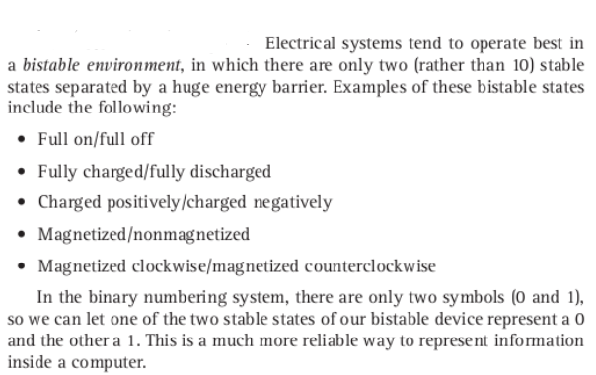
Binary Codes
In a computer, all data is represented in binary codes
e.g., sequences of 0s and 1s
All hardware components operate in a
‘bistable environment’
Why 0 & 1?
→ historical accident

Slide 7
Digitization of analog data
What does analog mean?
Digitize: to convert to a digital form
Sampling: record analog values at fixed, discrete intervals
So for images, that would involve overlaying a grid with a specified resolution, and sampling each cell's intensity
For audio, that would be capturing the amplitude of a signal at a specified frequency
For video, it would be both of the above at the specified frequency.

Slide 8
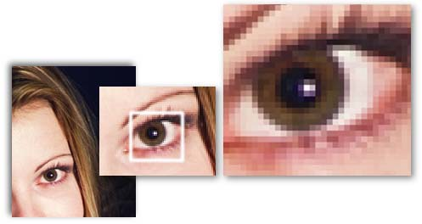
Images
Image sampling: record color or intensity at fixed, discrete intervals in 2D
Pixels: individual recorded samples
RGB encoding scheme:
  Colors are combinations of red, green, and blue
  One byte each for red, green, and blue
Raster graphics store picture as
2D grid of pixel values
Vector graphics store a picture as
a set of functions for generating
objects in the image
Matt Parker

Slide 9
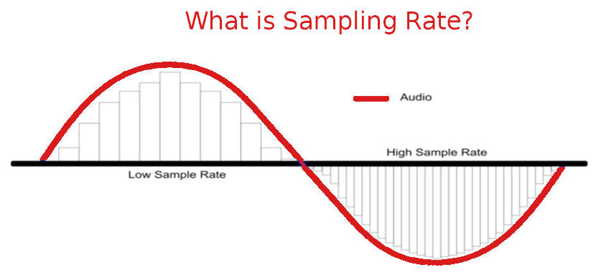
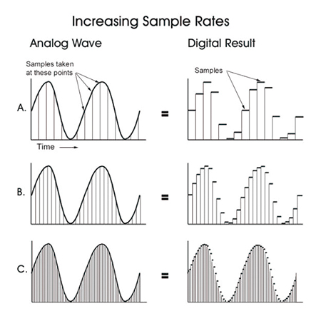
Sound
Sounds are literally waves of vibration in the air, so we can graph those waves to get a visualization of the sound.
Sampling: record sound wave values at
fixed, discrete intervals
The sampling rate is the frequency
at which the waveform is measured
  More samples = more accurate wave form
The bit depth is the number of bits per sample
  More bits = more accurate amplitude

Slide 10
Text: ASCII & Unicode
https://www.ascii-code.com/
http://www.unicode.org/standard/WhatIsUnicode.html

