Slide 1
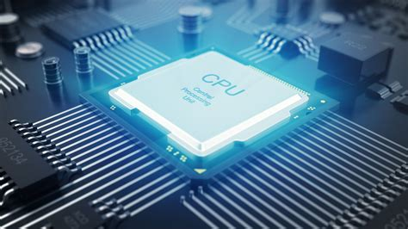
Secondary Memory, The CPU, and Moore's Law

Slide 2
ALERTs
Assignment 3 is available on Brightspace. It is due on Friday, 1/30.
Read Kernighan Chapter 2 (pp. 25-38)

Slide 3
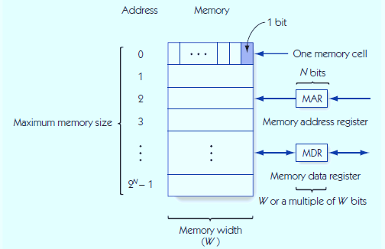
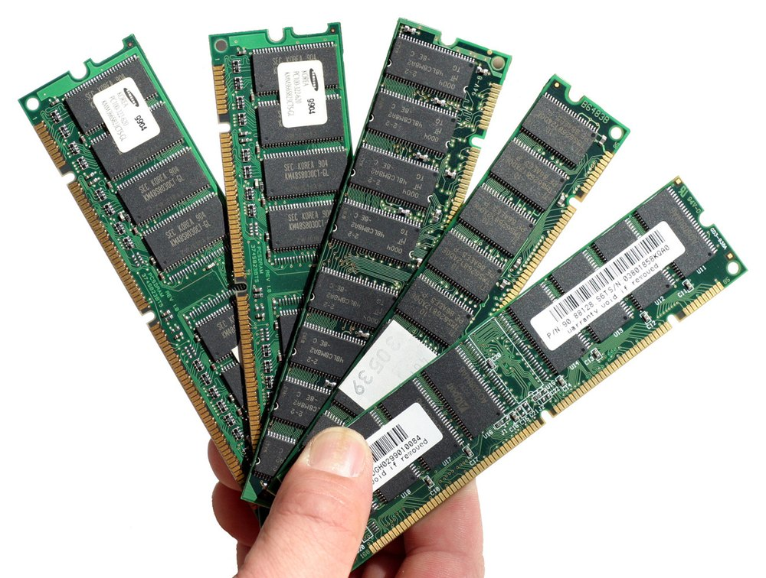
The Structure of Memory

Slide 4
Memory Access
Fetch: retrieve from memory (nondestructive)
Store: write to memory (destructive)
Memory access time
time required to fetch/store
Modern RAM requires 5-10 nanoseconds
MAR holds memory address to access
MDR receives data from fetch, holds data to be stored

Slide 5
Memory Fetch/Store
Memory system circuits: decoder and fetch/store controller
Decoder converts MAR into signal to a specific memory cell
One-dimensional versus two-dimensional memory organization
Fetch/Store controller = traffic cop for MDR
Takes in a signal that indicates fetch or store
Routes data flow to/from memory cells and MDR

Slide 6
The Components of a Computer System Mass Storage
RAM is not the only form of memory or storage in a computer:
RAM = volatile memory (erased without power)
Currently measured in GB (4-32 is typical)
Mass storage systems = nonvolatile memory (persists without power)
Direct access storage devices (DASDs)
Sequential access storage devices (SASDs)

Slide 7
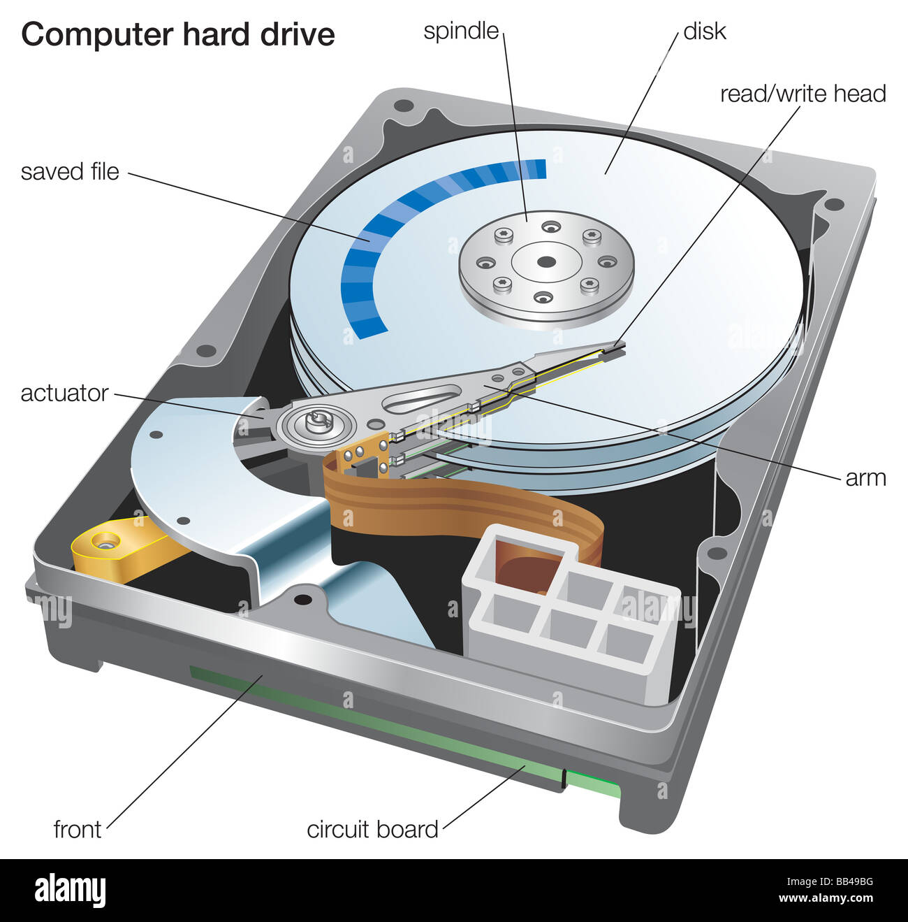
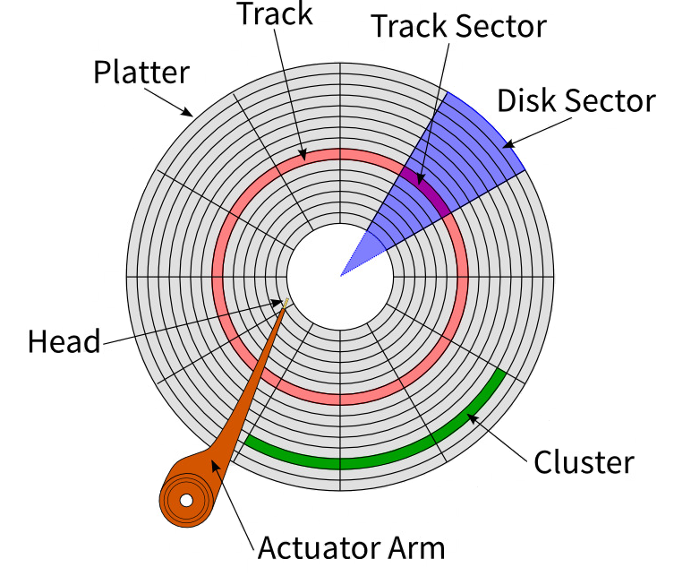
The Components of a Computer System Mass Storage
DASDs
Currently measured in TB (0.25 – 5.0)
Hard drives, CDs, DVDs (contain disks)
Tracks: concentric rings around disk surface
Sectors: fixed size segments of tracks, unit of retrieval
Time to retrieve data based on:
seek time
latency
transfer time
Other non-disk DASDs: flash memory, optical

Slide 8
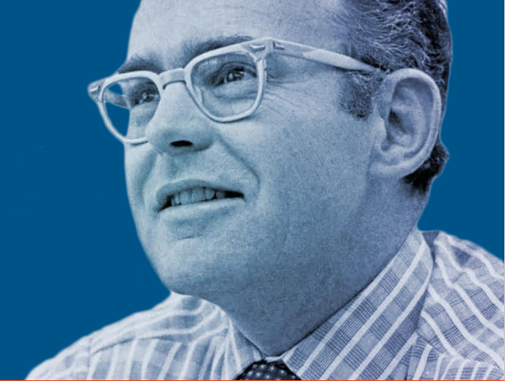

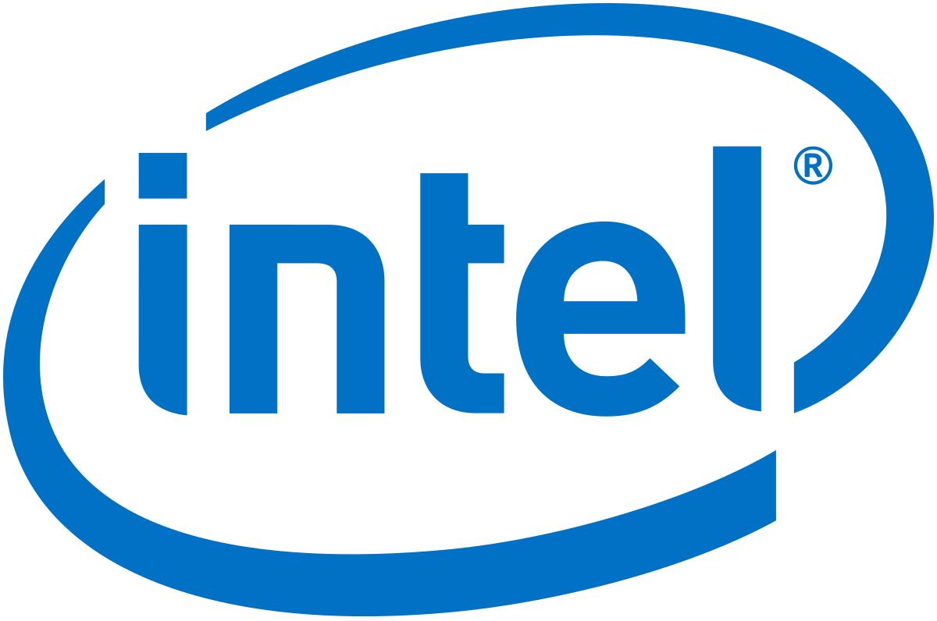
Gordon Moore
Co-founder of Intel
Worth just under $10 billion today
Moore’s Law (1965)
“The observation that the number of transistors in a dense integrated circuit doubles about every two years.”
https://www.intel.com/content/www/us/en/silicon-innovations/moores-law-technology.html

Slide 9
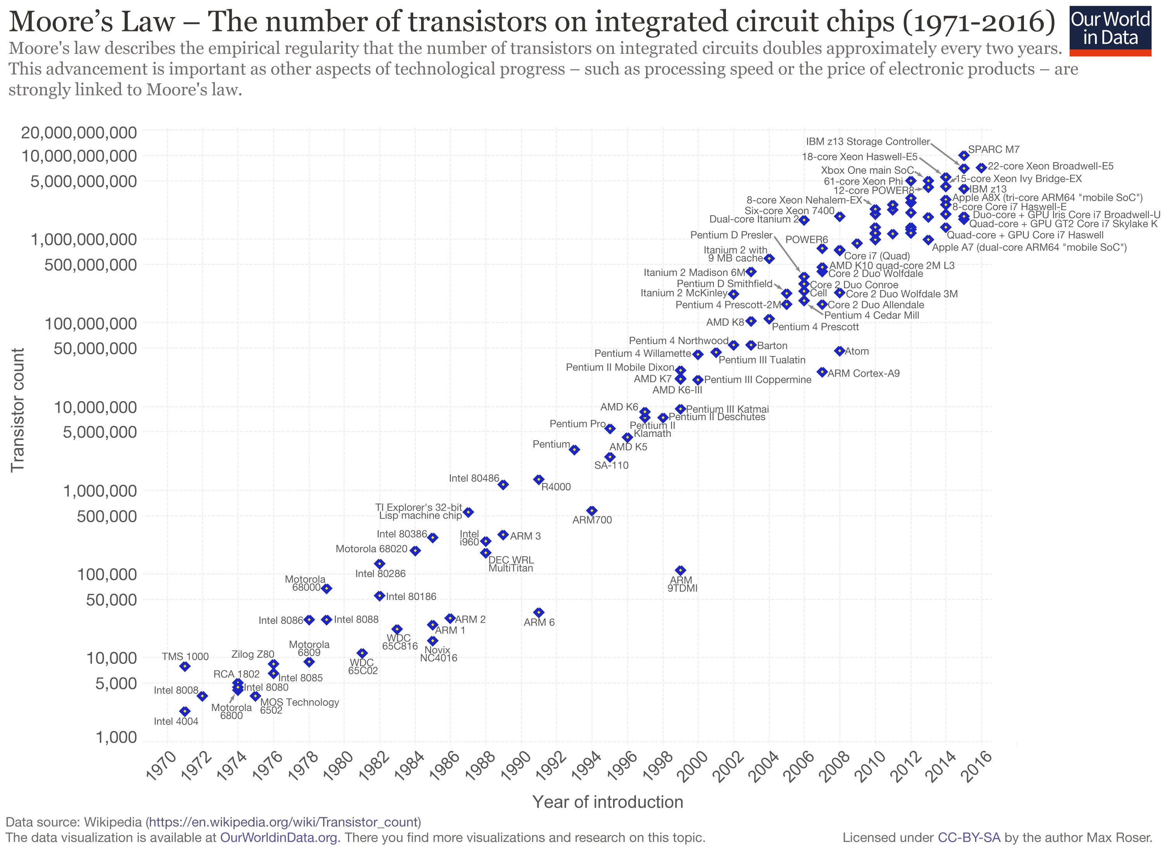

Slide 10
Next time...
Data Representation

