Slide 1
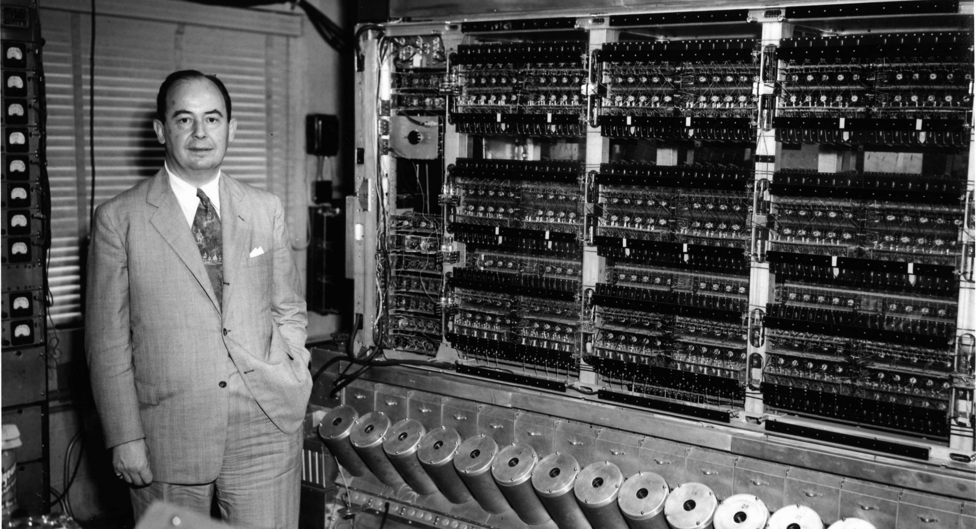
The Von Neumann Architecture
COMP 1500

Slide 2
ALERTs
Reading assignment
Kernighan: Chapter 1 (pp. 7-24)
Assignment 1 is due today
Assignment 2 is due Friday at the start of class
Questions?

Slide 3

The Machine that Changed the World
Name one thing you remember
No repeats
What was most surprising?
What did you learn about the late 80s?
Questions?

Slide 4
What is a Computer?
How would you define computer?
Is that specific enough?
Is that general enough?
What are the essential components of the definition?
Physically?
Conceptually?

Slide 5
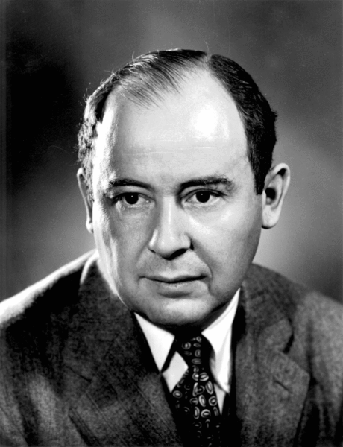
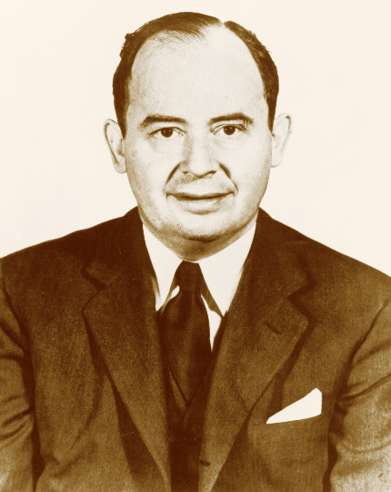
The Von Neumann Architecture
John Von Neumann
“If people do not believe that mathematics is simple, it is only because they do not realize how complicated life is.”

Slide 6
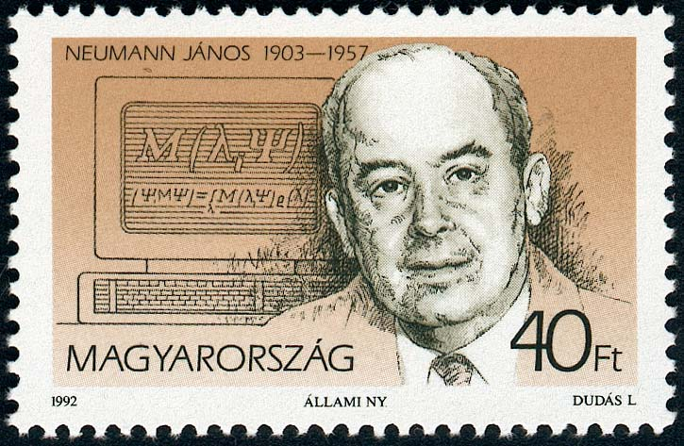
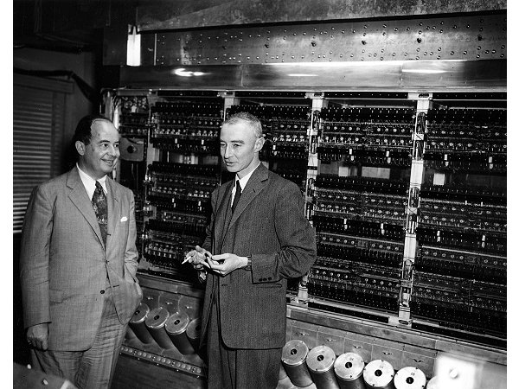
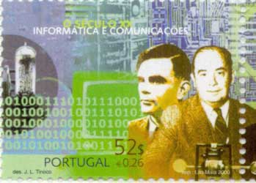
John Von Neumann
John von Neumann (left) and Manhattan Project leader J. Robert Oppenheimer, in front of Princeton’s Institute for Advanced Study (IAS) computer

Slide 7
The Components of a Computer System
Von Neumann architecture
Foundation for nearly all modern computers
Characteristics:
Central Processing Unit (CPU)
arithmetic/logic unit (ALU)
control unit
RAM: random access memory
I/O: input/output
Stored program concept
Sequential execution of instructions

Slide 8
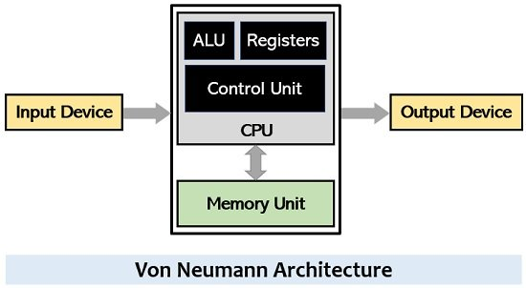
The Von Neumann Architecture
https://circuitglobe.com/wp-content/uploads/2021/06/Von-Neumann-Architecture.jpg

Slide 9
Memory
Memory: functional unit for data storage/retrieval
Random access memory (RAM)
Organized into cells, each given a unique address
Equal time to access any cell
Cell values may be read and changed
Cell size/memory width typically 8 bits
Maximum memory size/address space is 2^{N}, where N is length of address

Slide 10
Measuring Memory
1 KB = 1 kilobyte
2¹⁰ = 1024 ~ 10³
1 MB = 1 megabyte
2²⁰ = 1,048,576 ~ 10⁶
1 GB = 1 gigabyte
2³⁰ = 1,073.741,824 ~ 10⁹
1 TB = 1 terabyte
2⁴⁰ = 1,099,511,627,776 ~ 10¹²
1 PB = 1 petabyte
2⁵⁰ = 1,125,899,906,842,624 ~ 10¹⁵
1 EB = 1 exabyte
2⁶⁰ = 1,152,921,504,606,846,976 ~ 10¹⁸
1 ZB = 1 zettabyte
2⁷⁰ ~ 10²¹
1 YB = 1 yottabyte
2⁸⁰ ~ 10²⁴
2¹⁶ = 65,536
2²⁴ = 16,777,216
2³² = 4,294,967,296
2⁶⁴ = 18,446,744,073,709,551,616

Slide 11
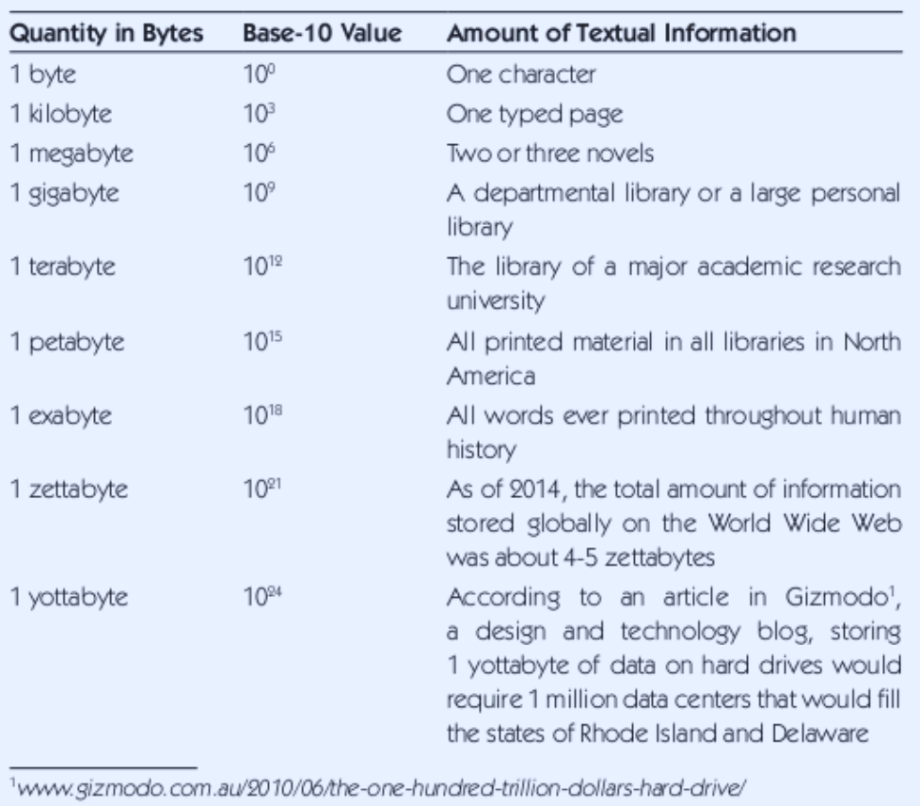
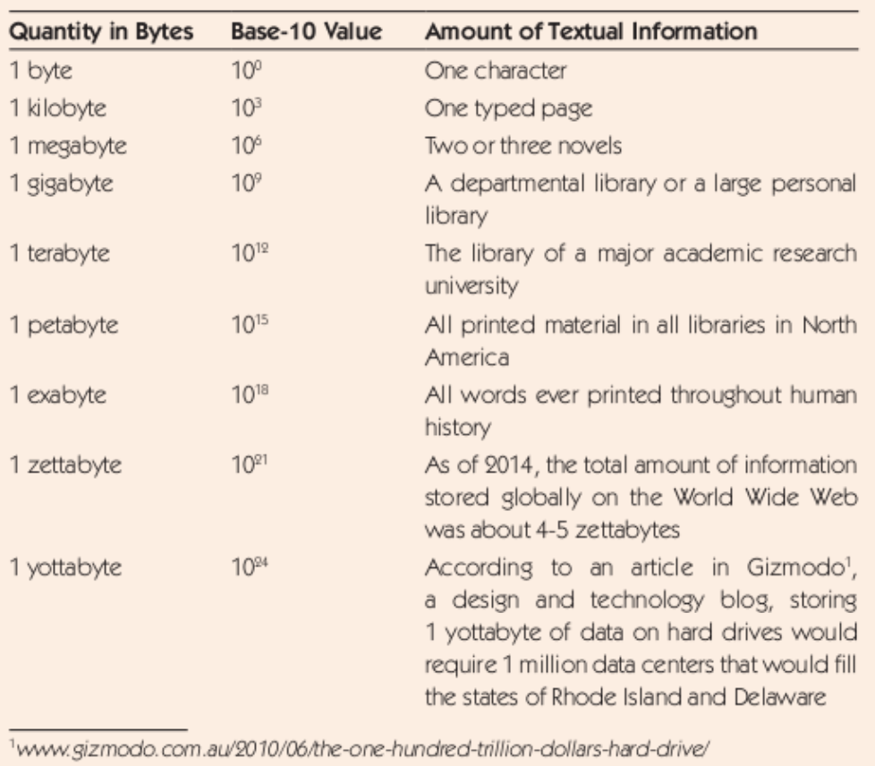

Slide 12
Next time...
More memory
The CPU
Secondary storage
Moore's Law

