Slide 1
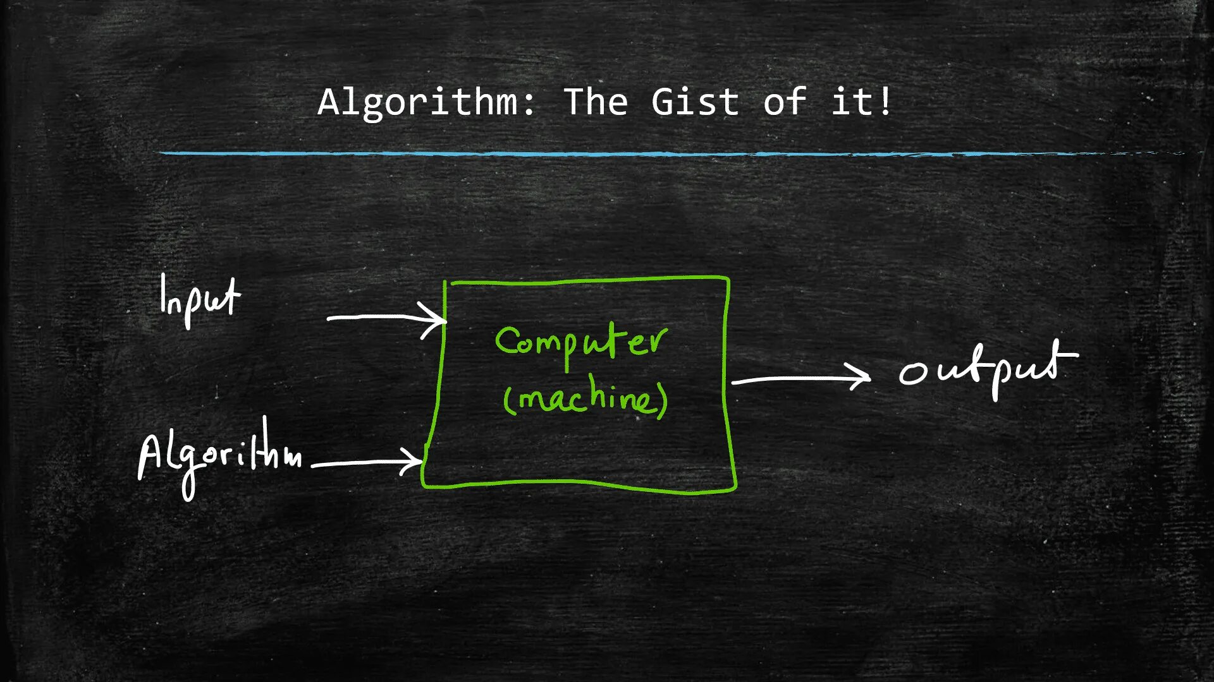
Algorithms
COMP 1500

Slide 2
ALERTs
Reading assignment
  Kernighan: Chapter 1
Assignment #1
  Watching TMTCTW this Wednesday...
  Due Wednesday, 1/21
Assignment #2
  Due Friday, 1/23

Slide 3
Assignment 2
Lab software
Mechanics of doing labs
Lab assignment
Submit hard copy

Slide 4
Formal Definition of Algorithm
A well-ordered collection of unambiguous and effectively computable operations that, when executed, produces a result and halts in a finite amount of time

Slide 5
A well-ordered collection of unambiguous and effectively computable operations that, when executed, produces a result and halts in a finite amount of time
Well-ordered collection
  This is where Turing’s building blocks come in…
  Upon completion of an operation we always know which operation to do next
  The ordering of operations must be unambiguous
  Control constructs must have well-defined behavior
    No “I’m feeling lucky” jump instructions
    Go back and do it again (Do what again?)
    Start over (From where?)

Slide 6
A well-ordered collection of unambiguous and effectively computable operations that, when executed, produces a result and halts in a finite amount of time
Unambiguous operation
  May only have one possible interpretation
  Can be understood by the computing agent without having to be further defined or simplified—no knowledge gap
  Primitive operations: simple, built-in

Slide 7
A well-ordered collection of unambiguous and effectively computable operations that, when executed, produces a result and halts in a finite amount of time
Effectively computable operations
  It must also be doable (also called feasible) by the computing agent
  Negative examples
    Compute largest prime
    Sum all perfect squares
    Compute the mean/median/min/max of empty set
    Write program A which reads any program B and dataset C and which halts IFF B doesn’t halt on input C
    Find all TCP/IP routes between otterbein.edu and google.com and then take quickest route

Slide 8
A well-ordered collection of unambiguous and effectively computable operations that, when executed, produces a result and halts in a finite amount of time
Produces a result
  Duh…
  Result may be a number, text, a light, picture, sound, or a change in the computing agent’s environment

Slide 9
A well-ordered collection of unambiguous and effectively computable operations that, when executed, produces a result and halts in a finite amount of time
Halts
  No infinite loops
  Usually a mistake
  Operating systems & event-driven software…

Slide 10
Why Algorithms?
The Importance of Algorithmic Problem Solving
  “Industrial revolution” of 19th century
    Mechanized and automated repetitive physical tasks
    Through mechanical machinery
  “Computer revolution” of the 20th and 21st centuries
    Mechanized and automated repetitive mental tasks
    Through algorithms and computer hardware

Slide 11
Organization of the Text
Computer science is the study of algorithms including: | Chapters of the text:
1. Their formal and mathematical properties, | Algorithms
2. Their hardware realizations, | What is a computer? Bits, Bytes, and Representation of Information Inside the Processor
3. Their linguistic realizations, | Programming and Programming Languages Software Systems Learning to Program
4. Their applications. | Networks The Internet The World Wide Web Data and Information Artificial Intelligence and Machine Learning Privacy and Security

Slide 12
Next Time...
History of Computing documentary:
  The Machine that Changed the World—Giant Brains

