Slide 1
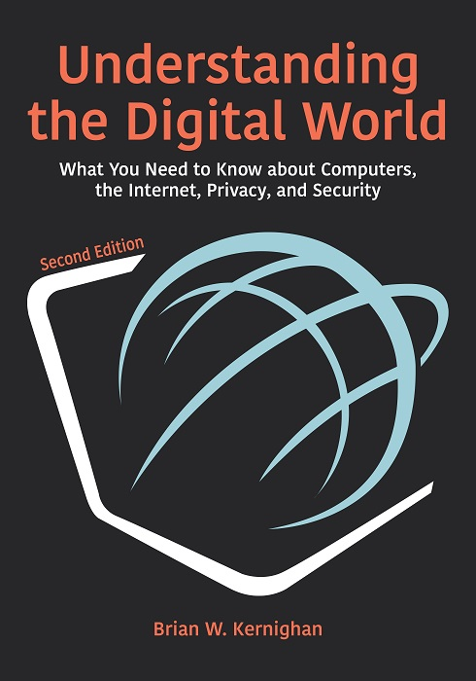
COMP 1500
David J Stucki
MWF 12:40-1:35
Comm 111
Introductions
Syllabus
Brightspace & Web Site
Software
Q & A

Slide 2
ALERTs
Reading assignment
Kernighan: Preface (pp. xi-xvi), and Introduction (pp. 1-6)

Slide 3
What is Computer Science?
Misconceptions
Computer science is:
The study of computers…
Git out yer magnifying glasses!
The study of how to write computer programs
The study of the uses and applications of computers and software
Information Technology: certifications, etc., …

Slide 4
What is Computer Science?
"Computer Science is no more about computers
than astronomy is about telescopes,
biology is about microscopes, or
chemistry is about beakers and test tubes."
Michael R. Fellows and Ian Parberry Computing Research News, 5(1):7, 1993

Slide 5
The Definition of Computer Science
Computer science is the study of algorithms, including:
Their formal and mathematical properties
Their hardware realizations
Their linguistic realizations
Their applications
ACM Curriculum (https://csed.acm.org/)

Slide 6
The Definition of Algorithm
Merriam-Webster
OED
Algorithm
Informally, “an ordered sequence of instructions that is guaranteed to solve a specific problem.”
Alan Turing: Building Blocks of Algorithms
Sequence: specifying computational order
Selection: making decisions
Iteration: repeating tasks

Slide 7
Example Problem
Given two positive integers compute their sum
Assume that each integer contains m digits
Call the first integer x and the second integer y
Call the sum z
Let the individual digits of each number be subscripted elements with the rightmost digit having subscript 0 (so x = x_{m-1}x_{m-2}...x₀)
Express the algorithm for computing the result as a step-by-step process in terms of these variables

Slide 8
Example Problem
Set the value of carry to 0
Set the value of i to 0
While the value of i is less than or equal to m – 1, repeat the instructions in steps 4 through 6
Add the two digits x_{i} and y_{i} to the current value of carry to get z_{i}
If z_{i} > 9, then reset z_{i} to (z_{i} – 10) and reset the value of carry to 1; otherwise, set the new value of carry to 0
Add 1 to i, effectively moving one column to the left
Set z_{m} to the value of carry
Print out the final value of z
Stop

Slide 9
Formal Definition of Algorithm
A well-ordered collection of unambiguous and effectively computable operations that, when executed, produces a result and halts in a finite amount of time

Slide 10
Formal Definition of Algorithm
A well-ordered collection of unambiguous and effectively computable operations that, when executed, produces a result and halts in a finite amount of time

Slide 11
Next Time...
What is an Algorithm, continued

