Slide 1

COMP 1100
Data Modeling & Management
David J Stucki
Otterbein University
Notes:
Bring Wirth & playing cards

Slide 2
ALERTS
  Projects due Thursday, April 4
  Power BI Homework 11 available, due next Tuesday
  Questions?

Slide 3
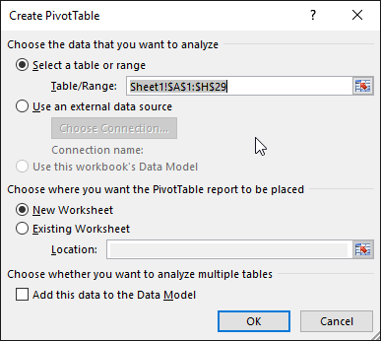
Creating PivotTables
These are used for summarizing complex information.
Making a PivotTable
  PivotTables are based on an entire range.
  Insert the PivotTable on the same or a separate worksheet.
  Add fields for the row, column, and value areas
  of the PivotTable.

Slide 4
What Is a PivotTable?
A Pivot Table allows you to aggregate data from a worksheet to get a high level summary or view of the data.
To “pivot” is to turn or rotate, and PivotTables allow you to quickly switch between different views.
A PivotTable comparing product and service sales for employees, grouped by position

Slide 5
Creating PivotTables (cont.)
Arranging the Source Data
  Source data is raw data and isn’t summarized in any way.
  Column headings (fields) appear across the top.
  Rows contain unique entries.
  No blank rows or columns or duplicate values are allowed.
Remove Duplicates
  Use the Remove Duplicates command.
  You must specify which columns must match.

Slide 6
Adding PivotTable Fields
The PivotTables Fields pane allows you to add and remove fields easily.
Check field names to include in the PivotTable
Drag field(s) to become column header(s).
Drag field(s) to calculate.
Drag field(s) to become row header(s).

Slide 7
Using PivotTables for Analysis
You can modify at any time by adding/removing fields.
You can change the positioning and order of fields.
In these two PivotTables, the data is the same but is grouped in different ways.
NOTE! Arranging fields appropriately is the most important skill when working with PivotTables.

Slide 8
Formatting PivotTables
Format them to make information easier to read and understand.
Choose styles from gallery on the Design tab.
Choose from layout and style options.
Change the number formatting.

Slide 9
Changing Value Field Settings
Change the settings of each value field to better tell the story of your data.
Customize the name.
Choose from a variety of functions.

Slide 10
Filtering a PivotTable
There are multiple ways to filter: AutoFilter, add a filter field, add a slicer.
Totals and subtotals instantly recalculate after filtering.
Filtering a PivotTable with AutoFilter
The AutoFilter button displays a menu with sorting and filtering options.

Slide 11
Filtering with a Filter Field and Slicers
Adding a Filter Field
  Drag a field to the Filters area.
Filtering with Slicers
  These are menu frames on a worksheet containing all filtering choices for one field.
The selected items are highlighted in the slicer.

Slide 12
Creating Calculated Fields
You can create your own calculations
instead of using a function
Show Values As
  You can determine how values display
  by using comparison operations.
Refreshing PivotTable Data
  You must refresh a PivotTable after updates have been made to the data.
  You can select an option to refresh upon
  opening the file.

Slide 13
Creating PivotCharts
These are based on PivotTable data.
  The value area fields display as data series on the chart.
  The row labels become axis labels.
  The column labels become the chart legend.
Filtering PivotCharts
Row/Column label AutoFilter buttons

Slide 14
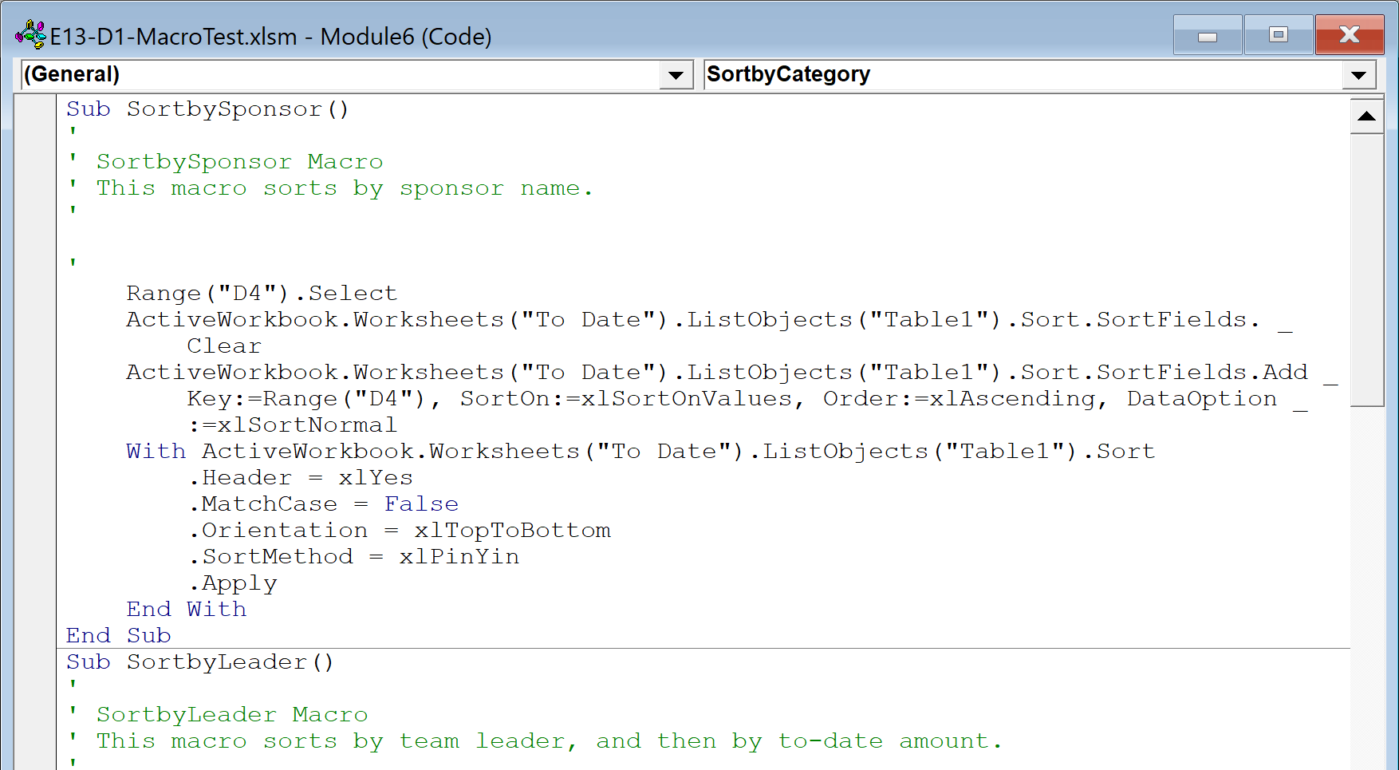
Introducing Macros
A macro is a recorded set of mouse and keyboard actions that can be played back.
It records a repetitive series of tasks that can be completed with a mouse click or shortcut.
The coding behind a macro.

Slide 15
Changing Macro Security
Macros can contain viruses, so there are added security features associated with them.
There are four options for macro security:
  Disable all macros without notification.
  Disable all macros with notification.
  Disable all macros except digitally signed macros.
  Enable all macros.
NOTE! The default and recommended option is “disabling all macros with notification.” It is not recommended that you choose the “enable all macros” option due to potentially unsafe macros.

Slide 16
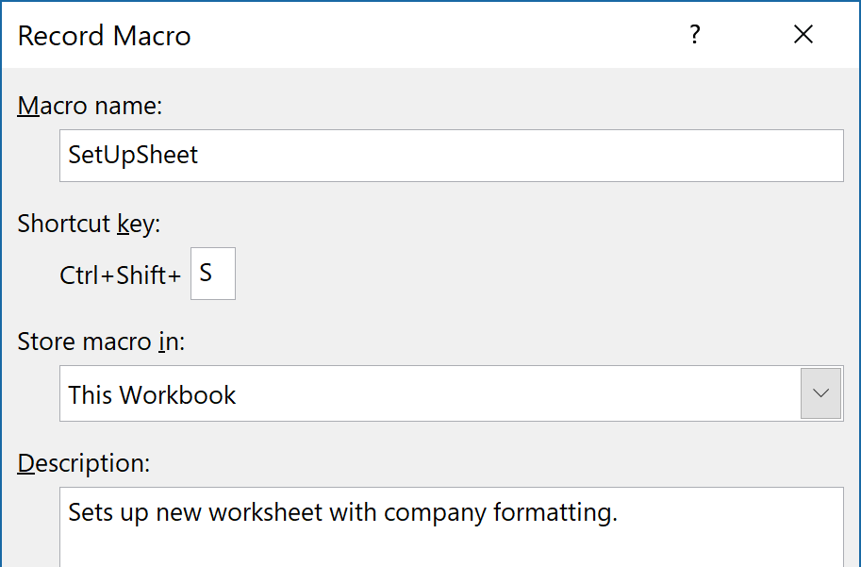
Recording Macros
Creating a macro is as simple as clicking a button and completing the series of actions you wish to include in the macro. It’s like using a video camera!
When you choose to create a macro, you will see the Record Macro dialog box in which you can add details for the new macro.

Slide 17
Recording the Macro Steps
Most actions performed are recorded in the macro, including:
  Mouse actions
  Choosing Ribbon commands
  Selecting options in dialog boxes
  Using arrow keys to navigate the worksheet
  Typing text
NOTE! It’s a good idea to practice the steps before actually recording the macro!

Slide 18
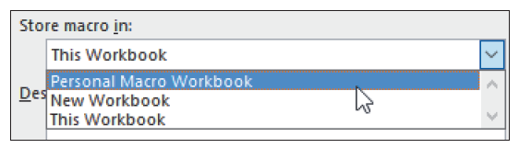
Storing and Sharing Macros
By default, a recorded macro is saved only for the current workbook.
You can, however, assign it to the Personal Macro Workbook, which makes it available to all open workbooks.
Choose “Personal Macro Workbook” when saving to make it available to all open workbooks.

Slide 19
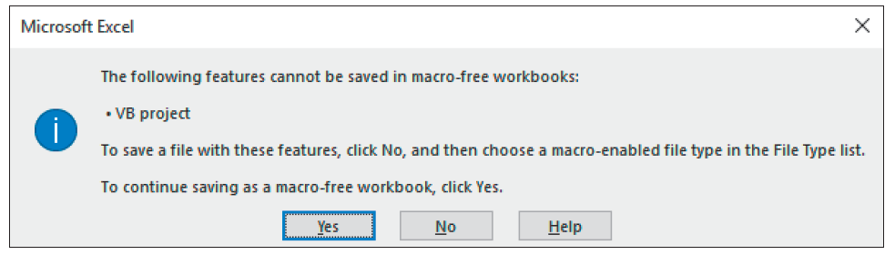
Saving a Workbook Containing Macros
Choose “Excel Macro-Enabled Workbook” as the type of file to avoid losing the macro(s) you have created.
If you attempt to save it as a “normal” Excel workbook, you will see the following warning message:

Slide 20
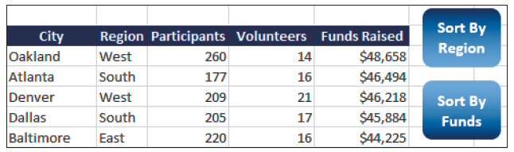
Running and Assigning Macros
Running macros is easy and can be accomplished by:
  Issuing the command from the Macro dialog box
  Using a shortcut key
  Clicking a custom button on a worksheet
  Clicking a custom button on the Quick Access toolbar
You can insert a shape in a worksheet (like the rounded rectangles displayed above) and assign a macro to it to create a custom button.

Slide 21
Demos

