Slide 1

COMP 1100
Data Modeling & Management
David J Stucki
Otterbein University
Notes:
Bring Wirth & playing cards

Slide 2
ALERTS
  Projects due Thursday, April 4
  Power BI In-Class Assignment 10 due today
  Power BI Homework 11 available, due next Thursday
  Questions?

Slide 3
Conditional Formatting
This applies formatting to cells meeting a criteria.
Preset options can be applied.
You can create multiple rules for same set of data.
Conditional formatting updates cells when data is entered.
You can apply conditional formatting with graphics.
  Apply data bars, color scales, or icon sets.

Slide 4
Conditional Formatting Rules Manager
Create, edit, and delete rules or rearrange the order.
This displays existing rules for the entire worksheet or current selection.
In this example, the Conditional Formatting Rules Manager is displaying the rules for the entire worksheet.

Slide 5
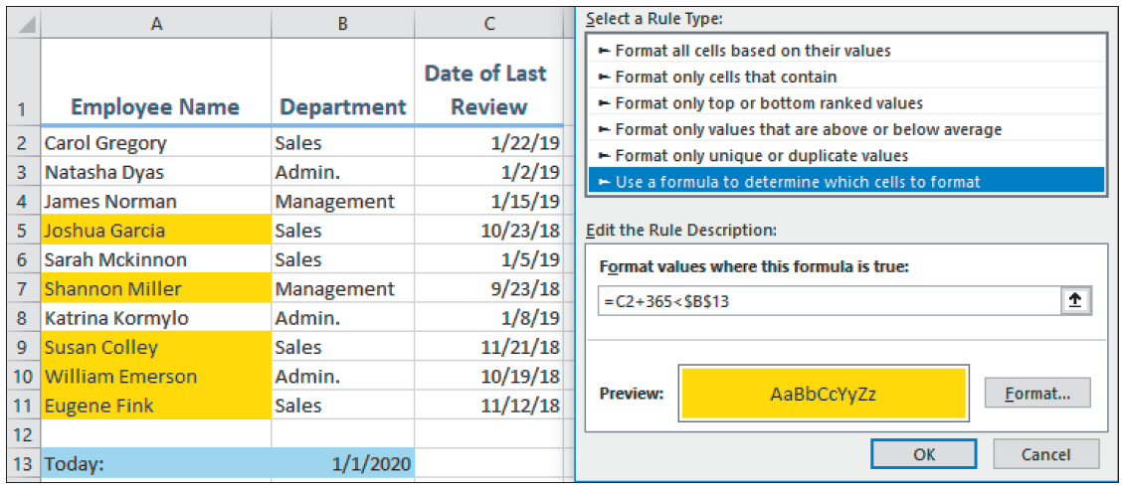
Conditional Formatting Using Formulas
Expand the possibilities of conditional formatting by creating a custom rule using a formula.
In this example, a formula is used to determine which employees are due for their annual wage review.

Slide 6
Using Functions to Modify Text
Text functions let you change text entries.
Changing case
  PROPER converts only the first letter to uppercase.
  UPPER converts all letters to uppercase.
  LOWER converts all letters to lowercase.

Slide 7
Extracting Text
LEFT, MID, RIGHT removes a specified number of characters.
TRIM leaves only a single space between words.

Slide 8
Merge and Modify with Functions and Flash Fill
CONCATENATE
combines two or more
separate text entries
into one cell
Flash Fill tool
  Extracts one part of a cell only
  Inserts text into a cell
  Combines two names into one cell
  Separates one name into two cells

Slide 9
Other Text Functions
There are many other text functions in Excel. The table here shows just a few of them.

Slide 10
Creating Conditional Functions Using IF Criteria
If a range of cells meets a stated criteria, you can apply a function to it.
IF functions use one criterion; IFS functions use multiple criteria.

Slide 11
IF Criteria Function Arguments
There are two required arguments for IF/IFS functions, Range and Criteria, as well as optional ones.

Slide 12
The IF Function in Action!
The Function Arguments dialog box displays criteria and a preview of the formula result.
Formula bar displays the formula
Multiple criteria and their ranges
Preview of the formula result

Slide 13
Nested Functions
You can create one function inside another function.
  Example: AVERAGE function nested inside a ROUND function
The formula first finds the average for the range and then rounds the results.

Slide 14
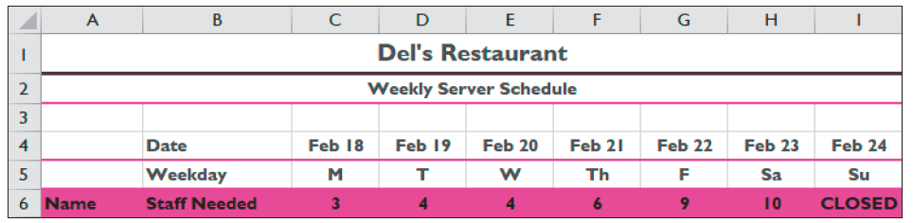
The SWITCH Function
This is a logical function that can simplify nested functions in some situations.
It compares “an expression” to a list and returns the desired result for the matching value.
In this example, the SWITCH function evaluates the date in row 4 to return a short text entry in row 5 and the number of staff needed in row 6.

Slide 15
Troubleshooting Formulas
The Trace Precedents and Trace
Dependents auditing tools help
identify cells used in a formula.
Trace Precedents works backwards to show which cells affect the formula result.

Slide 16
Troubleshooting Formulas (cont.)
Trace Dependents looks forward to show any cells using the current formula cell.
Tracing your formulas
  Check accuracy with tracer arrows.
  Trace a cell or a formula.
  Continue clicking the Trace Precedents or Trace
  Dependents button to see all references.

Slide 17
Checking for Errors
The Error Checking tool spots and corrects formula errors.
Errors are indicated by a green indicator triangle in the upper-left corner of a cell.
Warning sign displays after clicking cell with error
Green error-indicator triangle
Warning sign options

Slide 18
Evaluate a Formula
This is an auditing tool that allows you to see a breakdown of how the formula was created to look for errors.
Underlining indicates which step is being evaluated.

Slide 19
3-D Cell References
You can refer to data in multiple worksheets at the same time.
  Compare the two formulas:
  =SUM(January!A5+February!A5+March!A5)
  =SUM(January:March!A5)
The second one uses a 3-D cell reference!
Data on new inserted sheets in the range are automatically included in the formula.

Slide 20
Introducing Lookup Functions
Lookup functions retrieve data from one table using a piece of information from a single record.
The VLOOKUP and HLOOKUP Functions
  They are the most commonly used Lookup functions.
  VLOOKUP looks for information arranged in columns.
  HLOOKUP looks for information arranged in rows.

Slide 21
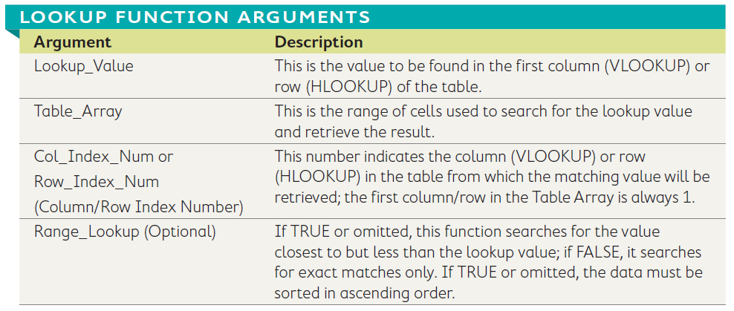
VLOOKUP and HLOOKUP
The VLOOKUP AND HLOOKUP functions use the same arguments:

Slide 22
VLOOKUP and HLOOKUP (cont.)
Lookup_Value: This is the amount in column B each customer spent.
VLOOKUP example: Look up the amount each customer spent to date to determine the discount:
Table_Array: Cell range E3-F7 contains data to look up.
Col_Index_Num: Column 2 (F) of the table array contains the value to retrieve.

Slide 23
The Outline Feature
Used to group related information by columns or rows
Create outline manually or by using Auto Outline
Outline lets you control which data to display
Show or hide column details with the buttons at the top.
Show or hide row details with the buttons along the left side.

Slide 24
The Outline Feature (cont.)
First, insert formulas that sum or subtotal information from groups of rows or columns.
Auto Outline will recognize the distinct areas of data and group them accordingly.
Auto Outline then adds the outline structure along the top and left sides so the view can be adjusted.

Slide 25
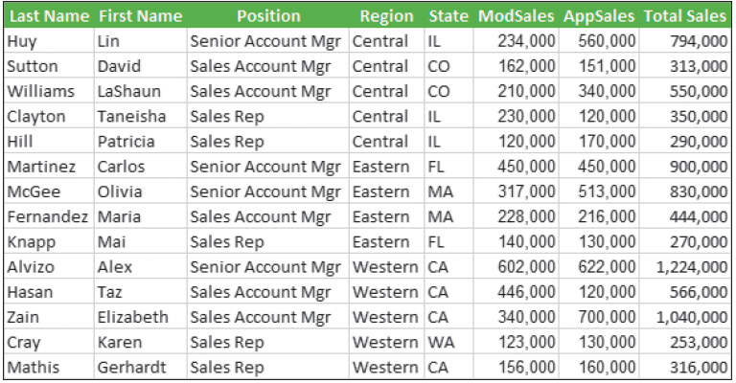
Creating Subtotals
This is somewhat simpler and quicker than creating an outline.
  If data has no dividers or subtotals, the Subtotal command is the best option.
Then you issue the Subtotal command and set the options (check out the next slide for the result).
Start by sorting the list by the column you wish to use to group the subtotals (Region).

Slide 26
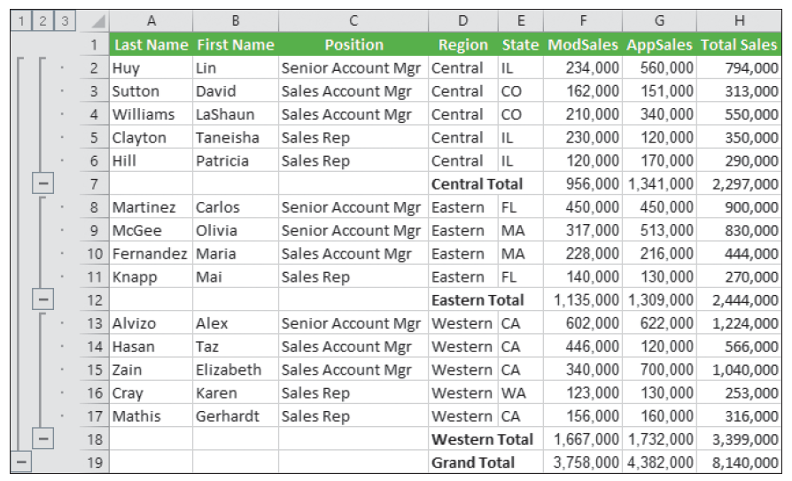
Subtotals
This figure shows the result of the Subtotal operation shown on the previous slide.
Note the similarity between using the Subtotal and Outline features.

Slide 27
Using the Quick Analysis Tool
This is a quick, easy way to access popular analysis options without using the Ribbon commands.
The Quick Analysis tool button only appears when the mouse is near a selected range.
Options contain five categories
based on the type of selected data.

