Slide 1

COMP 1100
Data Modeling & Management
David J Stucki
Otterbein University
Notes:
Bring Wirth & playing cards

Slide 2
ALERTS
  Projects due Thursday, April 4
  Power BI In-Class Assignment 10 due Thursday
  Power BI Homework 11 available Thursday, due next Thursday
  Questions?

Slide 3

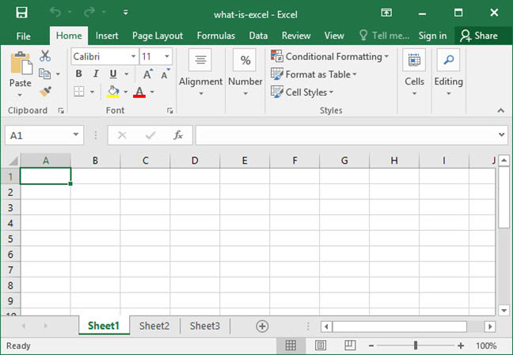

Excel: What is it?
How many of you have used Excel?
  What for?
What is it good for?
What would you consider to be
its essential/must have features?
What does it have to do with
data modeling & management?
Remaining slides thanks to

Slide 4
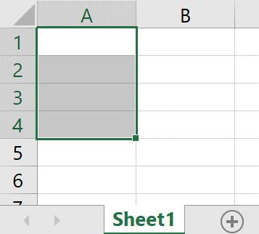
Introducing Excel
For working with numbers, formulas and data
Performs calculations
What is a worksheet?
  Made up of rows and
  columns of individual cells
Cell ranges
  Group of cells
Cell A1
Columns
Rows
Cell range A1:A4
Worksheet tab

Slide 5
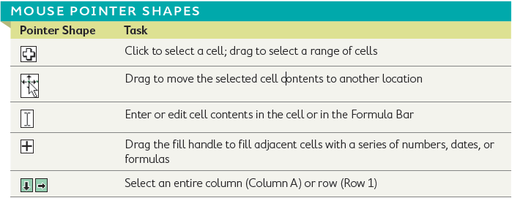
Cell Selection and the Mouse Pointer
The shape of the mouse pointer determines what you can do with it!

Slide 6
Entering and Editing Data
You can enter text, numbers, or a calculated value.
Name box
Formula bar
Data entered
in cell A1

Slide 7
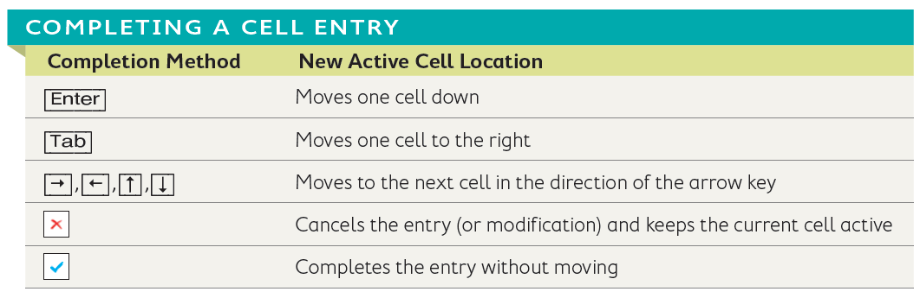
Entering and Editing Data
Completing cell entries
  [Enter] or [Tab] keys
  One of the four arrow keys
  Cancel and Enter buttons
Cancel and Enter

Slide 8
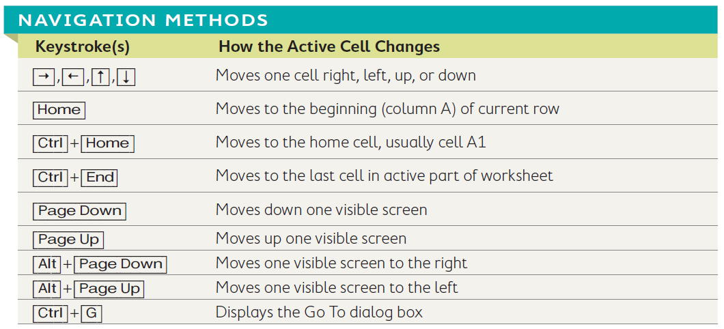
Navigating Around a Worksheet
Worksheets have 1,048,576 rows and 16,384 columns max.
Use keystrokes or mouse clicks to navigate.
Type a cell name in the Name Box.
Name Box

Slide 9
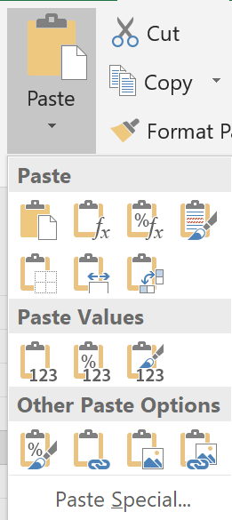
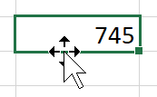
Rearranging Data in Excel
Pasting options
  Found on the Ribbon, shortcut menu, and Paste Options button
Quickly move data
  Use move pointer over the cell border and drag
  [Ctrl] while dragging to copy cell contents.
The move pointer has four-arrows showing you can move the selection in any direction.
The paste options displayed from the Ribbon.

Slide 10

Adjust Column Width and Row Height
Select row(s) or column(s) before adjusting.
Use AutoFit.
Use Ribbon commands for precise settings.
Drag the row or column header to manually adjust.
Drag to the left or right to change a column’s width when you see the double arrow.

Slide 11
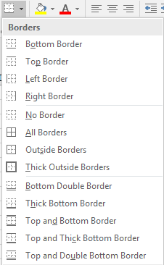
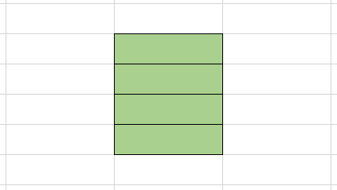
Formatting Cells
Borders and Fill
  Borders add lines around the cells.
  Fill adds color shading inside a cell.
Fill button
Border button and menu
This range of four cells is filled with a green color and has black borders around each cell within it.

Slide 12
Cell Alignment
Default alignments:
  Text entries are left-aligned.
  Number entries are right-aligned.
Merge and Center: Merge multiple cells together and center the contents across them.
Before Merge & Center
After Merge & Center

Slide 13
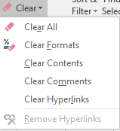
Clear Formatting and Clear All
All (Everything)
Formatting – leaves data in selected cells
Contents – leaves formats in selected cells
Comments
Hyperlinks
Tip! When you click the Clear button in the Editing group on the Home tab,
you will see a menu that allows you to choose what you want to clear.

Slide 14
Working with Numbers and Dates
The Number group on the Home tab allows you to choose how numbers in selected cells will appear.
Negative Numbers
  Represented with a – (minus) sign, red digits, brackets, or both red digits and brackets
Date Entries
  Best way to enter: MM/DD or MM/DD/YY
The dialog box launcher opens a window where you can choose from additional options to format your numbers.

Slide 15
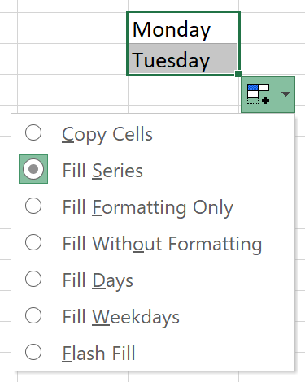
Enter a Series Using AutoFill
Using AutoFill to fill a series
  Quickly extend a series, copy data, or copy a formula into adjacent cells with the fill handle
Copy an entry
Using the AutoFill Options button
  Offers options for how the fill is completed
Fill handle
When you use the fill handle you can use the Options button to change what is filled into the cells. In this case, the default is to continue the days of the week series.

Slide 16
Creating Formulas
Use formulas to perform calculations.
  Formulas are written as mathematical problems.
  Formulas always begin by typing an “=” sign.
The Formula Bar displays the formula.
The formula cell displays the result.

Slide 17
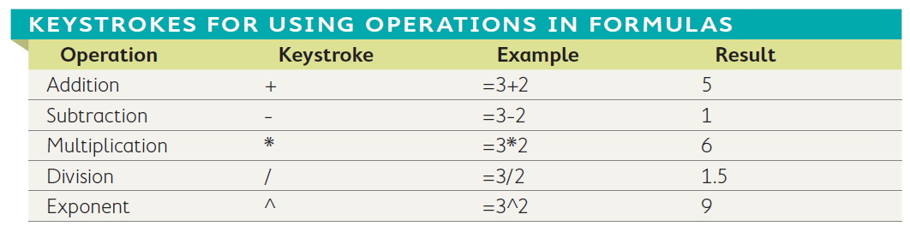
Perform Worksheet Calculations
Mathematical operator keystrokes

Slide 18
Cell References
They take the place of a number in a formula.
They make it easier to copy formulas.
Excel automatically recalculates if the value in the cell reference changes.
Cell D2 references cells B2 and C2, multiplying them together.

Slide 19
Importance of Order of Operations
If you don’t apply the order of operations properly, it can significantly change the outcome of your formula.
=5+7*10-9
Results in:
=5+70-9
=75-9
=66
=(5+7)*(10-9)
Results in:
=(12)*(1)
=12

Slide 20


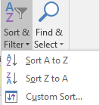
Rearrange Data on a Worksheet
You can insert and delete rows, columns, and cells.
You can hide and unhide rows and columns.
You can sort data by column.
In this example, column B and row 2 are hidden.

Slide 21
Managing Multiple Worksheets
You can insert and delete worksheets.
You can rename worksheets.
You can move a worksheet.

Slide 22
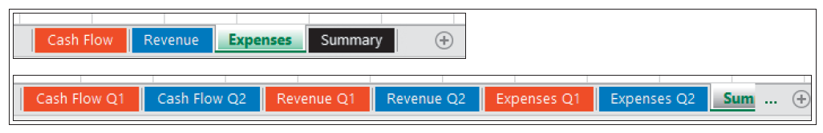

Managing Multiple Worksheets
You can change the worksheet tab color.
You can hide a worksheet.

Slide 23
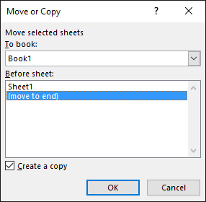

Managing Multiple Worksheets
You can create a cell reference to another worksheet.
You can create a copy of a
worksheet.
You can edit multiple sheets at one time.
Different workbook name
Worksheet name in different workbook
The Participation and Exam worksheets are grouped and now can be edited simultaneously.

Slide 24

Using Functions in Formulas
Functions allow you to easily perform mathematical operations on ranges of cells.
They start with an “=” sign, just like all formulas.
The function name follows the = sign
The function arguments are placed inside parentheses. In this case, Excel will add the values in cells D3:D7.

Slide 25
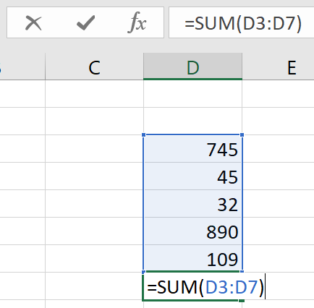
Using Functions in Formulas
They can be typed directly into a cell or inserted a number of other ways:
  AutoSum
  Formulas tab on the Ribbon
  Insert Function button
A function that sums (adds) all numbers in a range can be typed into a cell or entered using one of the other three options.

Slide 26
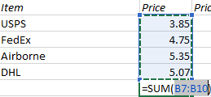
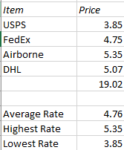
Using Functions in Formulas
Use the AutoSum feature.
AutoSum Functions
  SUM
  AVERAGE
  COUNT
  MAX
  MIN
AutoSum automatically adds adjacent cells in columns or rows.
The name of the function tells Excel which operation to perform on a selected cell range.

Slide 27
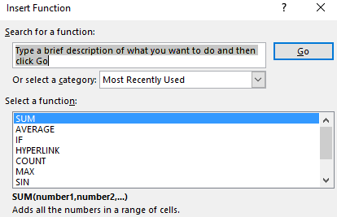
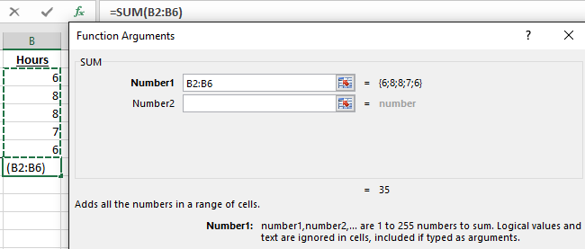
Insert Function
Clicking the Insert function button displays the Insert Function dialog box.
The many functions from which to choose.
The Function Arguments dialog box displays the range of cells to be included in the function.

Slide 28
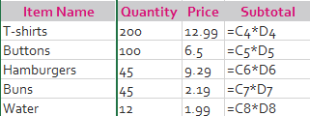
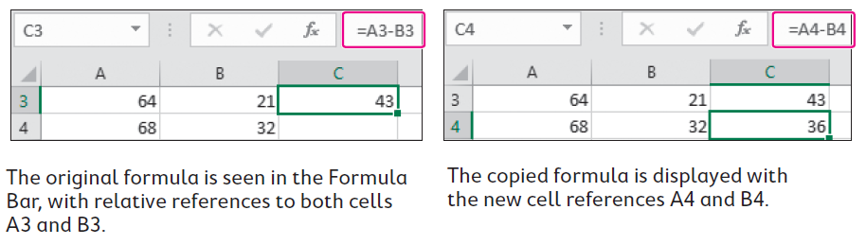
Using Relative Cell References
When you copy a formula, relative cell references update automatically and refer to new cells relative to the new formula cell.
A relative cell reference will change when it is copied from one cell to another.
Relative cell references

Slide 29
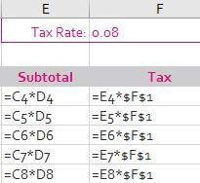
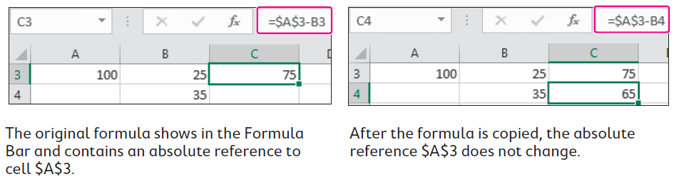
Using Absolute Cell References
Absolute references always refer to the same
cell, regardless of which cell the formula is
moved or copied to.
There are two ways to create an absolute cell reference:
  Type the cell reference, including $ in front of the column and row references.
  Use the mouse pointer to select the cell and tap [F4] on the keyboard to insert the dollar signs.
NOTE! Absolute cell references are denoted with $ signs.

Slide 30
Mixed Cell References
You can combine a relative and absolute reference in a cell reference.
This can be useful when copying a formula both across a row and down a column..
Tapping the [F4] key will toggle between the four different cell reference options.
In $C5: the column reference, C, is absolute and the row reference, 5, is relative.
In C$5: the column reference, C, is relative and the row reference, 5, is absolute.

Slide 31
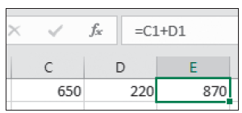
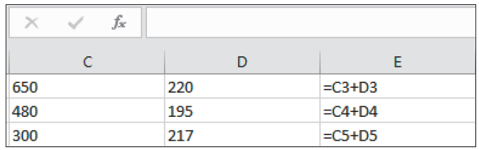
Display and Print Formulas
You can choose to display formulas, rather than the resulting values, in cells.
Normally you have to select a cell to see the formula, and it appears in the Formula Bar.
When Show Formulas is turned on, you see the formulas in the worksheet but not in the results.
TIP! Use the Show Formulas button, found in the Formula Auditing group on the Formulas tab of the Ribbon, to toggle between displaying formulas and values.

Slide 32
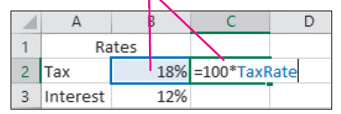
Creating Names for Cells and Ranges
Use names for a range of cells used often in formulas.
  Easier to remember than a cell range
  Cannot contain a space
A cell name in a formula acts as an absolute cell reference.
Name Box displaying name of selected cell(s)
Notice how the cell name is used in the formula and what the resulting value is.

Slide 33
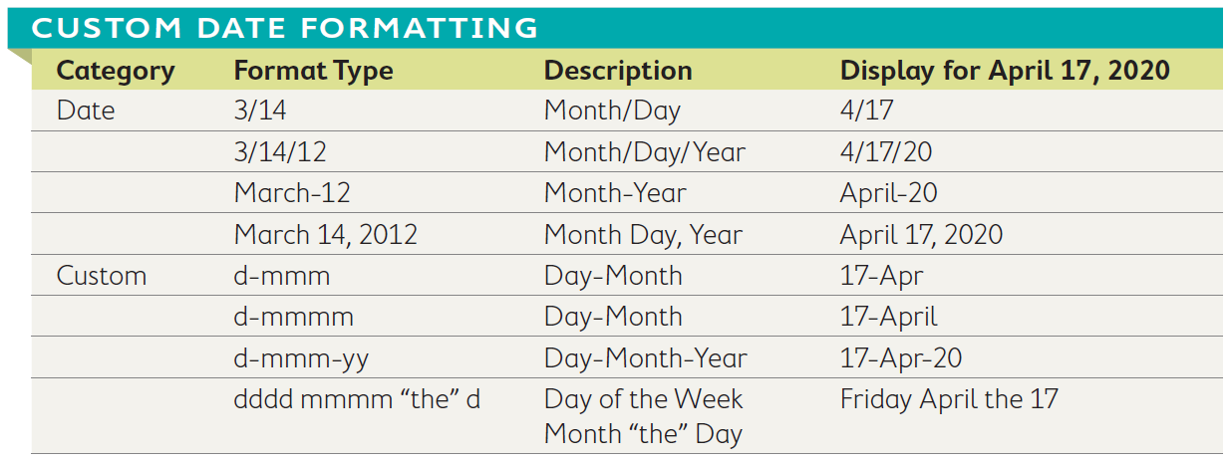
Date Serial Numbers
Dates are stored as sequential serial numbers.
Dates stored as serial numbers allow dates to be used in calculations.
You can apply custom date formatting.
The formula in cell C2 is: =B2-A2

Slide 34
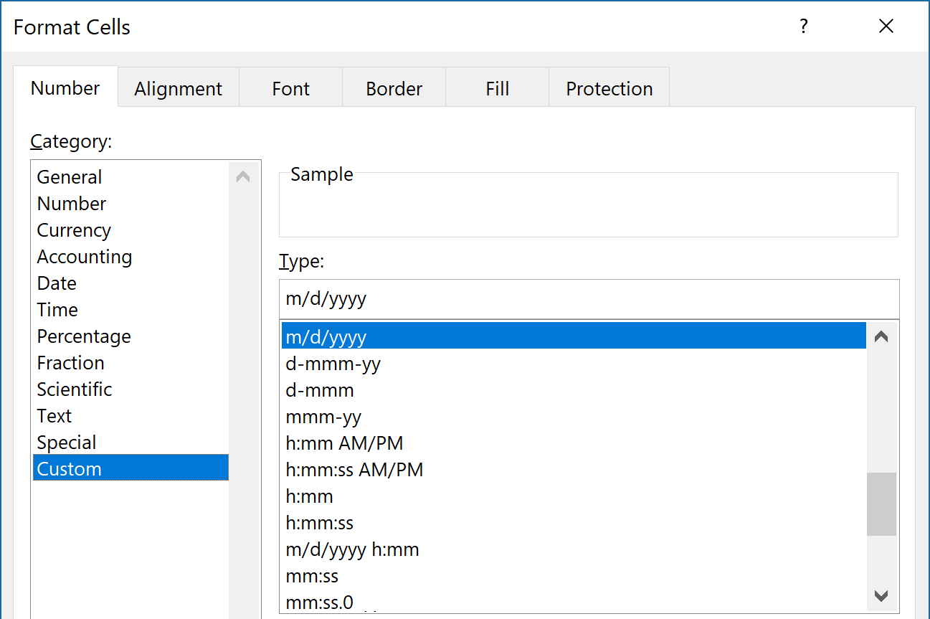
Applying Custom Date Formatting
There are custom date format codes:
  Day, Month, and Year (d, m, and y)
  Slash and Dash (/ and –)
Set them up in the Format Cells dialog box.

Slide 35
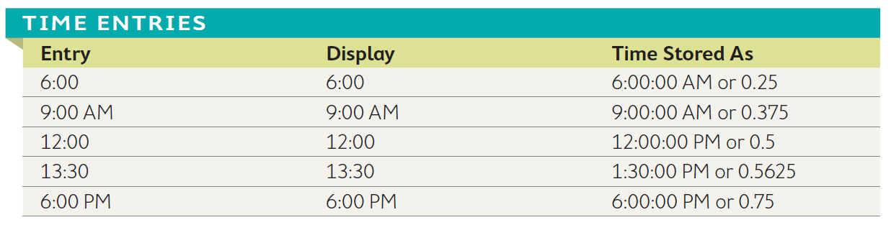
Entering Time Information
Times have serial numbers attached, like dates.
Excel applies the correct custom number formatting.
  Example: Excel knows that 6:00 is 6:00 AM because it assumes you are using a 24-hour clock.
Times can be customized.
Note the difference between how an entry is displayed and how it is stored in Excel.

Slide 36
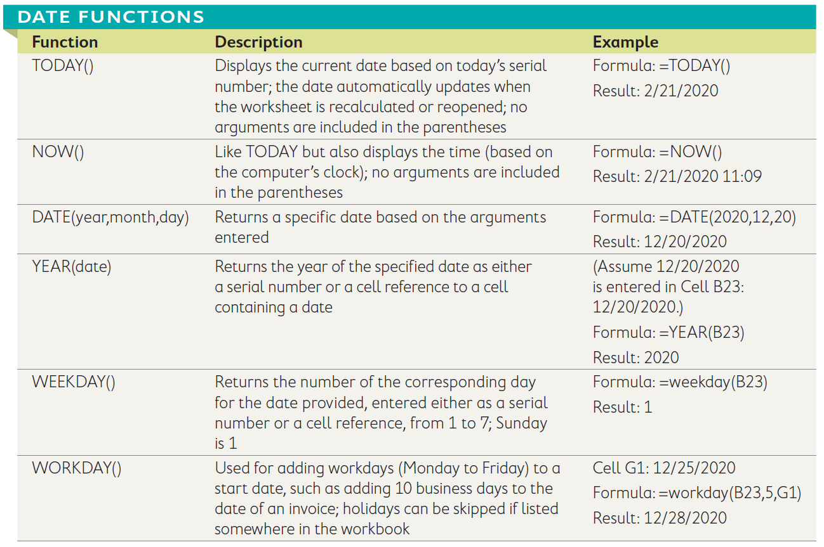
Using Date Functions
Dates provide important information and are even more valuable when used in functions.

Slide 37
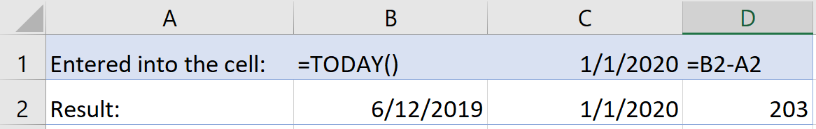
Calculations Using Date and Time
Use mathematical operations in date and time formulas.
  You can subtract to find the number of days between two dates or two times.
  You can add a number of days to a particular date.
You can combine a formula with a date function.
In this example a function is used for the current date and a formula is used to calculate the number of days until 2020.

