Slide 1

COMP 1100
Data Modeling & Management
David J Stucki
Otterbein University
Notes:
Bring Wirth & playing cards

Slide 2
ALERTS
  Projects due Thursday, April 4
  Quiz #3 next Thursday
    Quizzes and the syllabus...
  Power BI
    Installation issues?
    New assignment

Slide 3

Power BI: What is it?
From Microsoft's marketing materials:
Power BI is a collection of software services, apps, and connectors that work together to turn your unrelated sources of data into coherent, visually immersive, and interactive insights. Your data might be an Excel spreadsheet, or a collection of cloud-based and on-premises hybrid data warehouses. Power BI lets you easily connect to your data sources, visualize and discover what's important, and share that with anyone or everyone you want.

Slide 4
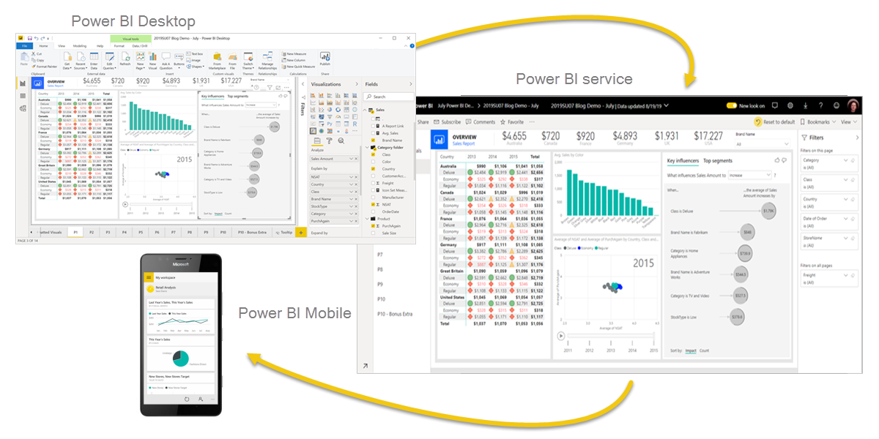
Power BI: What is it?
Power BI consists of several elements that all work together, starting with these three basics:
A Windows desktop application called
Power BI Desktop.
An online software as a service (SaaS) service called the Power BI service.
Power BI Mobile apps for Windows, iOS, and Android devices.

Slide 5
Power BI: What is it?
The next several slides are from a Microsoft promotional presentation
They will give you an idea of how Power BI fits into the larger Office 365 ecosystem.

Slide 6



A powerful new way to work with data
Self-service business intelligence and analytics with Excel and the power of the cloud
Analyze in Excel
1 Billion Office Users
Collaborate in Power BI for Office 365
1 in 4 enterprise customers on Office 365
Discover
Analyze
Visualize
Share
Question
Mobility
Q&A
Scalable | Manageable | Trusted
Notes:
Our Approach:
Excel is the most commonly used analytical tool for business users – it truly is accessible to anyone. No other vendor has the ability to reach a billion users through tools they already know and use. Today Excel delivers end-to-end self-service BI functionality through capabilities such as Power Query, Power Pivot, Power View and Power Map. With the accessibility of Excel and proliferation of Office 365, we can lower the barrier of entry for businesses who want to take advantage of the benefits of business intelligence by putting the right analytics tools in everyone’s hands with no friction.
Ease of deployment through Office 365.. Power BI dramatically simplifies and reduces the time it takes for IT to setup and manage the complex infrastructure needed for an enterprise wide BI platform. Power BI enables businesses to balance between the needs of business users working in Excel and an IT department’s requirements for agility, monitoring and governance. IT can also provide business users the ability to search and access IT sanctioned corporate data sources both on premises and in the cloud while monitoring query usage against their data.

Slide 7
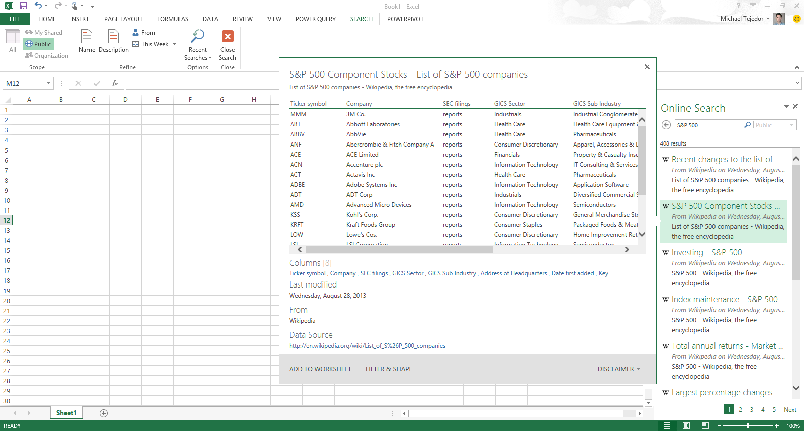
Analyzing data with Excel
Easily discover and access public and corporate data
Discover
Analyze
Visualize
Explore
Notes:
Powerful Self-Service BI in Excel 2013: We are taking our most powerful business intelligence solutions and building them directly into Excel.
There has never been such an abundance of available and useful information as there is today both across the web and across your organization. However, users are challenged with effectively discovering and connecting to this information so that they can gain the insights they need.
Power Query enables information workers with a familiar and intuitive experience for finding and connect to data from within Excel. Providing them with ease of combining and transforming this data so that it can be analyzed and visualized for deeper insight. Power Query supports a wide variety of data sources including relational, structured and semi-structured data, OData, data from the Web, Hadoop, as well as Data Search capabilities that provide users with a search experience for data, returning relevant data sets from across the enterprise and from external sources.

Slide 8
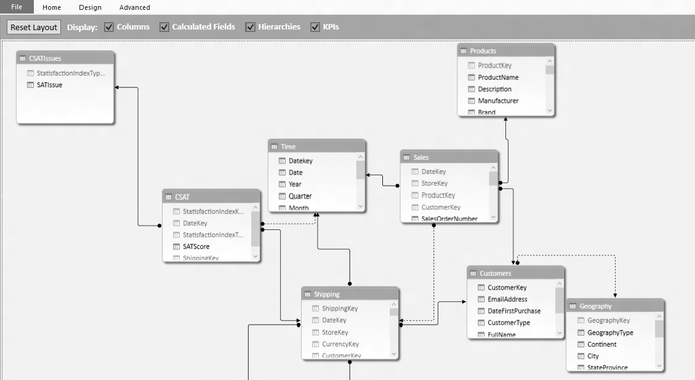
Analyzing data with Excel
Model & analyze 100’s of millions of rows of data
Discover
Analyze
Visualize
Explore
Notes:
Power Pivot allows Excel users continue to create sophisticated models with data in Excel by creating relationships, custom measures and calculations, hierarchies, and KPI’s. Power Pivot models process data in-memory so that users can analyze 100’s of millions of rows of data with lightning fast performance. Power Pivot also compresses the data to reduce file sizes.

Slide 9
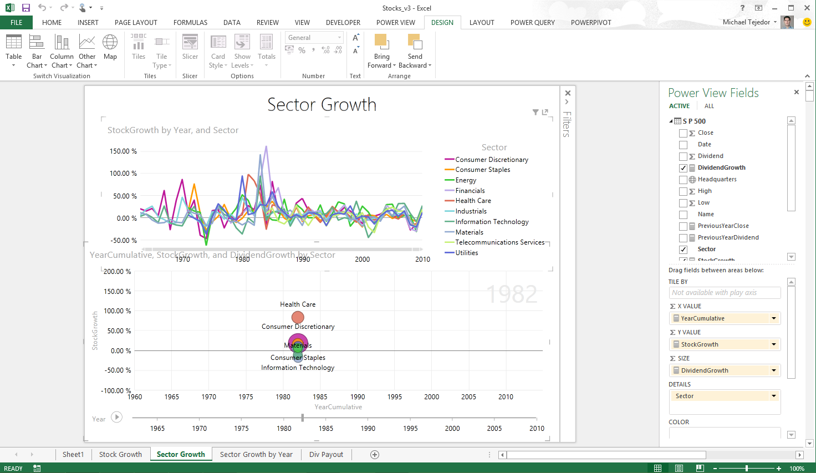
Analyzing data with Excel
Explore your data with interactive visualization
Discover
Analyze
Visualize
Explore
Notes:
In Excel 2013 we also introduced a host of new visual capabilitie. Quick Analysis provided immediate views of various visualization options and reduced the time to add them on your data, Chart Recommendations used intelligent heuristics to suggest charts. The charting functionality provided live preview, richer data labels, and easier ways to add chart elements, apply styles, and filter directly from the charts.
Excel 2013 also introduced Power View, and with it brought beautiful interactivity to visualizations and more fluid exploration capabilities.
Power View easily creates visual reports and analytical views through interactive charts and graphs that help you explore and present your data in bold new ways in Excel. Customers can create dashboards of interactive visualizations that provide instant answers to variety of questions. This capability has resonated well with our customers, one of whom mentioned the rigidity of static snapshots during meetings has been replaced by the “Power View lifestyle”, their term for the transformational way of presenting and using information.

Slide 10
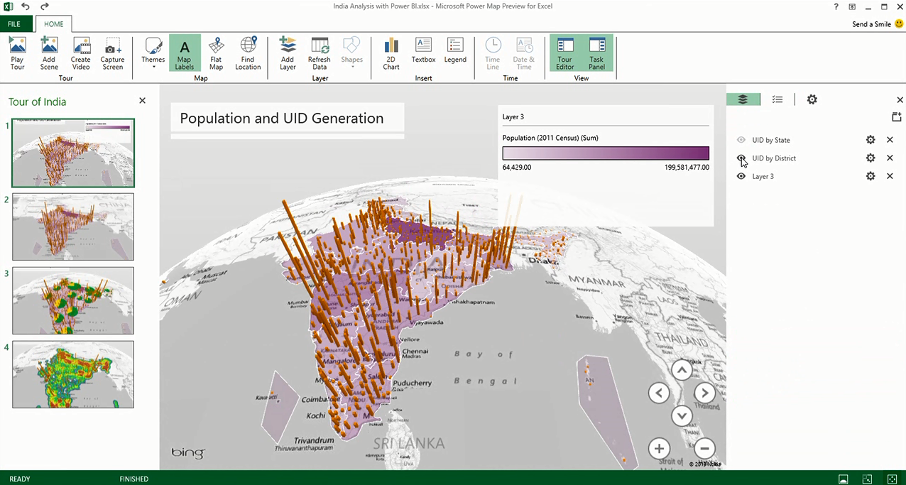
Analyzing data with Excel
Uncover new insights with 3D geospatial analysis
Discover
Analyze
Visualize
Explore
Notes:
Increasingly, we have access to geospatial data, and recently introduced Power Map brings new 3D visualization tool for mapping, exploring, and interacting with geographical and temporal data to Excel, enabling people to discover and share new insights such as trends, patterns, and outliers in their data over time. In addition, with Power Map, users can easily capture and distribute their insights in the form of an interactive movie, telling compelling stories about their data.
Inspiration for Power Map came from Microsoft Research’s WorldWide Telescope project. Launched in 2008, WorldWide Telescope is used by the astronomy community to visualize imagery and data, essentially giving astronomers an observatory in a PC.
What’s Next?
The importance for data visualization is on the rise. Deeper interactivity that blend analysis and visualizations even more fluidly, newer types of visualizations that enable you to see deeper insights more easily, richer experiences on the devices customers use most, and great storytelling experiences are just a few of the areas we’re investing in to make sure Excel remains the data productivity app of choice as our customer needs evolve.

Slide 11
A powerful new way to work with data
Self-service business intelligence with familiar Excel and the power of the cloud
Analyze in Excel
1 Billion Office Users
Collaborate in Power BI for Office 365
1 in 4 enterprise customers on Office 365
Discover
Analyze
Visualize
Share
Question
Mobility
Q&A
Scalable | Manageable | Trusted
Notes:
Power BI for Office 365 is a complete self-service BI solution delivered through Excel and Office 365 that provides data discovery, analysis, and visualization capabilities to identify deeper business insights from data in Excel. The Power BI for Office 365 service is a cloud-based solution that enable collaboration and reduces the barriers to deploying a BI environment for sharing reports and accessing information.

Slide 12
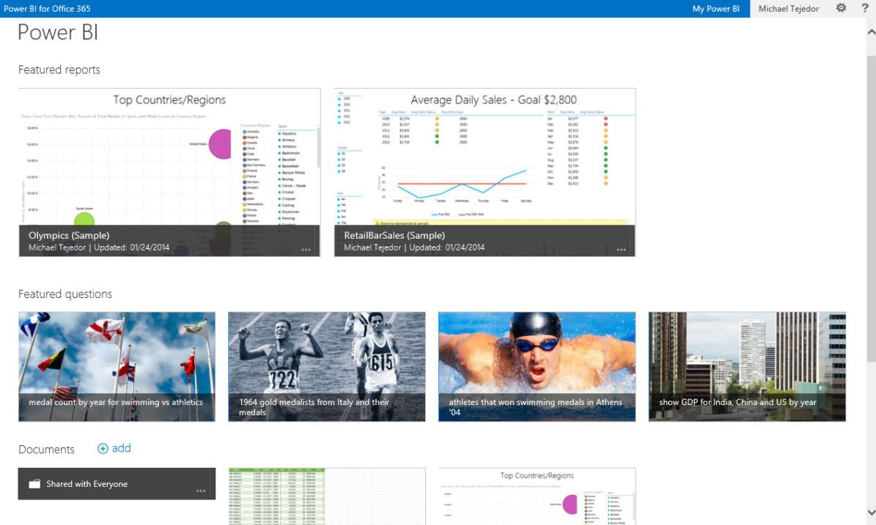
Share & collaborate with Power BI for Office 365
BI Sites
Quickly create collaborative BI sites
Shared Queries
Data Refresh
Data Search
Mobile Access
Natural Language Questions
Notes:
Collaborate and stay connected with Office 365: Extends Self-Service BI with ease of collaboration and sharing of reports and data sets which reducing friction from deployment and adoption.
Power BI Sites – quickly create collaborative BI sites for your team to share reports. Larger workbook viewing is now supported (up to 250MB) so that users can view and interact with larger workbooks through the browser. Power BI sites provide a highly visual experience for sharing reports including live report tiles to ease in locate the right report quickly.

Slide 13
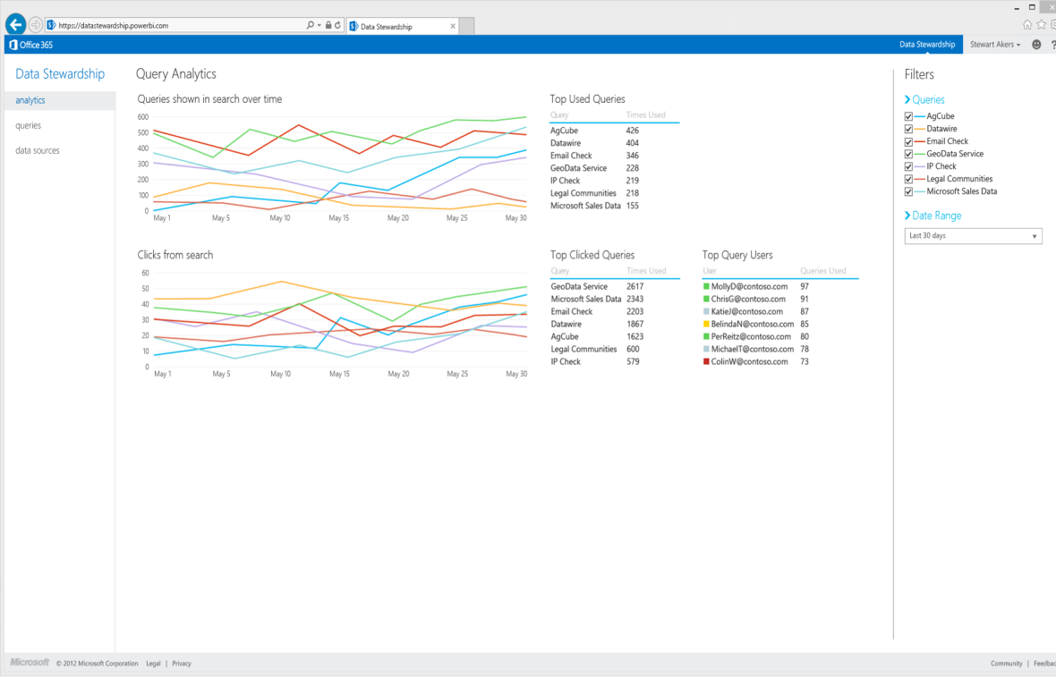
Share & collaborate with Power BI for Office 365
BI Sites
Manage data queries for the team
Shared Queries
Data Refresh
Data Search
Mobile Access
Natural Language Questions
Notes:
Manage data queries for the team
With Power BI people can share not only workbooks but also the queries they create using Power Query in Excel. This allows members of the team to build and manage data queries for others to use when creating their own reports.
Once published to Power BI users can define who they want to share their data queries with and track who’s accessing which queries. Data queries are registered with the Data Catalog so that they can be easily discovered through data search in Excel. If a user tries to access a query but they do not have access to the underlying data source, a workflow will allow them to request access from the DBA responsible for the data.

Slide 14
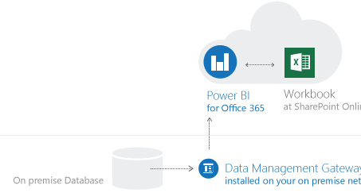
Share & collaborate with Power BI for Office 365
BI Sites
Keep reports up to date with scheduled data refresh
Shared Queries
Data Refresh
Data Search
Power BI
for Office 365
Workbook
Cloud
Mobile Access
On Premise
Data Management Gateway
Installed on-premises
Natural Language Questions
Notes:
Keep reports up to date with data refresh
A cloud based Business Intelligence solution must enable you to keep your reports connected to your on-premises data to keep their data fresh.
Keep your reports up to date by scheduling when the data should refresh. The Data Management Gateway allows reports that have been saved to the cloud to connect back to on-premises data sources to refresh data.
Scheduled data refresh for your reports
Connect cloud based report to on-premises data
The data management gateway is installed and configured by IT on-premises, and enables reports to connect through the firewall back to their underlying data sources.

Slide 15
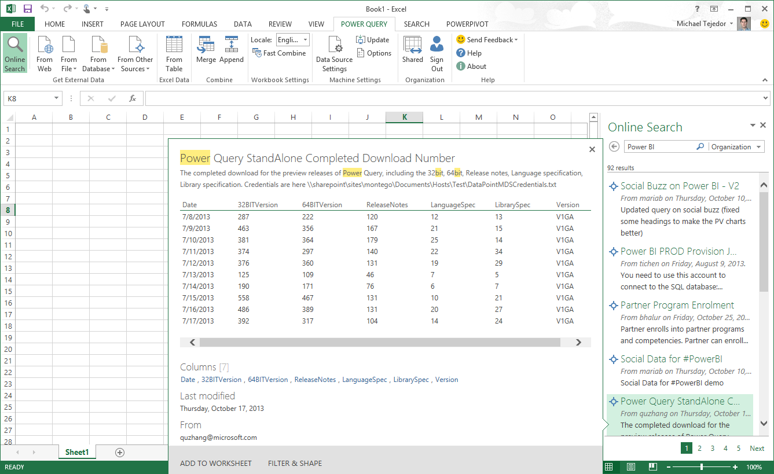
Share & collaborate with Power BI for Office 365
BI Sites
Maintain a data catalog of searchable data
Shared Queries
Data Refresh
Search for:
Public Data
Corporate Data
Shared Queries
Data Search
Mobile Access
Natural Language Questions
Notes:
Maintain a Data Catalog of searchable data
IT departments can now use the Data Catalog feature of Power BI to make it easier for everyone to find and connect to corporate data.
The Data Catalog is a feature of Power BI which serves as a search engine for data, the IT department can register data from across the organization with the Data Catalog. This data is then searchable from within Power Query in Excel so that users can easily find and connect to corporate data they need without having to call IT with one off data requests.
When searching for data from Excel, users will now receive results from public data sources, corporate data sources managed by IT, as well as data queries that colleagues are publishing into Power BI. Making it easier to discover what connect exists and reducing duplicative efforts across the organization.
The Data Catalog also tracks data access and usage across the organization, providing IT with better telemetry for data governance and resource allocation.

Slide 16
Share & collaborate with Power BI for Office 365
BI Sites
Stay connected with mobile access to your reports
Shared Queries
Data Refresh
Data Search
Mobile Access
Natural Language Questions
Notes:
Stay connected with mobile access to your reports
Mobile BI access to reports in Office 365 is provided through two mechanisms. First, Excel and Power View reports now render in HTML5 so that you can access these reports from any HTML5 compatible browser, on any device. The second, is through native mobile BI apps connect to the Power BI service to keep users connected to their favorite reports, which they can view and explore from their tablet devices. Windows 8.1 tablet devices will be supported are currently supported and iOS will be supported in H2 of CY2014.

Slide 17
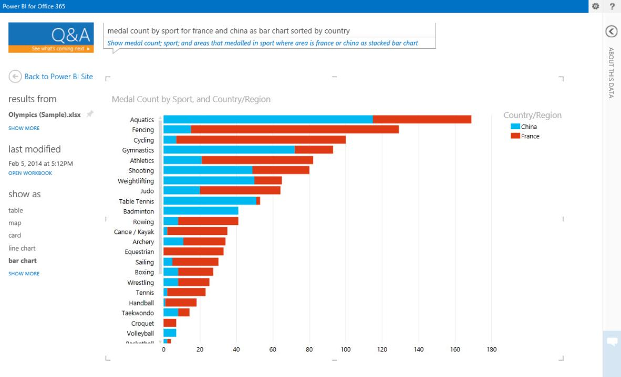
Share & collaborate with Power BI for Office 365
BI Sites
Ask questions of your data in natural language
Shared Queries
Data Refresh
Data Search
Mobile Access
Natural Language Questions
Notes:
Power BI enables business users to interact with their data in natural language. The natural language query capability allows users to ask questions of their corporate data and get instant and visual results. The experience is instantaneous and uses natural language query. Q&A interprets the semantics of the question the user is asking and serves up the correct interactive chart or graph.
It’s as easy as going to a colleague to ask a question. This dramatically increases how many business users can get more value from their existing BI solutions.

Slide 18
Power BI: Demo
Let's fire it up and see how it works...

