Slide 1
COMP 1100 Data Modeling & Management
David J Stucki
Otterbein University
Notes:
Bring Wirth & playing cards

Slide 2
SQL Retrieval
SQL retrieval operation: SELECT statement
SELECT <attributes>
FROM <tables>
WHERE <condition>;
<attributes> - Projection attributes
<condition> - Selection condition

Slide 3
SQL Retrieval
Wildcards in the select clause
Retrieve all of the attributes
SELECT *
FROM EMPLOYEE;
This would return all employee data from the EMPLOYEE table

Slide 4
SQL Retrieval
Duplicate elimination
In a pure relational model, no relation would have duplicate tuples
But SQL does allow duplicate tuples in a relation
So long as there is no conflict in their primary keys
…but if there’s no primary key defined in a table, it can have duplicate entries

Slide 5
SQL Retrieval
Even on tables that have a primary key, sometimes queries will return duplicates
If we’re only getting a limited number of attributes, there could be overlap in those attributes
If we want to remove duplicates, we use the DISTINCT keyword
SELECT DISTINCT Salary
FROM EMPLOYEE;
This would return only the unique SALARY entries from the EMPLOYEE table, removing duplicate entries

Slide 6
SQL Retrieval
Wildcards in the WHERE clause
Sometimes we don’t want to match a whole attribute completely
A partial match is enough
We can use a wildcard in the WHERE clause to accomplish this
SELECT Fname, Lname
FROM EMPLOYEE
WHERE Address LIKE ‘%Houston%’;
If we really need a ‘%’ literal character, we need to escape it:
SELECT Product_name
FROM PRODUCTS
WHERE Discount LIKE ‘%5\%’;

Slide 7
SQL Retrieval
Arithmetic in queries
SELECT Lname, 1.1*Salary AS Increase
FROM EMPLOYEE;
This would give us back all of the employee last names with their salary increased by 10%
Note that it doesn’t change what’s in the database – just what is reported by the query
Ranges
SELECT *
FROM EMPLOYEE
WHERE Salary >= 30000
AND Salary <= 400000;

Slide 8
SQL Retrieval
Ordering
We can force the query to come back in a particular order
Very useful for reports and for debugging
SELECT *
FROM EMPLOYEE
ORDER BY Lname, Fname, Super_ssn;

Slide 9
More Complex Retrievals
SQL Query Syntax:
SELECT <attribute(s)>
FROM <table(s)>
[ WHERE <condition> ]
[ GROUP BY <attribute(s)> ]
[ HAVING <group condition> ]
[ ORDER BY <attribute list> ]

Slide 10
WHERE conditions -NULL
Comparisons involving NULL
NULL has three possible meanings:
Unknown value
Withheld value
Not Applicable value
Often not possible to tell which meaning is intended
SQL itself does not distinguish between different meanings for NULL (need to deal with that in applications)
When making comparisons, SQL considers NULL to mean “Unknown”
Three-valued logic – TRUE, FALSE or UNKNOWN

Slide 11
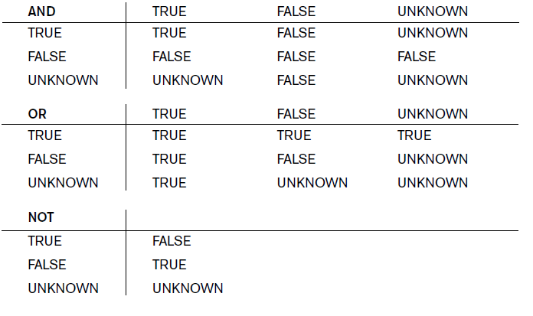
Three-valued logic

Slide 12
WHERE conditions - NULL
Note that because NULL means “Unknown”, we can’t test for equality to NULL
SELECT *
FROM EMPLOYEE
WHERE Super_ssn = NULL
Instead we use “IS” or “IS NOT” when looking for NULL values
SELECT *
FROM EMPLOYEE
WHERE Super_ssn IS NULL

Slide 13
WHERE Condition - Nested Queries
Use an SQL query (nested query) as the where condition for another SQL query (outer query)
SELECT Pname
FROM PROJECT
WHERE Pnumber IN
(SELECT Pnumber
FROM PROJECT, DEPARTMENT, EMPLOYEE
WHERE Dnum=Dnumber AND
Mgr_ssn=Ssn AND Lname=‘Wong’)

Slide 14
WHERE Condition - Nested Queries
Each nested query is just a boolean expression – can chain them together like other expressions
SELECT Pnumber
FROM PROJECT
WHERE Pnumber IN
(SELECT Pnumber
FROM PROJECT, DEPARTMENT, EMPLOYEE
WHERE Dnum=Dnumber AND
Mgr_ssn=Ssn AND Lname=‘Wong’)
OR Pnumber IN
(SELECT Pno
FROM WORKS_ON, EMPLOYEE
WHERE Essn=Ssn AnD Lname=‘Wong’);

Slide 15
WHERE Condition - Nested Queries
Can also use tuples instead of a single value in the where condition:
SELECT Essn
FROM WORKS_ON
WHERE (Pno, Hours) IN
(SELECT Pno, Hours
FROM WORKS_ON
WHERE Essn=‘123456789’);

Slide 16
WHERE Condition - Nested Queries
Can use the AS keyword to be able to refer to attributes at various scopes:
SELECT E.Fname, E.Lname
FROM EMPLOYEE AS E
WHERE E.Ssn IN
(SELECT Essn
FROM DEPENDENT AS D
WHERE E.Fname = D.Dependent_name
AND E.Sex = D.Sex);

Slide 17
WHERE Condition - Nested Queries
When an inner query references some attributes of a relation declared in an outer query, the queries are correlated:
SELECT E.Fname, E.Lname
FROM EMPLOYEE AS E
WHERE E.Ssn IN
(SELECT Essn
FROM DEPENDENT AS D
WHERE E.Fname = D.Dependent_name
AND E.Sex = D.Sex);

Slide 18
WHERE Condition - Nested Queries
Correlated nested queries can always be rewritten as a single-block query with a bit of thought:
SELECT E.Fname, E.Lname
FROM EMPLOYEE AS E, DEPENDENT AS D
WHERE E.Ssn = D.Essn AND E.Sex = D.Sex
AND E.Fname = D.Dependent_name;
Think of the nested query as being run once for each tuple in the outer query
This is equivalent to the block query above

