Slide 1
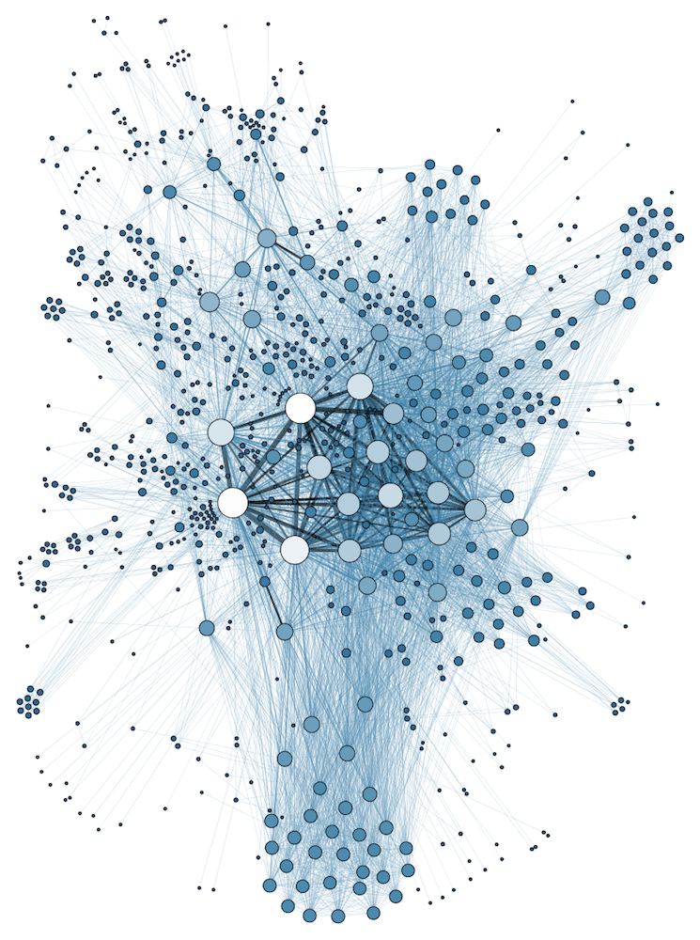
COMP 1100
Data Modeling & Management
David J Stucki
Otterbein University
Notes:
Bring Wirth & playing cards

Slide 2
ALERTS
  Access Week 6 is due Sunday before 11:59pm

Slide 3
Informal Design Guidelines (part 1)
Guideline 1
  Design relation schema so that it has an easy-to-explain meaning
  Do not combine attributes from multiple entity types or relationship types into a single relation

Slide 4
Informal Design Guidelines (part 2)
Guideline 2
  Design relation schemas so that no insertion, deletion or modification anomalies are present in the relations
  This ends up being equivalent to designing relation schemas so that no redundant information exists in tuples

Slide 5
Informal Design Guidelines (part 3)
Guideline 3
  Design relation schemas to avoid attributes that will frequently have NULL values
  If NULLs must be used, make sure they are the exceptional cases and not the typical value for the attribute for the majority of tuples

Slide 6
Informal Design Guidelines (part 4)
Guideline 4
  Design relation schemas to join using equality conditions on appropriate attributes – primary key/foreign key
  Don’t build relations that contain matching attributes that are not primary key/foreign key matches

Slide 7
Normalization
What is normalization?
  A process where we examine and revise our relation schemas based on their functional dependencies and primary keys
    Normalization attempts to improve the quality of our database by:
      Minimizing redundancy in our stored data (relation sets)
      Minimizing the number of update anomalies in our stored data
  Provides database designers with:
    A formal framework for analyzing relation schemas
    A series of tests that allow us to have different degrees of normalization on our data, depending on our needs

Slide 8
Normalization
Define: Normal Form
  A criteria for determining how vulnerable a relation is to logical inconsistencies (update anomalies or redundancy)
  Different levels of Normal Form
    1st normal form (1NF), 2nd normal form (2NF), …
    Highest Normal Form (HNF) of a relation – the highest level of normal form criteria the relation meets

Slide 9
Normalization
Normal forms by themselves do not guarantee good database design
  No “magic formula” for making a good design
  Designers must confirm additional properties in their designs:
    Lossless join property – guarantee that the spurious tuple generation previously discussed does not occur
    Dependency preservation – guarantee that if a dependency existed before altering the schema it still is represented in the altered schema

Slide 10
First Normal Form (1NF)
1NF is the most basic normal form
  So basic that since it was defined it has become part of the definition of a relation in the relational model
A relation is in 1NF if it:
  has only atomic attributes AND
  The value of any attribute must be a single value
    No multivalued attributes
    No composite attributes

Slide 11
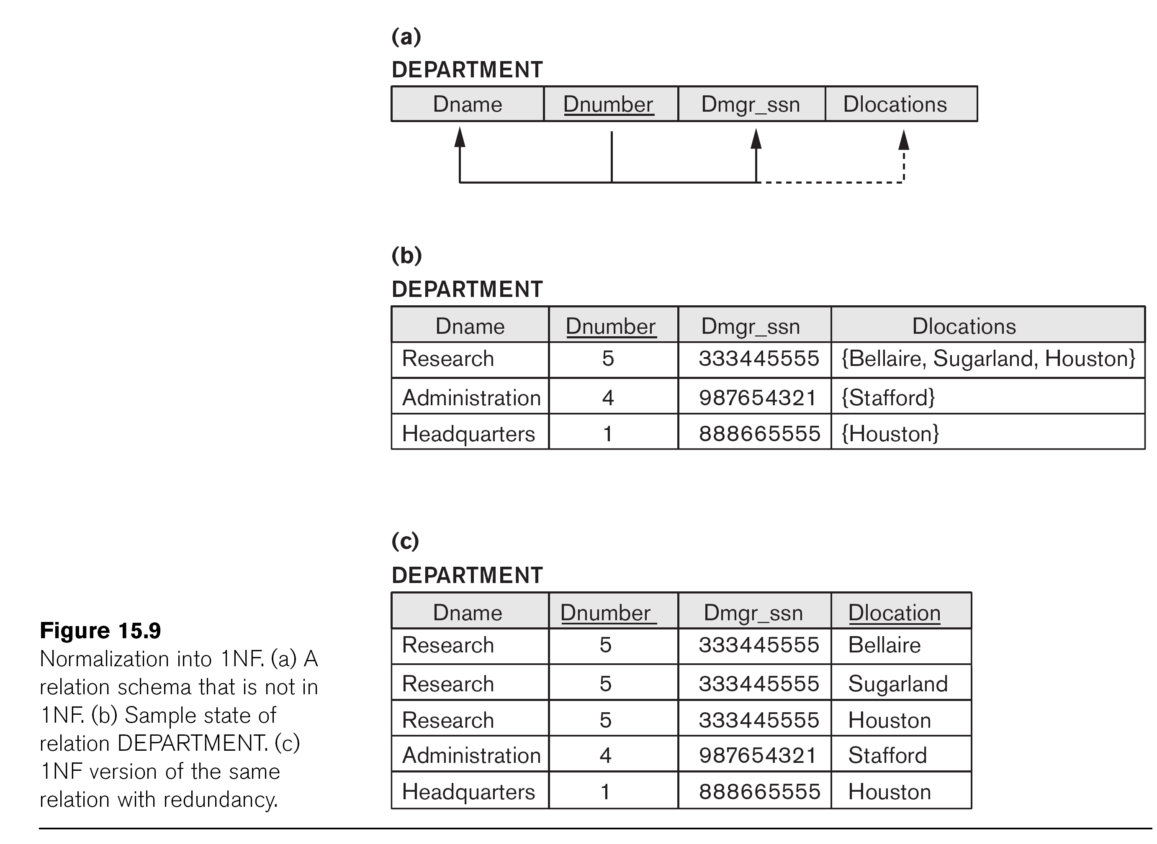
First Normal Form (1NF)
Here’s an example of a schema that is NOT 1NF
  Note that this violates our definition of a relation – Dlocations is a set rather than an atomic value
  To fix this we can do one of two things:
    Change Dlocations to be atomic and expand tuples with multiple locations into multiple tuples (adding redundant information)
    Break Dlocations out into its own relation, using Dnumber as a foreign key

Slide 12
First Normal Form (1NF)
  To fix this we can do one of two things:
    Change Dlocations to be atomic and expand tuples with multiple locations into multiple tuples (adding redundant information)
    Break Dlocations out into its own relation, using Dnumber as a foreign key

Slide 13
Second Normal Form (2NF)
2NF is a stricter normal form than 1NF
  A relation schema R is in 2NF if it is in 1NF and no nonprime attribute A in R is dependent on a subset of the primary key of R

Slide 14
Second Normal Form (2NF)
Testing for 2NF
  No test needed if the primary key has a single attribute
    Always 2NF if a relation is 1NF and has a primary key with a single attribute
  If primary key is made of multiple attributes:
    Examine your primary key and nonprime attributes
    Can you remove an attribute from your primary key and still have a dependency with at least one nonprime attribute?
      If so, relation is not 2NF

Slide 15
Second Normal Form (2NF)
Consider the EMP_PROJ relation above
  Primary key is SSN + Pnumber
    The pair uniquely determines Hours
  Remove Pnumber from key
    Ssn → Ename
      Unique Ssn determines what the Ename will be – no need for Pnumber at all
  Remove Ssn from key
    Pnumber → {Pname, Plocation}
      Pname and Plocation are both independent of the employee’s Ssn
  EMP_PROJ is not 2NF

Slide 16
Second Normal Form (2NF)
INSTRUCTOR_SECTIONS
EmpId | SecId | Cname | Cnumber | Iname
Consider the above relation schema
  Iname – Instructor Name
  Cname, Cnumber – Course name and number
Is this schema in 2NF?
  What are the dependencies?
    EmpId→ Iname
    SecId→ {Cname, Cnumber}
  2NF?

Slide 17
Second Normal Form (2NF)
COURSES
Dept | CourseNo | Cname
Consider the above relation schema
  Dept – Department Name
  Cname – Course Name
Is this schema in 2NF?
  What are the functional dependencies?
    {Dept, CourseNo} → Cname
  2NF?

Slide 18
Second Normal Form (2NF)
EMP_PROJ had three FDs
  {Ssn,Pnumber} → Hours
  Ssn → Ename
  Pnumber → {Pname, Plocation}
Becomes three separate
relations, one for each
dependency

Slide 19
Second Normal Form (2NF)
INSTRUCTOR_SECTIONS
EmpId | SecId | Cname | Cnumber | Iname
IS1
IS2
IS3
EmpId | Iname
SecId | Cname | Cnumber
EmpId | SecId
INSTRUCTOR_SECTIONS
  EmpId→ Iname
  SecId→ {Cname, Cnumber}
Becomes two separate relations, one for each dependency
  IS3 is our original primary key
  Keeps relationship between Instructors and Sections, but nothing else

Slide 20
Third Normal Form (3NF)
3NF is even stricter than 2NF
  A relation schema R is in 3NF if it is in 2NF and if no nonprime attribute of R is transitively dependent on the primary key

Slide 21
Third Normal Form (3NF)
Testing for 3NF
  First make sure the relation schema is in 2NF
    If it isn’t in 2NF, it can’t be in 3NF
  Next determine if there are any nonkey attributes that are functionally determined by other nonkey attributes
    If so you have a transitive dependency and are not in 3NF

Slide 22
Third Normal Form (3NF)
Consider EMP_DEPT above
  Is it in 3NF?
  First, is it in 2NF?
    Yes – only a single attribute in primary key – 2NF
  Are there any transitive dependencies?
    Yes:
      Dnumber → {Dname, Dmgr_ssn}
      Ssn → Dnumber
    Not in 3NF

Slide 23
Third Normal Form (3NF)
COURSE_SECTIONS
SecId | CourseId | Cname | Cnumber | Iname
Consider COURSE_SECTIONS above
    SecId – section ID
    CourseId – special unique id for courses
  Is it in 3NF?
    First, is it in 2NF?
      Dependencies:
        SecId → {CourseId, Cname, Cnumber, Iname}
        CourseId → {Cname, Cnumber}
    Are there any transitive dependencies?

Slide 24
Third Normal Form (3NF)
COURSES
Dept | CourseNo | Cname
Consider the above relation schema
  Dept – Department Name
  Cname – Course Name
Is this schema in 3NF?
  Is it in 2NF?
    Dependencies:
    {Dept,CourseNo} → Cname
  Are there any transitive dependencies?

Slide 25
Third Normal Form (3NF)
EMP_DEPT had one transitive dependency
  Dnumber → {Dname, Dmgr_ssn}
  Ssn → Dnumber
  Break out Dnumber, Dname and Dmgr_ssn
  into its own relation schema
  Keep the original relation schema with Ssn
  as primary key

Slide 26
Third Normal Form (3NF)
COURSE_SECTIONS
SecId | CourseId | Cname | Cnumber | Iname
CS1
CS2
SecId | CourseId | Iname
CourseId | Cname | Cnumber
COURSE_SECTIONS had one transitive dependency
  CourseId → {Cname, Cnumber}
  SecId → CourseId
  Break out CourseId, Cname and Cnumber into its own relation schema
  Keep the original relation schema with SecId as primary key

Slide 27
1NF, 2NF and 3NF Summary

