Slide 1
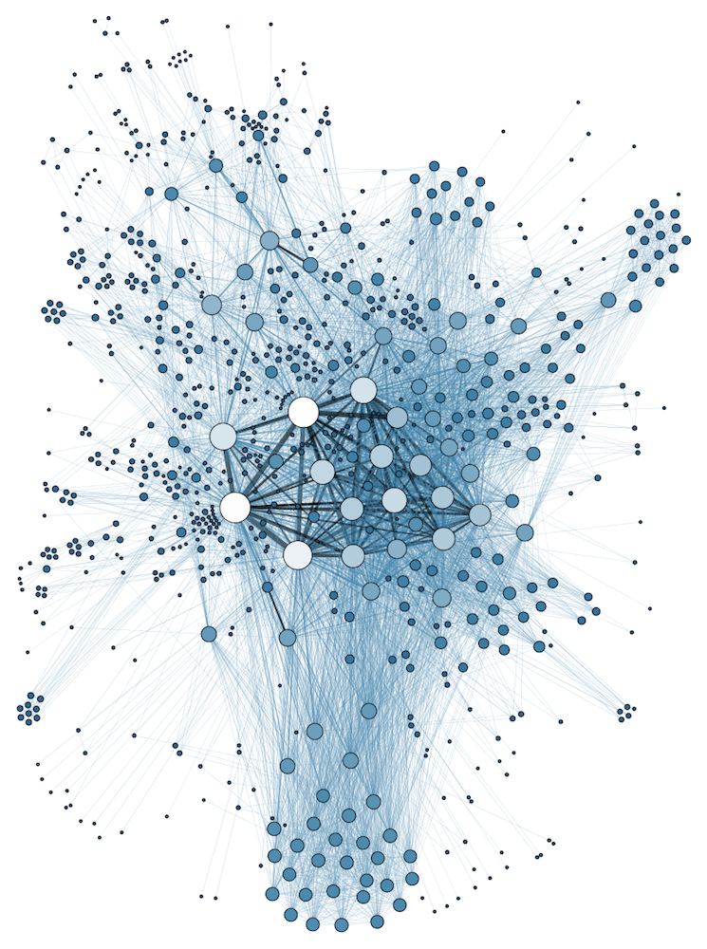
COMP 1100
Data Modeling & Management
David J Stucki
Otterbein University
Notes:
Bring Wirth & playing cards

Slide 2
ALERTS
  Lab this Thursday
    Access Week 5 is due Sunday before 11:59pm
    ER Diagram HW is due Thursday by the end of lab
  Read Hoberman chapter 10

Slide 3
What makes a “good” model?
How do we judge the quality of a relational model?
  What makes one model of the data better than another model?
  Implicit goals:
    Information preservation
      Maintain all concepts described by our higher level models (ER)
    Minimum redundancy
      Keep the amount of redundant storage of the same information to a minimum – fewer copies of things the better

Slide 4
Informal Design Guidelines (part 1)
What entity does this relation describe?
  Hard to put into words
    Not “Parts” – same part shows up
    multiple times
    Not “Suppliers” – same supplier
    shows up multiple times
    Not easy to describe this as a single
    entity – it’s showing a list of parts and
    the suppliers who supply those parts

Slide 5
Informal Design Guidelines (part 1)
What entity does this relation describe?
  Problem here is that the
  semantics of the relation
  are unclear
    Semantics – meaning behind the
    attribute values in the tuple
  We’re better off if we design
  our relations to have clear
  semantics

Slide 6
Informal Design Guidelines (part 1)
Guideline 1
  Design relation schema so that it has an easy-to-explain meaning
  Do not combine attributes from multiple entity types or relationship types into a single relation

Slide 7
Informal Design Guidelines (part 1)
Poor Design:
SUPPLIER-PARTS
S# | SNAME | STATUS | CITY | P# | PNAME | COLOR | WEIGHT | QTY
Better Design:
SUPPLIER
S# | SNAME | STATUS | CITY
PARTS
P# | PNAME | COLOR | WEIGHT | QTY

Slide 8
Informal Design Guidelines (part 1)
Poor Design:
EMP_DEPT
Ssn | Ename | Bdate | Address | Dnumber | Dname | Dmgr_ssn
Better Design:
EMP
Ssn | Ename | Bdate | Address | Dnumber
DEPT
Dnumber | Dname | Dmgr_ssn

Slide 9
Informal Design Guidelines (part 2)
What about this redundant information?
  Part Number shows up multiple times
  Supplier city shows up multiple times
  Supplier name also

Slide 10
Informal Design Guidelines (part 2)
What about this redundant information?
  Every repeated entry is more storage you are wasting
    More things in database also impacts performance
      Retrieval time, Insertion time
  Best designs waste the smallest
  amount of storage

Slide 11
Informal Design Guidelines (part 2)
Redundant information can cause other problems too
  “Update Anomalies”
  Logical problems that stem from poor choices in relational representation

Slide 12
Insertion Anomalies
If we want to add a new part, we need to:
  Have a supplier OR
  Put NULL values in for the supplier
  But S# is part of the primary key for this relation!
    Violates integrity constraints
    Must have both supplier and part
    before we can add either of them
  Even if S# were not part of the primary
  key, would still be bad
    Need to have a Supplier for every
    Part – even though we’re talking
    about two different things

Slide 13
Deletion Anomalies
Suppose we stop needing Part P2 and delete it from the database
  We’ve now deleted all of the information related to supplier S3
  Not good – just because we’ve stopped using a part that doesn’t mean we’ve dropped them as supplier entirely

Slide 14
Modification Anomalies
Suppose Supplier S1 changes its name to “Consolidated Parts Inc.”
  We now need to update all of the lines describing parts that come from supplier S1
  If we miss any, we leave our relation in an inconsistent state

Slide 15
Informal Design Guidelines (part 2)
Guideline 2
  Design relation schemas so that no insertion, deletion or modification anomalies are present in the relations
  This ends up being equivalent to designing relation schemas so that no redundant information exists in tuples

Slide 16
Informal Design Guidelines (part 3)
EMP
Ssn | Ename | Bdate | Address | Dnumber | ManagesDno
123… | Bob… | … | … | 05 | NULL
345… | Mary… | … | … | 05 | 05
789… | Tom… | … | … | 05 | NULL
444… | June… | … | … | 05 | NULL
076… | Alice… | … | … | 05 | NULL
What’s wrong here?
  Every employee has an attribute for which department they manage
  Most employees are not managers
    All of those employees have NULL values in the ManagesDno column
    These take up space for no good reason

Slide 17
Informal Design Guidelines (part 3)
Reasons to avoid attributes with many NULL values
  Take up storage space for no good reason
  Can make entities harder to understand
    More difficult to figure out how to JOIN properly
  Different NULL values have different meanings
    Does not apply
    Unknown
    Known but absent

Slide 18
Informal Design Guidelines (part 3)
Guideline 3
  Design relation schemas to avoid attributes that will frequently have NULL values
  If NULLs must be used, make sure they are the exceptional cases and not the typical value for the attribute for the majority of tuples

Slide 19
Informal Design Guidelines (part 4)
SUPPLIER
SUPPLIER_INFO
SUPPLIER_LOCATION
S# | Name | Status | City
S# | Name | Status
Name | City
Consider the above rethinking of the SUPPLIER schema into two separate schemas
  Can we easily recover the relation SUPPLIER from SUPPLIER_INFO and SUPPLIER_LOCATION?
  No – note that Name does not have to be unique in SUPPLIER or in SUPPLIER_INFO
    But it IS unique in combination with City in SUPPLIER_LOCATION
    This can lead to spurious tuples when we combine tables
    Two different companies both with the same name

Slide 20
Informal Design Guidelines (part 4)
SUPPLIER_INFO
SUPPLIER_LOC
SUPPLIER
S# | Name | Status
01 | Smith | Y
02 | Smith | N
Name | City
Smith | Columbus
Smith | Boston
S# | Name | Status | City
01 | Smith | Y | Columbus
02 | Smith | N | Boston
SUPPLIER_INFO * SUPPLIER_LOC
S# | Name | Status | Name | City
01 | Smith | Y | Smith | Columbus
01 | Smith | Y | Smith | Boston
02 | Smith | N | Smith | Columbus
02 | Smith | N | Smith | Boston
    Two different companies with the same name
    Original SUPPLIER table shows one line for each
    Querying modified schema – spurious tuples
      Why? Poor choice of match condition for the SUPPLIER_LOC table

Slide 21
Informal Design Guidelines (part 4)
Guideline 4
  Design relation schemas to join using equality conditions on appropriate attributes – primary key/foreign key
  Don’t build relations that contain matching attributes that are not primary key/foreign key matches

Slide 22
Next Time: Normalization

