Slide 1

COMP 1100
Data Modeling & Management
David J Stucki
Otterbein University
Notes:
Bring Wirth & playing cards

Slide 2
ALERTS
  ER Diagram HW is due today by the end of class
  Read Hoberman chapters 7-9
  An updated syllabus is on the course web page with the correct course ID for the Microsoft Access eLab/text.
  First quiz next Tuesday

Slide 3
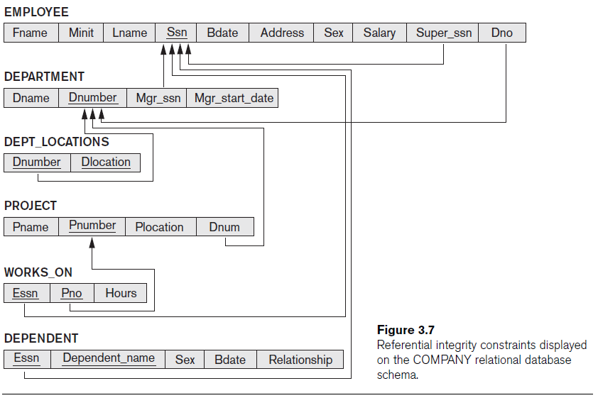
ER-Relational Mapping
So how do we get from this
to this?

Slide 4
ER-Model to Relational Model
Once we have our ER-Model, we use it to come up with our Relational model
  Must map elements of ER-model to elements of relational model
    Entities, Relationships, Attributes, etc. must become Relations, Attributes, etc.

Slide 5
Strong Entity Types
Each strong entity type in an ER model becomes a relation
  Entity type E → Relation R
  Simple attributes of E become attributes of R
  Include only the component attributes of a composite attribute
  Choose one key of E to become the primary key of R
Fname
M
Lname
EMPLOYEE
Ssn
Name
Address
Ssn | Fname | M | Lname | Address
EMPLOYEE

Slide 6
Weak Entity Types
Each weak entity type becomes a relation
  Weak entity W owned by entity E
    Entity E -> Relation R1
    Entity W -> Relation R2
  All simple attributes of W become attributes in R2
    Include as a foreign key the primary key attribute of R1
    Primary key of R2 will be that foreign key, plus the partial key of W
EMPLOYEE
Ssn | Fname | M | Lname | Address
DEPENDENT
Essn | Name | Sex | Bdate | Relationship
EMPLOYEE
1
Dependents_of
N
Sex
DEPENDENT
Bdate
Name
Relationship

Slide 7
Binary 1:1 Relationships
Three approaches:
  Foreign Key Approach
  Merged relation Approach
  Cross-reference Approach
  Should use “Foreign key approach” unless there is good reason not to

Slide 8
Binary 1:1 Relationships
Foreign key approach
  Two entities in the relationship – E1 and E2
    Generate two relations R1 and R2 associated with E1 and E2
    Include in R1 a foreign key pointing at the primary key of R2
      R1 should be an entity with Total Participation if possible
EMPLOYEE
Ssn | Fname | M | Lname | Address
DEPARTMENT
Dname | Dnumber | MgrSsn

Slide 9
Binary 1:1 relationships
Merged relation approach
  If both entities have TOTAL participation in the relationship, you can merge them into a single entity
    Each table would have an exact one-to-one correspondence between rows, so they’re essentially the same entity
Cross-reference approach
  Set up a third relation as a “lookup table” for the relationship
    Required for many-to-many relationships

Slide 10
Binary 1:N Relationships
Use the foreign key approach
  Identify which relation represents the entity on “many” side of the relationship
  Give that relation a foreign key pointing at the primary key on the “one” side of the relationship
Or use cross-reference
EMPLOYEE
Ssn | Fname | M | Lname | Address | Dno
DEPARTMENT
Dname | Dnumber | MgrSsn

Slide 11
Binary M:N Relationships
EMPLOYEE
Ssn | Fname | M | Lname | Address | Dno
WORKS_ON
Cross-reference approach
  For Entities E1 and E2 connected by Relationship R
  Create a new relation for R
    Include as attributes foreign keys pointing at the primary keys of E1 and E2 – combination will be the primary key
    Include any attributes tied to R
    Think of this as a “lookup table”
Ssn | Pnumber | Hours
PROJECT
Name | Pnumber | Location

Slide 12
Multivalued Attributes
Each multi-valued attribute A in the entity E1 gets its own relation
  Relation includes the attribute A and a foreign key pointing at the primary key of the relation associated with E1
  Primary key of the new relation is a combination of A and the foreign key
DEPARTMENT
Dname | Dnumber | MgrSsn
DEPT_LOCATIONS
Dno | Dlocation

Slide 13
N-ary Relationships
N-ary relationships modeled using cross-reference approach
  Each n-ary relationship is made into a new relation
    Attributes of this relation include foreign keys pointing at the primary keys of all the participating entity relations
    Include all simple attributes as well
    Primary key is usually a combination of all foreign keys
      Be careful – cardinality constraints may mean that we need to leave some of these out

Slide 14
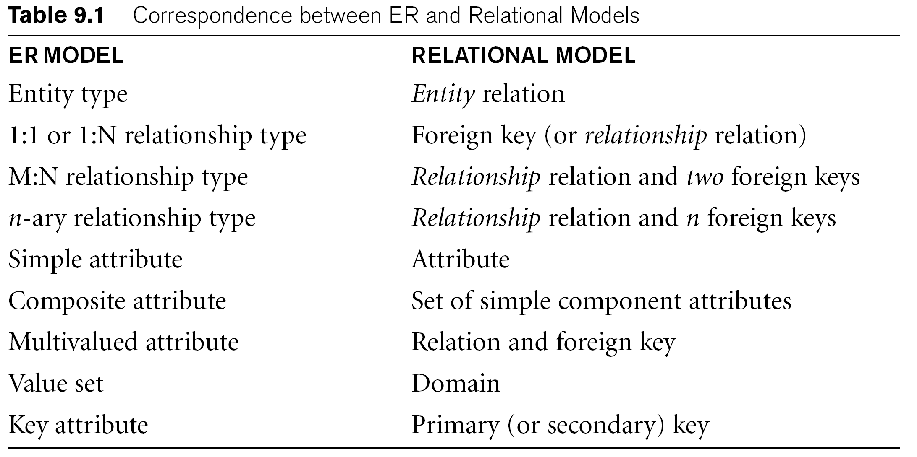
Summary of ER-to-Relational mapping

