Slide 1
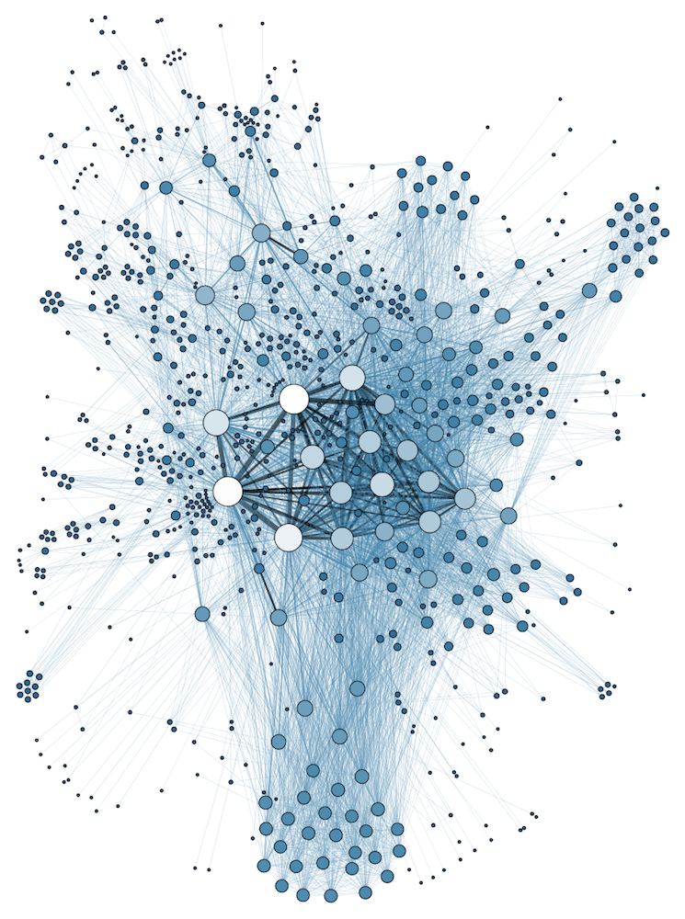
COMP 1100
Data Modeling & Management
David J Stucki
Otterbein University
Notes:
Bring Wirth & playing cards

Slide 2
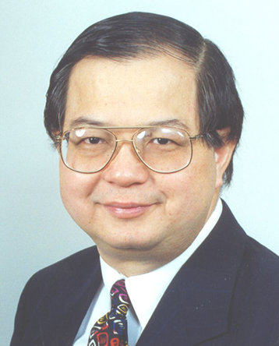
Peter Chen
"The entity-relationship model adopts the more natural view that the real world consists of entities and relationships. It incorporates some of the important semantic information about the real world." (1976)

Slide 3
ALERTS
  Read Hoberman chapters 4-6
    Chapter 4: What are entities?
    Chapter 5: What are attributes?
    Chapter 6: What are relationships?
  In-class assignment 1 is due next Tuesday in class.
  HW assignment 2 is available on the course web page
    Due next Thursday in class

Slide 4
Entity-Relationship (ER) Model
Outline
  Overview
  History
  Entities
  Attributes
  Binary relationships
  Weak entity types

Slide 5
Sample (preliminary) Conceptual Designs

Slide 6
Relationships
In ER diagrams relationships are shown as diamond boxes, connected by lines to the participating entities
Fname
M
Lname
Name
Number
Ssn
Name
Address
Manager
EMPLOYEE
WorksFor
DEPARTMENT
ManagerStartDate

Slide 7
Relationships
The degree of the relationship is the number of participating entities
  WORKS_FOR has degree 2 – “binary” relationship
  Most common relationship is the binary relationship
    Larger degrees possible – “ternary” relationships of degree 3

Slide 8
Ternary Relationship

Slide 9
Recursive Relationships
Same entity type participates in a relationship with itself in different roles
  Example: Supervision relationship
    One EMPLOYEE supervises another EMPLOYEE
Here we need to represent the role of each entity participating in the relationship
  e.g. “SUPEVISOR” vs. “SUPERVISEE”
  We include the relationship on the lines connecting the entity to the relationship

Slide 10
Recursive Relationships
EMPLOYEE
SUPERVISOR
SUPERVISEE
SUPERVISION

Slide 11
Cardinality Ratios
The cardinality ratio of a binary relationship specifies the maximum number of relationship instances an entity can participate in
  Can be:
    1-to-1 (1:1)
    1-to-many (1:M)
    Many-to-1 (M:1)
    Many-to-Many (M:N)

Slide 12
1:1 binary relationship - MANAGES

Slide 13
M:N binary relationship – WORKS_ON

Slide 14
Cardinality ratios
We indicate cardinality ratios on ER diagrams by annotating the lines connecting entities to relationships
Fname
M
Lname
Name
Number
Ssn
Name
Address
Manager
N
1
EMPLOYEE
WorksFor
DEPARTMENT
ManagerStartDate

Slide 15
Participation constraints
Specifies the minimum number of relationship instances each entity can participate in
  “minimum cardinality constraint”
Total participation constraint
  Every entity in an entity set must be related to an entity in the other entity set
    Example: WORKS_FOR – every EMPLOYEE must be related to a DEPARTMENT entity via the WORKS_FOR relationship
Partial participation constraint
  Some entities in an entity set are related to an entity in the other set, but this is not required
    Example: MANAGES – only some EMPLOYEE entities are managers for DEPARTMENT entities

Slide 16
Participation constraints
Total participation constraints indicated by double lines
  Partial participation constraints indicated by single lines
Fname
M
Lname
Name
Number
Ssn
Name
Address
Manager
N
1
EMPLOYEE
WorksFor
DEPARTMENT
1
1
ManagerStartDate
Manages

Slide 17
Relationship attributes
Relationship types can have attributes
  For 1:N or 1:1 relationships, the attributes can be on either the entity types or on the relationship type
    1:1 – relationship between two entities, attribute could be on either
      MANAGES relationship – relates EMPLOYEE entity as manager of a DEPARTMENT entity
        MGR_START_DATE attribute – could be on EMPLOYEE or on DEPARTMENT
    1:N – relationship between one entity and many entities, attribute needs to be on the “many entity” side
      WORKS_FOR relationship – relates EMPLOYEE entity as working for a DEPARTMENT entity
        START_DATE attribute – could ONLY be on EMPLOYEE type – start date varies by EMPLOYEE

Slide 18
Relationship attributes
  For M:N relationships, attributes are determined by a combination of both entities
    Cannot be modeled as part of the entity type – must be part of the relationship type
      WORKS_ON relationship – relates an EMPLOYEE entity with a PROJECT entity
      Attribute: HOURS_WORKED – how many hours an EMPLOYEE worked on a particular PROJECT
        Can’t associate it with the EMPLOYEE entity – could work on many projects
        Can’t associate it with the PROJECT entity – could have many EMPLOYEEs working on the project
        Must associate it with the relationship directly

Slide 19
Relationship attributes
We indicate relationship attributes by connecting them to the relationship entity via a line
Fname
M
Lname
Name
Number
Ssn
Name
Address
Manager
Start_date
N
1
EMPLOYEE
WorksFor
DEPARTMENT
1
1
ManagerStartDate
Manages

Slide 20
Weak Entity Types
Entity types without a key attribute
  Considered to “belong” to another entity in another entity set
  We can only identify an entity in a weak entity type uniquely if we know which entity it “belongs” to
    Known as the identifying entity type
    Connected to weak entity type via an identifying relationship
      Total existence constraint – every entity in the weak entity type MUST have an associated entity in the identifying entity type
    Partial key – key that uniquely identifies the line IF you know which entity it belongs to

Slide 21
Weak Entity Types
Example: DEPENDENT entity type
  Attribute are Name, Birth_date, Sex and Relationship to the employee (son, daughter, spouse)
    None of these attributes are uniquely identifying on their own or in combination
      You could have two people with the same first name, same birth date, same gender and same relationship to their respective employees
      The only unique distinction between them is which employee they are associated with
      Partial key – Name – as long as you assume that first names are unique in a household
        Name and Birthdate as a compound key is probably safer

Slide 22
Weak Entity Types
We denote weak entities by double lines around their boxes
  Identifying relationship identified the same way
  Dashed line under the partial key
EMPLOYEE
1
Dependents_of
N
Sex
DEPENDENT
Bdate
Name
Relationship

Slide 23
Sample conceptual model

Slide 24
Exercise
Continue to work on In-class assignment 1

Slide 25
Next Time...
Introduction to the Relational Data Model

