Slide 1
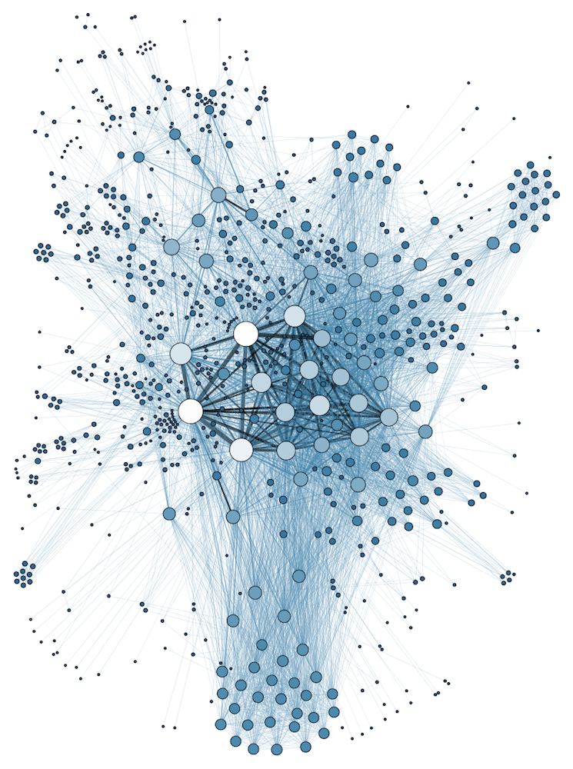
COMP 1100
Data Modeling & Management
David J Stucki
Otterbein University
Notes:
Bring Wirth & playing cards

Slide 2

Peter Chen
"The entity-relationship model adopts the more natural view that the real world consists of entities and relationships. It incorporates some of the important semantic information about the real world." (1976)

Slide 3
ALERTS
  Read Hoberman chapters 4-6
    Chapter 4: What are entities?
    Chapter 5: What are attributes?
    Chapter 6: What are relationships?

Slide 4
Entity-Relationship (ER) Model
Outline
  Overview
  History
  Entities
  Attributes
  Binary relationships
  Weak entity types

Slide 5
Recall: Conceptual models
  Model of the concepts that the data is built on
  Close to how the users perceive the data
  Here's how it fits into the bigger picture

Slide 6
Recall: Conceptual models
  Model of the concepts that the data is built on
  Close to how the users perceive the data
  Here's how it fits into the bigger picture
Whoa, that's a lot of detail. How'd it get so complicated?

Slide 7

Historical Development
1960—Charles Bachman developed Integrated Data Store (IDS) at GE
  1st Database Management System (DBMS)
1963—Bachman introduced Data Structure Diagrams to help with design
1960s—IBM developed Information Management System (IMS), another DBMS
These early systems were specialized and expensive, designed by engineers to optimize the performance of computer hardware and software
Physical models were the only models that existed at this point

Slide 8
Historical Development
In the 1970s it became apparent that going from business requirements directly to physical models was too big of a leap
  Limitations in naming, mapping between data strucures, and technical concerns were a challenge for business stakeholders to understand
1970—E.F. Codd publishes paper introducing the idea of relational databases
1976—Peter Chen introduced Entity Relationship Diagrams (ERD)
1978—William Kent published Data & Reality, a seminal book laying a philosophical foundation for data modeling
1979—Relational Software, Inc. releases Oracle database (1st client was CIA)

Slide 9
Historical Development
Logical modeling was introduced as an intermediate layer between business requirements and the physical model
  Used common business terms for data elements, and organized around the concept of relations
As business systems continued to grow in complexity two additional abstract layers to the modeling process were later added:
  Conceptual modeling
  Enterprise architecture
In practice, these models are now produced in reverse of their historical development.

Slide 10
Why model?
Learn from the modeling process
  Not all elements of your application are going to be obvious
Reduce complexity via abstraction
Communication
  With team members
    Documentation
  With stakeholders
    At all levels – end users, managers, etc.

Slide 11
ER modeling
Helpful for conceptualizing the world
Provides a simple description of a complex system, breaking the world into:
  Entities
    E.g. employee, project, department, student, major, section, etc.
  Entity set
    E.g. employees, projects, departments, students, etc.
  Attributes
    E.g. employee – name, address, ssn, etc.
  Domain
    E.g. ssn – 9 digit number

Slide 12
Sample Database Application
COMPANY database
  Employees
    Have ssn, name and address
    Work for a department
    May work on many projects (or no projects at all)
  Departments
    Have unique department number and a manager
  Projects
    Have unique project number, location and name
  Need to track hours per week employee works on a project

Slide 13
Entities and Attributes
Entities are “things” in the world
  Employee, Department, Project
Each entity will have attributes
  Employee
    Name, Address, Ssn, Salary, etc.
  Department
    Name, Number, Location
  Project
    Name, Number, Location

Slide 14
Entities and Attributes
In the ER model, we represent entity types rather than individual entities
  Individual entity – a single employee, a single department
  Entity set – all employees, all departments
    All members have same attributes – same entity type
  Entity type – list of attributes for an entity
  Represented as a rectangle
EMPLOYEE

Slide 15
Entities and Attributes
Entity types have associated attributes
  Attributes associated with each individual entity type
  Represented as circles connected to the entity type via lines
Ssn
Name
Birthday
EMPLOYEE

Slide 16
Entities and Attributes
We can also define composite attributes
  Attributes made up of smaller subparts
  Represented as circles connected to the composite attribute via lines
    Used when we want to refer to a collection of attributes as a single unit
Fname
M
Lname
Ssn
Name
Birthday
EMPLOYEE

Slide 17
Attributes
Attributes can be singled valued or multi-valued
  Single valued – only one value makes sense
    Date of birth, Ssn
  Multi-valued – attribute can have multiple values
    Projects worked on, courses taken, phone numbers
    Multi-valued attributes denoted by a double circle
      Can have their own attributes
Fname
M
Lname
Ssn
Name
Birthday
Project
Address
EMPLOYEE
WorksOn
Hours

Slide 18
Attributes
Attributes can be derived from other attributes
  Age is a derived attribute from the birthdate attribute
  Number of projects worked on is a derived attribute from the identity of projects worked on
    Derived attributes shown with a dashed circle rather than a solid circle
Fname
M
Lname
Ssn
Name
Birthday
Project
Age
Address
EMPLOYEE
WorksOn
Hours

Slide 19
Attributes
NULL
  NULL is a special value used for attributes.
  We use NULL as a value when:
    We don’t have the value for an attribute
    OR when there is no value applicable for an attribute
  We might not know the Date of Birth for a new employee
    NULL as a placeholder until we get the value
  An employee might not have a middle name
    NULL because the attribute is “not applicable” for this employee

Slide 20
Attributes
Key attribute
  Attribute that uniquely identify an individual entity in an entity set
    Each individual entity in the set must have a distinct key attribute value
  Key attribute is identified by underlining the name of the attribute
Fname
M
Lname
Ssn
Name
Birthday
EMPLOYEE

Slide 21
Key Attributes
Entity sets can have more than one key attribute
  Sometimes multiple values need to be unique – each one is a key attribute
  Unlike in schema diagrams, each underlined attribute is a separate key
    All keys are equal in an ER diagram – no concept of “primary”
    If we need a multi-valued key, we create a composite attribute to represent it
Name
Number
DEPARTMENT
Manager
ManagerStartDate

Slide 22
Attributes
Each attribute has a set of values that may be assigned to that attribute
  Known as a value set
  Also known as the domain of the attribute
Value sets not explicitly noted on ER diagram
  Typically specified using basic data types
    int, boolean, float, string, etc.
    Sometimes useful to use enumerated types
    Also usually include date, time, timestamp
  Value set is the set of all possible values for an attribute

Slide 23
Sample (preliminary) Conceptual Designs

Slide 24
Relationships
Whenever one attribute of an entity type refers to an attribute of another entity type, a relationship between those entities exists
  EMPLOYEE’s “Department” attribute refers to an entity in the DEPARTMENT entity set
    Relationship: what department does the employee work for?
  DEPARTMENT’s “Manager” attribute refers to an entity in the EMPLOYEE entity set
    Relationship: which employee manages the department?
  PROJECT’s “Controlling Department” attribute refers to an entity in the DEPARTMENT entity set
    Relationship: which department controls this project?

Slide 25
Relationships
These kinds of associations should be represented as relationships in the ER model
  In the initial design phase, relationships modeled as attributes
  As the design is refined, relationships explicitly modeled as connections between entity types

Slide 26
Relationship Example
Suppose we have two entity types – EMPLOYEE (E) and DEPARTMENT (D)
  We have a relationship between these two entity sets – each employee entity works for one department entity
  We define a relationship set WORKS_FOR (W)
    Each relationship instance in W contains two elements – one from the entity set E and one from the entity set D
    Each relationship instance associates one employee with one department

Slide 28
Relationships
A relationship type defines a relationship set among entities
  Suppose we have n entity sets: E1 … En
  A relationship set R is a set of relationship instances ri that associates n different entities (e1..en) where each entity ej is in an entity set Ej above
  Each of the entity types Ej participates in the relationship type R
    Each of the individual entities e_{j} participates in the relationship instance r_{i}
  Informally – a relationship instance r_{i} is an association of entities that includes exactly one entity from each of the participating entity types

Slide 29
Relationships
In ER diagrams relationships are shown as diamond boxes, connected by lines to the participating entities
Fname
M
Lname
Name
Number
Ssn
Name
Address
Manager
EMPLOYEE
WorksFor
DEPARTMENT
ManagerStartDate

Slide 30
Exercise
See Handout...

Slide 31
Next Time
More E-R Diagrams

