Slide 1
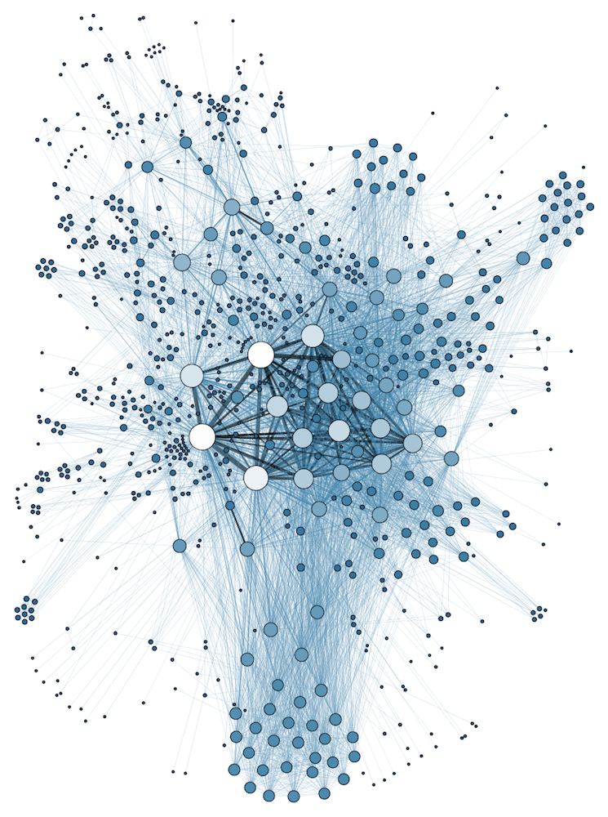
COMP 1100 Data Modeling & Management
David J Stucki
Otterbein University
Notes:
Bring Wirth & playing cards

Slide 2
Steve Hoberman
Data modeling is more than a job or a career – it is a mindset, an invaluable process, a healthy addiction, a way of life. Remember to Keep It Simple, and enjoy the ride!

Slide 3
ALERTS
Read Hoberman "Read me first!" & chapters 1-3

Slide 4
Data Modeling
Let's review:
Why are we interested in data modeling?
What is a model?
How does a model work (i.e., what function does it perform)?
Communication (symbolic)
Simplification & Focus (abstraction)
What is the difference between data and model?
Data is a sampling of the world
Model captures the structure of the world

Slide 5
Data Modeling: A Structure!
Types: the entries in a data model aren't values, but abstract descriptions of possible values
Make and model of vehicle rather than Ford Escape or Nissan Rogue
Interactions: how do different data elements interact or have dependencies between them?
What is wrong with Ford Rogue?
How do steering wheels and automobiles relate to each other? Spark plugs & tires? SUVs & Automobiles?
Concise Communication: a diagram can be a powerful communicator
"A picture is worth _________________"
Abstraction & Visualization are the key ingredients

Slide 6
Data Modeling: A Process!
Where do data models come from?
There is a design process:
Analysis of the domain (huh? what's that mean?)
Understand the problem (how is that different?)
Working with clients: interviews, collaborations, etc.
Abstraction: determine what to attend to and what to ignore
The primary tool for data modeling is the Entity-Relationship Diagram
Peter Chen (1976)
This represents the output of the Conceptual Modeling phase (what are the other two?)
G. Lawrence Sanders: "First, we should emphasize that conceptual design cannot be very much helped by automatic tools; the designer has full responsibility for the process of understanding and transforming requirements into conceptual schema."

Slide 7
Levels of Modeling
The modeling process takes place at 3 different levels of granularity, orientation, and focus
Conceptual Model
Logical Model
Physical Model

Slide 8
Conceptual Modeling
Identifying Entities, Attributes, and Relationships
Examples: a pizza place; a library; a gradebook
Graphical Representation
Boxes & Arrows
Annotations & Text
Orientation
Abstract
Business or problem oriented

Slide 9
Logical Modeling
Formal Data Specification
Logical Data Model
Relational
Object-Oriented
noSQL
Others...
Mapping Conceptual to Logical
Relational Tables with attributes & data domains
Data Dictionary
Normalization

Slide 10
Physical Modeling
Storage mechanisms on the computer
File system
File structure and organization
etc., ...
Concerns of efficiency and performance

Slide 11
Next Time...
Entity Relationship Diagrams

