Slide 1
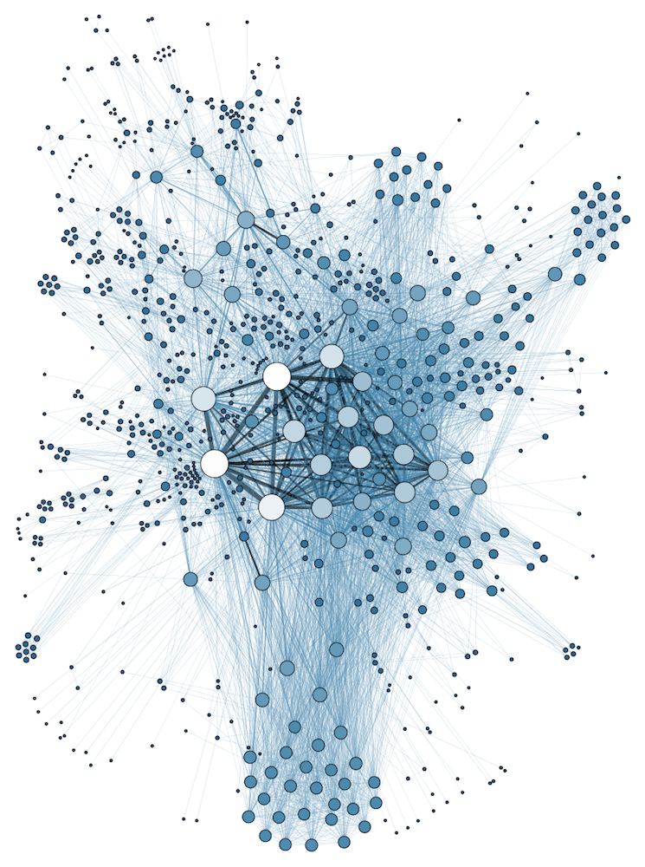
COMP 1100 Data Modeling & Management
David J Stucki
Otterbein University
Notes:
Bring Wirth & playing cards

Slide 2
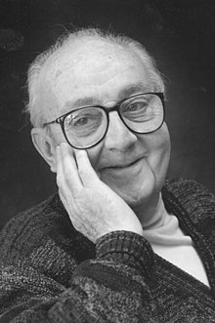
George E. P. Box
All models are wrong but some are useful
Now it would be very remarkable if any system existing in the real world could be exactly represented by any simple model. However, cunningly chosen parsimonious models often do provide remarkably useful approximations. ... For such a model there is no need to ask the question "Is the model true?". If "truth" is to be the "whole truth" the answer must be "No". The only question of interest is "Is the model illuminating and useful?" (1978)

Slide 3
Introductions
Please share:
What is your name, major, and year?
Why are you taking this course?
What is data modeling?
Name a non-academic interest of yours

Slide 4
Course Information
Syllabus
Course Web Site
Academic Demographics
First Assignment
Read Hoberman "Read me first!" & chapters 1-2 (pp. 5-26)

Slide 5
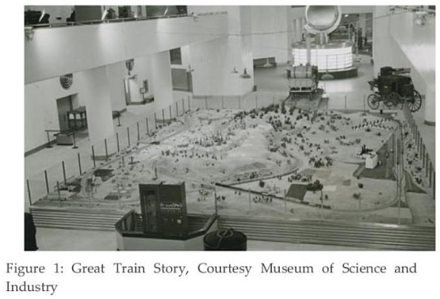
Data Modeling Story Time
Discussion?

Slide 6
Foreword by
Wayne W. Eckerson
Wayne Eckerson, a globally-known author, speaker, and consultant, formed Eckerson Group to help organizations get more value from their data. His goal was to provide organizations with expert guidance during every stage of their data and analytics journey.

Slide 7
Data Modeling
Why?
What did the museum story or the textbook preface suggest?
Automation!
What is a model?
Descriptively?
Examples?

Slide 8
Data Modeling
How does a model work (i.e., what function does it perform)?
Communication (symbolic)
Simplification & Focus (abstraction)
What is the difference between data and model?
Data is a sampling of the world
Model captures the structure of the world

Slide 9
Data Modeling: A Structure!
Types: the entries in a data model aren't values, but abstract descriptions of possible values
Make and model of vehicle rather than Ford Escape or Nissan Rogue
Interactions: how do different data elements interact or have dependencies between them?
What is wrong with Ford Rogue?
How do steering wheels and automobiles relate to each other? Spark plugs & tires? SUVs & Automobiles?
Concise Communication: a diagram can be a powerful communicator
"A picture is worth _________________"
Abstraction & Visualization are the key ingredients

Slide 10
Next Time...
Diving Deeper into Data Modeling...

