Slide 1
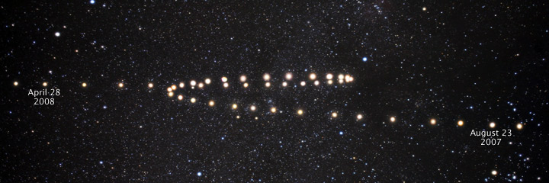
Phases of the Moon & Motion of the Planets

Slide 2
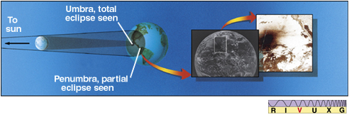
Solar Eclipses
Umbra – region of total shadow
Penumbra – region of partial shadow
Totality lasts only a few minutes!
Why isn’t there a solar eclipse every month?

Slide 3
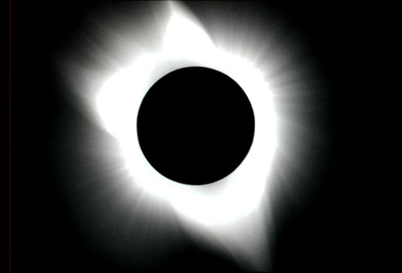
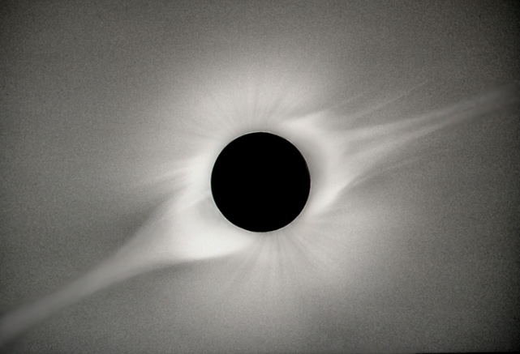
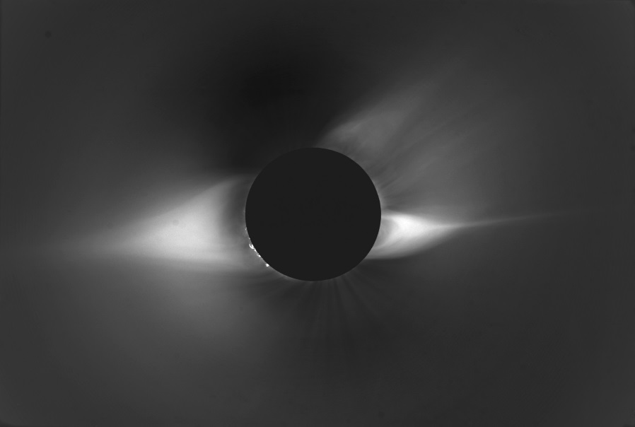
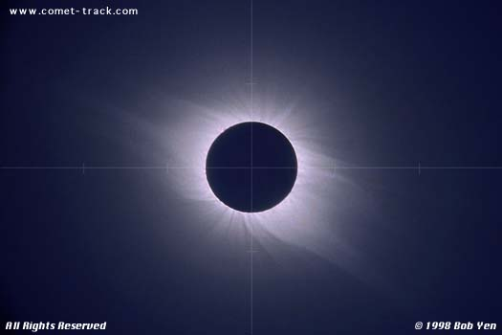
Solar Corona
Notes:
Thin outer atmosphere, usually swamped by other light and hence invisible

Slide 4
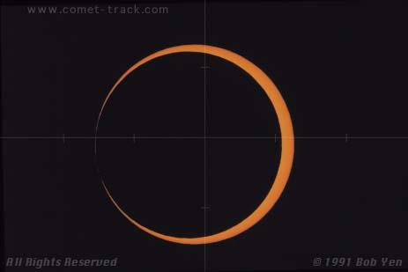
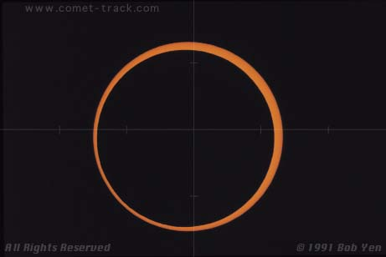
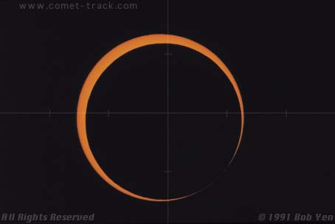
Annular Eclipse
1
2
3

Slide 5
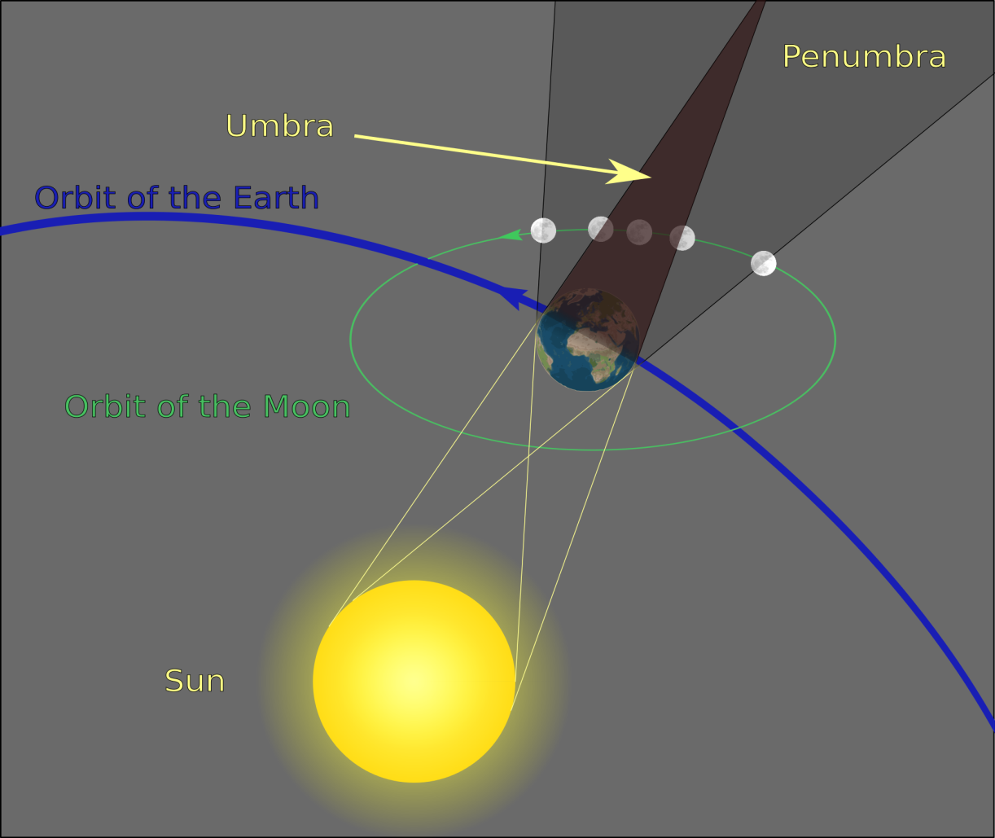
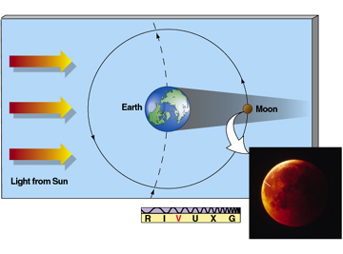
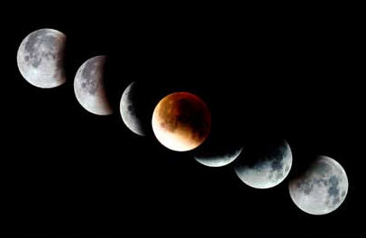
Lunar Eclipses
Moon moves into earth’s shadow…
…and out of it
(takes hours!)
Notes:
Moon appears reddish due to light bent by Earth’s atmosphere
Aristotle argues earth is round based on shape of its shadow on the moon

Slide 6
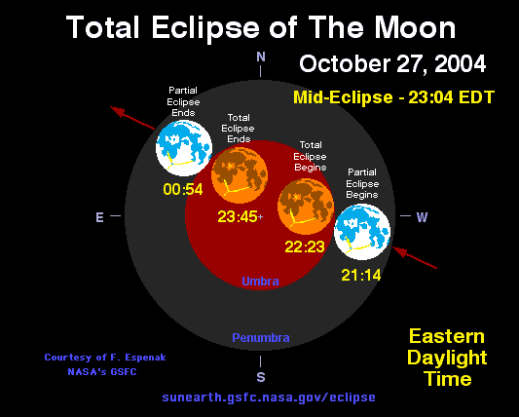

Slide 7
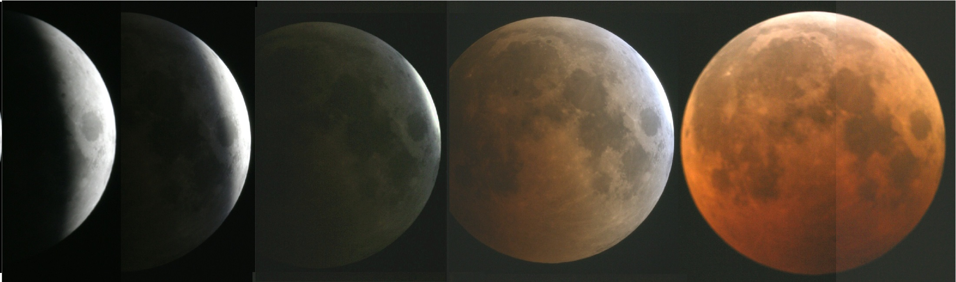
Misleading Summary
(The orange moon is MUCH dimmer)

Slide 8
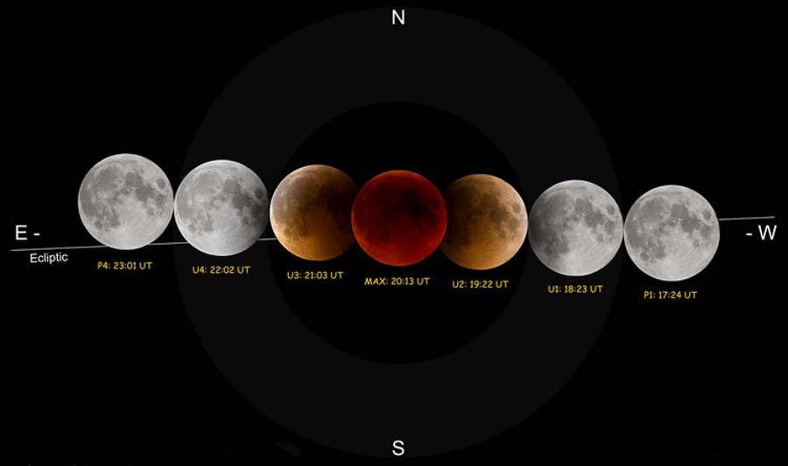
Moon’s orbit is tilted wrt the ecliptic

Slide 9
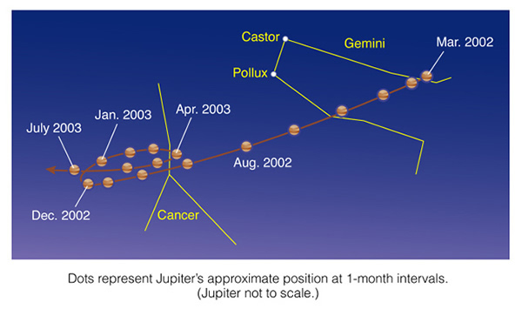
“Strange” motion of the Planets
Planets usually move from W to E relative to the stars, but sometimes strangely turn around in a loop, the so-called retrograde motion
Notes:
Note: outer planets are slower

Slide 10
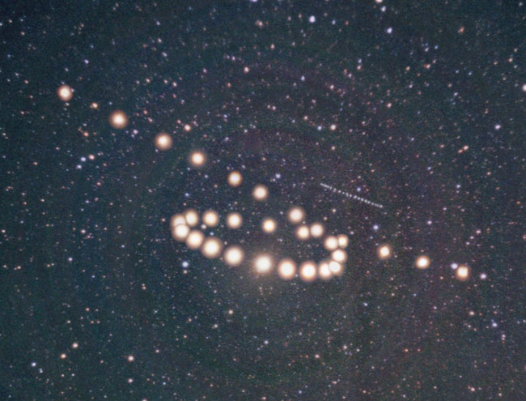
Mars and Uranus see skygazer: path of the planets
dimmer,
straight
brighter,
loopy
dimmer,
straight
Tunc Tezel

Slide 11
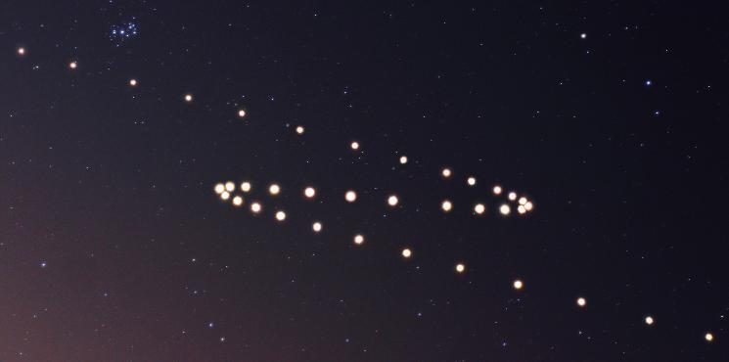
Mars 2005
Simulation of Mars 2003 is also on this Webpage by C. Seligman

Slide 12
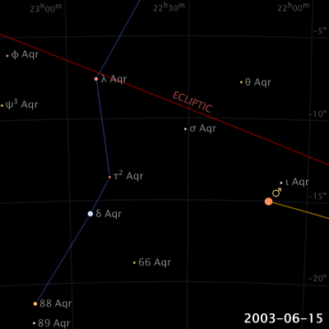
Apparent Motion of Planets in the Sky
Here: Mars relative to (the stars of) Aquarius
Note that Mars and Taurus would rise and set many times while this motion of Mars with respect to Aquarius happens!
(by Eugene Alvin Villar)

Slide 13
Confusion
Don’t confuse “orbit” with “path in the sky”
Potentially confusing, double meaning of “South”, etc.
  “North” and “South” are used in two different coordinate systems
    Equatorial (fixed stars): North means “closer to the CNP”
    Observer (horizon, stars not fixed, move from E to W): North means on the line that goes from the horizon via Polaris to the Zenith
    Oddly enough, northern stars (stars “above” the celestial equator) as well as southern stars, culminate in the south!
  Helpful Simulation

Slide 14
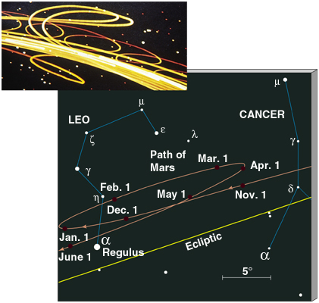
To Zenith if Midnight
CNP, larger
declination
East West
larger smaller
RA RA
RA

Slide 15
Naked-Eye Observation of the Planets
The planets change their position with respect to the stars
The planets, unlike the Sun and the Moon, show retrograde motion
The planets get brighter and dimmer
  They are brightest when they are in retrograde motion
    This must mean that they are closest to us at this point (Why?)

Slide 16
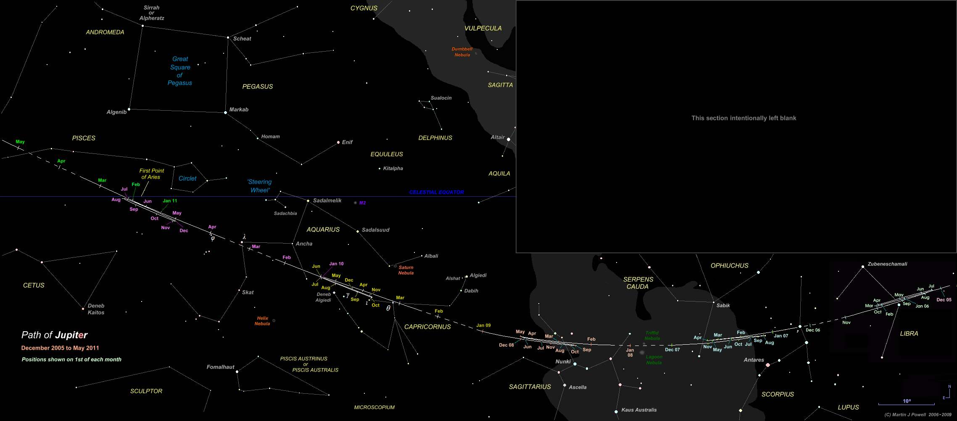
Jupiter Motion: Slow, about 1 constellation a year: 12 years for the Zodiac!
Invisible because Sun is also here in Feb/March

Slide 17
What can we conclude from observing patterns in the sky?
Earth OR Celestial Sphere rotates
Earth rotates around the Sun OR Sun moves about Earth
Moon rotates around the Earth or v.v.?
  Must be former, due to moon phases observed!
Size of the earth from two observers at different locations
Size of moon & moon’s orbit from eclipses
Much more from planetary motion …

