Slide 1
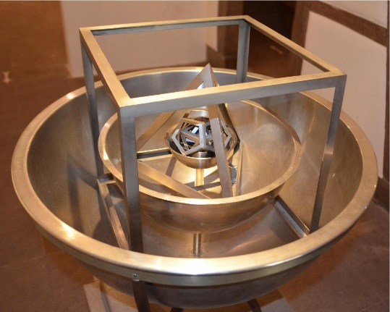
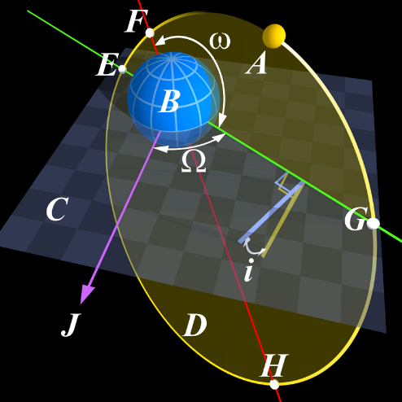
On a harmonic solution for two-dimensional adjoint QCD
Uwe Trittmann
Otterbein University*
APS Spring Meeting 2018, Columbus
April 16, 2018
*Thanks to OSU for hospitality!
Notes:
By No machine-readable author provided. Peo~commonswiki assumed (based on copyright claims). - No machine-readable source provided. Own work assumed (based on copyright claims)., CC BY-SA 3.0, https://commons.wikimedia.org/w/index.php?curid=431995

Slide 2
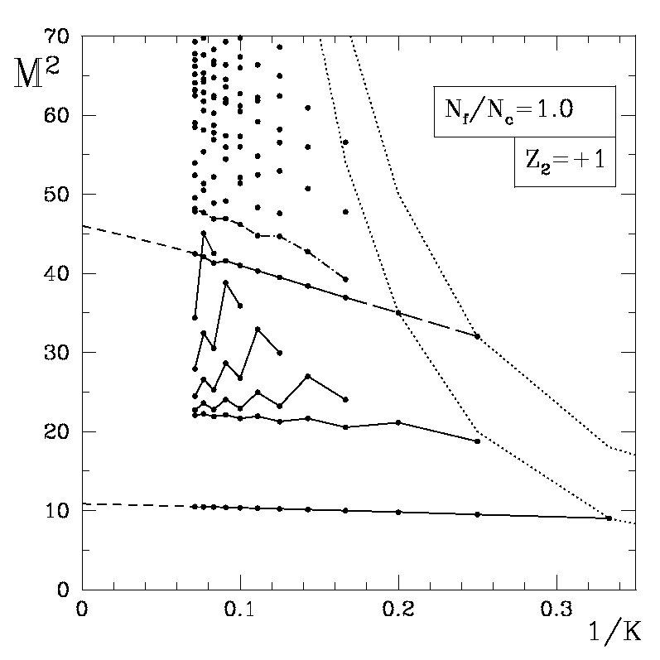
QCD_{2A} is a 2D theory of quarks in the adjoint representation coupled by non-dynamical gluon fields (“matrix quarks”)
The Problem: all known approaches are cluttered with multi-particle states (MPS)
We want “the” bound-states, i.e. single-particle states (SPS)
Get also tensor products of these SPS with relative momentum
SPS interact with MPS!
(kink in trajectory)
DLCQ calculation shown, but typical (see Katz et al JHEP 1405 (2014) 143)
➔ Need to solve theory with
new method → eLCQ
NPB 587(2000)
PRD 66 (2002)
Trouble!
Group of approximate MPS

Slide 3

Algebraic Solution of the Asymptotic Theory I
Since parton number violation is disallowed, the asymptotic theory splits into decoupled sectors of fixed parton number
Wavefunctions are determined by ‘t Hooft-like integral equations
Need to fulfill “boundary conditions” (BCs)
  Pseudo-cyclicity:
  Hermiticity (if quarks are massive):
Use sinusoidal ansatz with correct number of excitation numbers: n_{i} ; i = 1…r-1

Slide 4
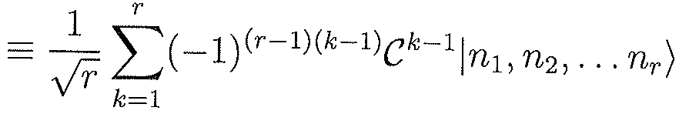
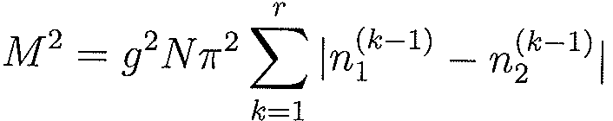
PRD92: Algebraic Solution of the Asymptotic Theory (cont’d)
ϕ_{3,sym}(x_{1,} x_{2,} x₃) = ϕ₃(x₁,x₂,x₃) + ϕ₃(x₂,x₃,x₁) + ϕ₃(x₃,x₁,x₂)
= ϕ₃(n₁,n₂) + ϕ₃(-n₂,n₁-n₂) + ϕ₃(n₂-n₁,-n₁)
ϕ_{4,sym}(x_{1,} x_{2,} x_{3,} x₄) = ϕ₄(x₁,x₂,x₃,x₄) – ϕ₄(x₂,x₃,x₄,x₁)
+ ϕ₄(x₃,x₄,x₁,x₂) – ϕ₄(x₄,x₁,x₂,x₃)
“Adjoint t’Hooft eqns” are tricky to solve due to cyclic permutations of momentum fractions x_{i} being added with alternating signs
But: Simply symmetrize ansatz under
C: (x₁, x₂, x₃,…x_{r}) → (x₂, x₃, …x_{r} ,x₁)
Therefore: ϕ_{r,sym}(n_{i}) ϕ_{r}(n_{i})
is an eigenfunction of the asymptotic Hamiltonian
with eigenvalue
3 parton WF characterized by 2 excitation numbers

Slide 5
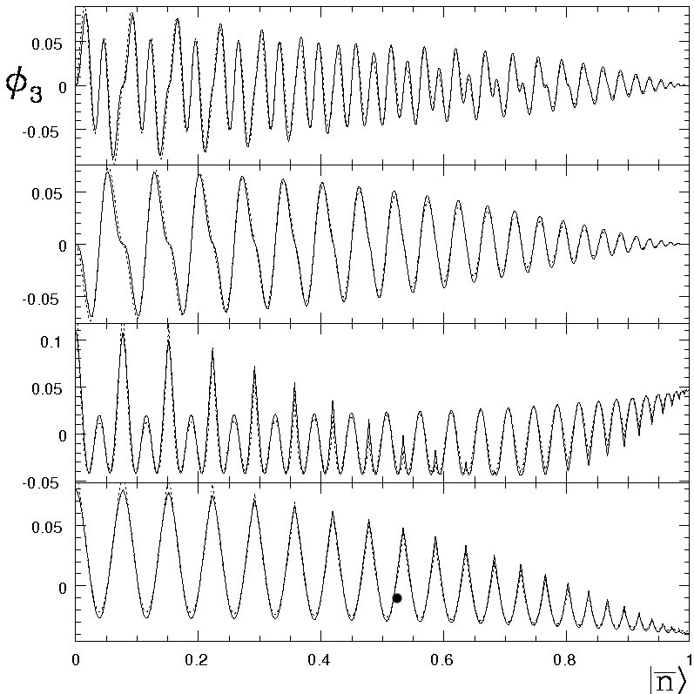
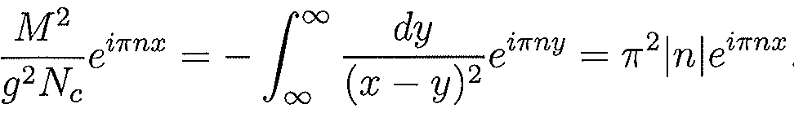
It’s as simple as that and it works – up to point
T-
T-
All follows from the two-parton (“single-particle”) solution
Can clean things up with additional symmetrization:
T : b_{ij} → b_{ji}
T+
T+
Caveat: in higher parton sectors additional symmetrization is required (I said in 2015…)
Want: EF should vanish if parton momenta vanish: ϕ(0, y, z, …) = 0
  So at the boundary?
How to achieve that? NOT with boundary conditions!
This is not a boundary condition, but the behavior of the wavefunction on a hyperplane characterized by x_{i}=0

Slide 6
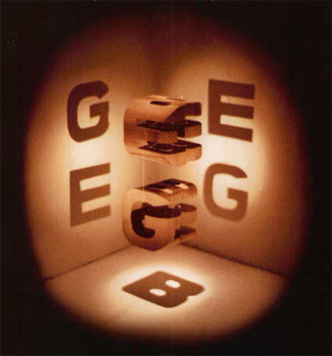
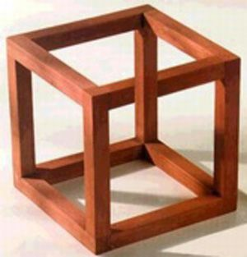
2017 – A New Hope
Idea: symmetrize the wavefunction so it does what we want at x_{i} =0
But we need to keep it cyclic in the bulk!
What if we can have the cake on one side – and eat from the other?
is this impossible?

Slide 7

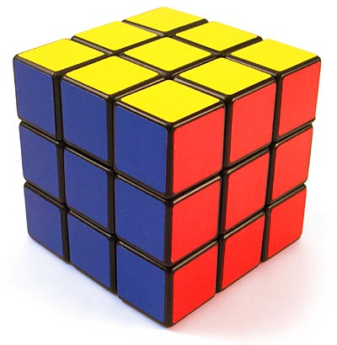
Possible, just need some group theory – and a group!
What is the group, what is the symmetry?
Want: EF should vanish if one or more parton momenta vanish: ϕ(0, y, z, …) = 0
Have: modular ansatz, ie a bunch of terms with different excitation numbers or frequencies: e^{iπ (nx+my+..)}
Unsurprisingly: e^{iπnx}– e^{-iπnx} = 0 for x = 0
Solution: add/subtract partner term with negative frequencies

Slide 8

The Devil is in the Details
Must not screw up other symmetries
Must have same mass eigenvalue
Not impossible: construct lower-dimensional inversion, i.e. the transformation
…or rather permutation of frequencies, and therefore parton momenta, so that the modified frequency safeguards the mass eigenvalue

Slide 9

2018 – A New Symmetry
Every permutation is formally an automorphism and thus a symmetry
  Subgroup B symmetrizes so that WFs are EFs of the Hamiltonian
  Subset E symmetrizes so that they vanish or are max at x_{i}=0
Construct a complete symmetrization under lower-dimensional inversion S ε E of the ansatz, but:
  S operators do not commute
  S operators do not commute with T, C ε B
  Therefore left and right cosets of B are in general not the same: S_{i}B ≠ BS_{i}

Slide 10

Solution: G = B × E
Symmetrize until the group is exhausted!
  “exhaustively-symmetrized Light-Cone Quantization” (eLCQ) ;-)
The group of perturbations of r objects with inversions has a finite order: |G| = 2r!
Can show this explicitly by constructing group in r parton sector
End result: Bona fide fully symmetrized states: |TIS; n > with quantum numbers under T, I, S and r-1 excitation numbers n

Slide 11
Works! Massless Four-Parton Eigenfunctions
Numerical (solid) vs. Algebraic (dashed)
T+ (even) under string reversal (odd) T –

Slide 12
Works! Five-Parton Eigenfunctions
Numerical (solid) vs. Algebraic (dashed)
T-
T-
T-
T-
2r!=240 terms in each eigenfunction!
T+
T+
T+
T+
Massless theory Massive theory

Slide 13
Results/Consequences
Bound state masses are much lower in the massive sector
  Since there is no mass term, this difference is generated by symmetrization alone!
Can compute pair-production matrix elements
which look like
Predict correct behavior of the eigenfunctions of the bosonized theory: sines of odd excitation number

Slide 14
Conclusions/ Outlook
Asymptotic theory was solved algebraically in all parton sectors
Can use complete set of solutions to solve full theory numerically with exponential convergence
  basis function ansatz, but symmetrization costs exponential also
Can use eLCQ method to tackle other theories
  Certainly with adjoint degrees of freedom
  Possibly higher dimensions, since group structure seems independent of space-time symmetries

Slide 15
Thanks for your attention!
Questions?

Slide 16
Not used

Slide 17
Works! Massive Four-Parton Eigenfunctions
Numerical (solid) vs. Algebraic (dashed)
T+ (even) under string reversal (odd) T –

Slide 18
The Formal Solution

Slide 19
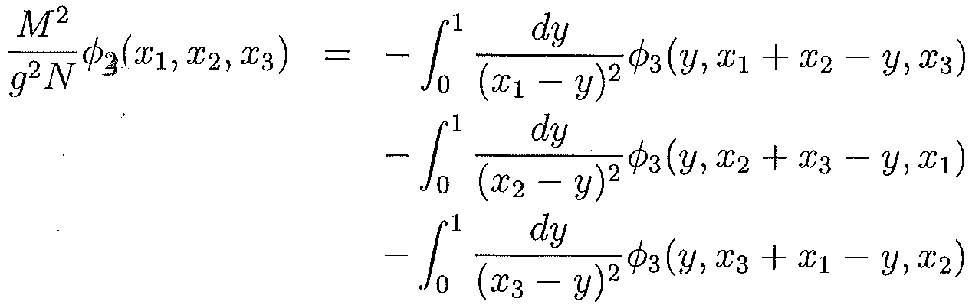
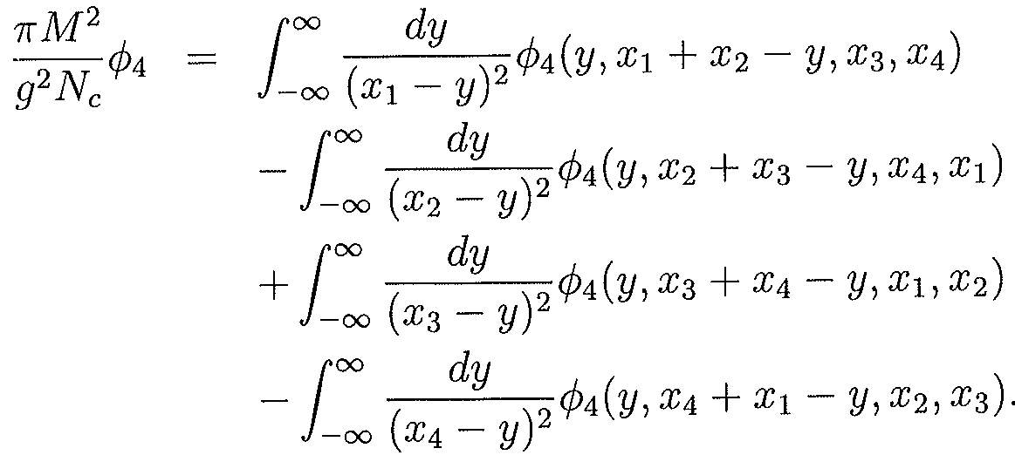
Start with asymptotic Theory: H_{asympt}=H_{ren}+H_{PC,s}
Since parton number violation is disallowed, the asymptotic theory splits into decoupled sectors of fixed parton number
Wavefunctions are determined by ‘t Hooft-like integral equations (x_{i} are momentum fractions)
r =3
r =4

Slide 20
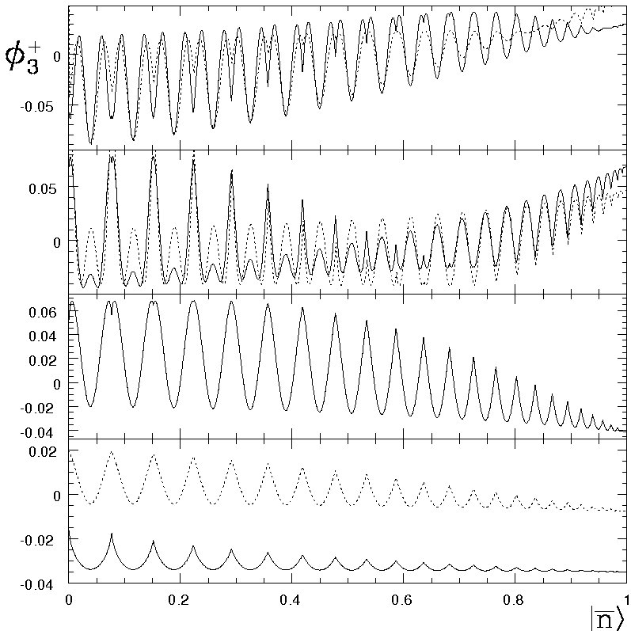
Generalize: add non-singular operators
Adding regular operators gives similar eigenfunctions but shifts masses dramatically
Dashed lines: EFs with just singular terms (from previous slide)
Here: shift by constant WF of previously massless state

