Slide 1
What Computers Can’t Do
INST 4200
David J Stucki
Spring 2015

Slide 2
Readings
Rick Robinson’s 11 Reasons Computers Can’t Understand…
Data Measurement: Heisenberg, Noise, & Continuity
Data Analysis: Gödel, Complexity, & the Limits of Computation
The World is Messy: Entropy, Quantum Mechanics, Local Sensitivity, Subjectivity, & Chaotic Systems
John Dentico’s Observations
Stories as the Meaning Makers
Garbage-in, Garbage-out: built-in assumptions
Active vs. Passive Engagement

Slide 3
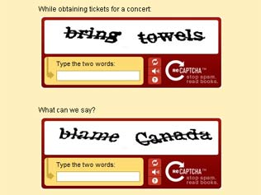
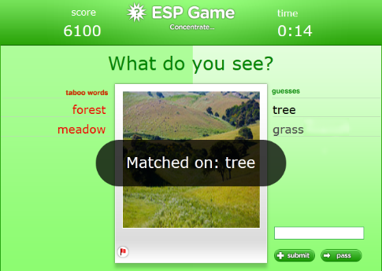
Google’s Luis von Ahn
TED Talk

Slide 4
Letter Spirit
What makes
an A an A?
D. R. Hofstadter. Metamagical Themas. Basic Books, New York, 1985.

Slide 5
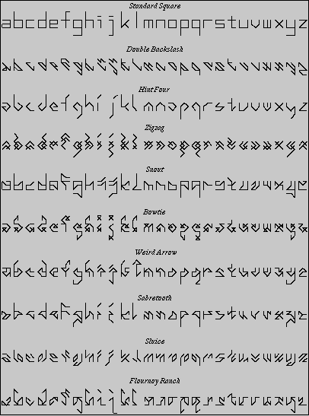
Douglas Hofstadter

Slide 6
Croudsourcing
Easy for a Human, Tough for a Computer
Image recognition
Approximation
Speech processing
Subjective evaluation
Rendering an opinion

Slide 7
Amazon Mechanical Turk
Provide a Web Services API to allow developers to easily integrate human intelligence directly into their processing!
The point of the Amazon Mechanical Turk web services API is for computers to integrate "artificial, artificial intelligence" directly into their processing by making requests of humans
Notes:
That is the point of the Amazon Mechanical Turk web services API -- for computers to integrate "artificial, artificial intelligence" directly into their processing by making requests of humans.

Slide 8
Put The Human In The Loop
while (read (photo))
{
ContainsHuman = CallMechanicalTurk(“Contains Human?”, photo);
if (ContainsHuman)
{ acceptPhoto(photo); } else
{ rejectPhoto(photo); }
}
Notes:
To the application, the transaction looks very much like any remote procedure call: the application sends the request, and the service returns the results. Behind the scenes, a network of humans fuels this artificial, artificial intelligence by coming to the web site, searching for and completing tasks, and receiving payment for their work.
All software developers need to do is write normal code. This pseudo-code below illustrates how simple this can be.
(on slide)
read (photo); photoContainsHuman = callMechanicalTurk(photo); if (photoContainsHuman) { acceptPhoto(photo); } else { rejectPhoto(photo); }

Slide 9
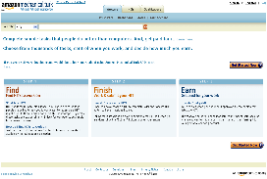
How It Works
www.mturk.com
Requester
(Developer)
Human
Intelligence
Tasks (HITs)
Worker
Qualifications
Completed
HITs
Artificial, Artificially
Intelligent Software
Workers
Notes:
Here is how it works:
Let’s say you are a developer with an amazing new idea for a business that before now has not been feasible because of the resources necessary to access a network of humans.
In the context of AMT, we call you a Requester. You use the API to submit submit tasks that require human intelligence – what we call HITs – to the Amazon Mechanical Turk web site where a vast network of people – what we call Workers – come to make money by using the skills their innate, and still extremely valuable, common human sense. They complete these tasks and submit them for approval back to the Requester or the software they wrote. Once the HIT is verified as accurate, the system automatically pays the Workers.
Developers can program this entire process to happen automatically and be integrated into the processing of their software. What does this mean for developers?

Slide 10
What This Means
For Software Developers
Solves problem of building applications that until now have not worked well without human intelligence
For Businesses
Efficiently, effectively and inexpensively complete millions of tasks that require human intelligence
Previously unimaginable business ideas are now feasible…
For Anyone
Make money using the skills you already have whenever your schedule allows
Notes:
For software developers, the Amazon Mechanical Turk web service solves the problem of building applications that until now have not worked well because they lack human intelligence. Humans are much more effective than computers at solving some types of problems, like finding specific objects in pictures, evaluating beauty, or translating text. The Amazon Mechanical Turk web service gives developers a programmable interface to a network of humans to solve these kinds of problems and incorporate this human intelligence into their applications.
For businesses and entrepreneurs who want tasks completed, the Amazon Mechanical Turk web service solves the problem of getting work done in a cost-effective manner by people who have the skill to do the work. The service provides access to a vast network of human intelligence with the efficiencies and cost-effectiveness of computers. Oftentimes, the cost of establishing a network of skilled people to do the work outweighs the value of completing it. By turning the fixed costs into variable costs that scale with business needs, the Amazon Mechanical Turk web service eliminates this barrier and allows work to be completed that before was not economical.
For people who want to earn money in their spare time, the Amazon Mechanical Turk web site solves the problem of finding work that they can do wherever and whenever they want.

