Slide 1
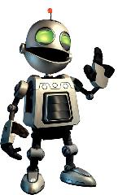
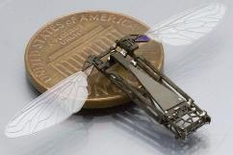
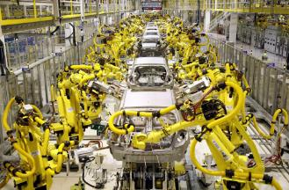
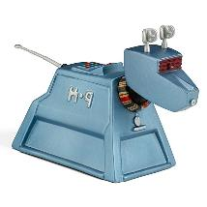
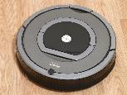
Robots
INST 4200
David J Stucki
Spring 2015

Slide 2
Hard Problems
Hardware
Physics
Materials
Power
Software
Information
Sensors
Control

Slide 3
State of the art
Amazon KIVA
Amazon PrimeAir Delivery (First Delivery)
Honda Asimo
Boston Dynamics Spot
MIT Swarm & MIT Tangible Media
Harvard Soft Gripper
Japanese Robots
Weird Robots

