Slide 1
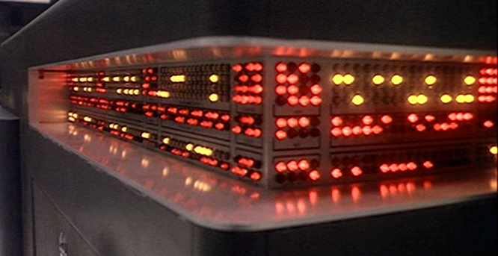
Purpose & Intentionality
INST 4200
David J Stucki
Spring 2017

Slide 2
Models of Mind
PHIL 3200 or PSYC 3710
What options did you discuss?
What kinds are there? How can we know?
Ontology vs. Epistemology
What do these mean?
Ontology: “The branch of metaphysics concerned with identifying the kinds of things that actually exist. E.g., What is existence? and What is the nature of existence?”
Epistemology: “The branch of philosophy concerned with the nature of knowledge itself. E.g., How do we go about knowing things? or How do we know what is true?

Slide 3
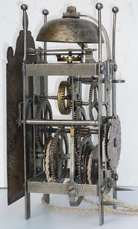
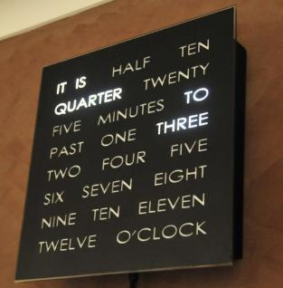
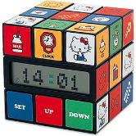
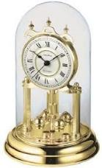
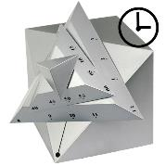
Functionalism
Functionalism
The function matters, not how it is carried out
“a clock is something that can be used to tell time”
Machine Functionalism
The mind is to the brain as
the program is to the computer

Slide 4
The Intentional Stance
Interpret the behavior of an entity as if it were making choices based on its beliefs and desires
Allows one to make predictions
Without knowing how the entity works
Dennett distinguishes 3 types of stance
Physical stance: the domain of physics and chemistry
Design stance: the domain of biology and engineering
Intentional stance: the domain of software and minds
Intentional systems are entities whose behavior is predictable from the intentional stance.

Slide 5
Intentionality
Aboutness, representation
“aimed at something”
Lock and key
Tweety flies away when Sylvester approaches
Thermometer “represents” temperature
Thermostat controls temperature
Frog gulps at a fly
Not “intentional” vs. “accidental”
Not “intensional”…

Slide 6
The Intentional Stance
Predict what an entity will do by modeling it (its mind) as if it had beliefs and desires
Beliefs: The entity’s model of the world
Desires: A utility function, or perhaps a ranked set of goals
Utilitarian: the model doesn’t have to be correct as long as it makes (mostly) reliable predictions.
Sunflowers intentionally follow the sun
Dogs intentionally beg for food
Students intentionally go to class and study

Slide 7
Intentionality’s power of explanation
Example: Distraction displays
Behavior:
A nesting birds feigns an injury when approached by a fox.
Explanation from Intentionality:
“The fox could be distracted by its desire to catch and eat me, but only if it thought that there was a reasonable chance of catching me; it would contract that belief if I gave it evidence I couldn’t fly anymore.”

