Slide 1
Philosophy of Computing
Computers are ‘Automatic Formal Systems’
A ‘Formal System’ is like a game in which tokens are manipulated according to definite rules, in order to see what configurations can be obtained. I.e., they are
Token-manipulation systems
Digital
Medium independent
Not all formal systems are games and not all games are formal systems.
Notes:
For more information about this view of computers, see John Haugeland, “What is Mind Design?”, in Mind Design II, MIT press, 1997, pp. 8-15.

Slide 2
Token-Manipulation Systems
Components
a set of types of formal tokens or pieces
one or more allowable starting positions
a set of formal rules specifying how arrangements of tokens may or must be changed into others
Self-contained
Rules have a ‘local’ perspective: current → next

Slide 3
Digital Systems
A process that makes things and then later identifies what was made is digital if it is positive and reliable.
It is positive if the re-identification can be absolutely perfect.
A positive technique is reliable if it not only can be perfect, but almost always is.
chess, tic-tac-toe, go, checkers
vs.
baseball, billiards, tiddly-winks, marbles

Slide 4
Medium Independence
Form, or structure, is what defines a formal system.
Its substance, or material, is irrelevant insofar as it supports the requisite form.
Chess
Can be played with pieces of wood, plastic, ivory, patterns of light on a video monitor, sand-drawings, even helicopters on skyscrapers;
but not frogs, shapes traced in water, or mountains.
Fire, food, electrical circuits, billiards, baseball are not independent of substance

Slide 5
Automatic Formal Systems
A formal system that “moves” by itself.
A physical device or machine that
has configurations and states which can be regarded as tokens and arrangements of some formal system, and
in its normal operation it automatically manipulates these tokens in accord with the rules of that system.
E.g., a Computer!

Slide 6
Implementation and Universality
The most basic idea of computer science:
“You can use one automatic formal system to implement another.”
This is what programming is!
One computer implements another when:
some configurations of tokens and positions of the former can be regarded as the tokens and positions of the latter, and
as the former follows its own rules, it automatically manipulates those tokens of the latter in accord with the latter’s rules.

Slide 7
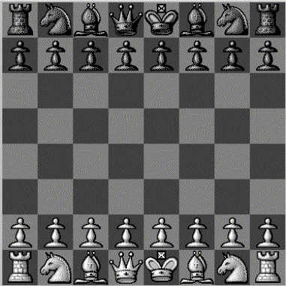
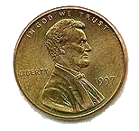
Chess
Assume the board is 8” square
Place a penny exactly 4.0747 inches from the bottom and 1.9761 inches from the left
Place a penny in the fourth rank (row) and second file (column).

