Slide 1
Being Human
INST 4200
David J Stucki
Spring 2015

Slide 2
Man vs. Machine
Is the conflict inevitable?
Machines are: Tools? Slaves? Companions? Enemies?
Where is the boundary between us & them?
Implants
Cyborgs
…and beyond?
Resistance is Futile!

Slide 3
The Horizon Effect
Predictions regarding machine intelligence are notoriously optimistic (and wrong…)
AI Timelines (technical report)
Future of Humanity Institute (Nick Bostrom, Stuart Armstrong)
Future Progress in AI Survey
There is, in some quarters, concern about high–level machine intelligence and super-intelligent AI coming up in a few decades, bringing with it significant risks for humanity. In other quarters, these issues are ignored or considered science fiction. We wanted to clarify what the distribution of opinions actually is, what probability the best experts currently assign to high–level machine intelligence coming up within a particular time–frame, which risks they see with that development, and how fast they see these developing. We thus designed a brief questionnaire and distributed it to four groups of experts in 2012/2013. The median estimate of respondents was for a one in two chance that high level machine intelligence will be developed around 2040-2050, rising to a nine in ten chance by 2075. Experts expect that systems will move on to super-intelligence in less than 30 years thereafter. They estimate the chance is about one in three that this development turns out to be ‘bad’ or ‘extremely bad’ for humanity.

Slide 4
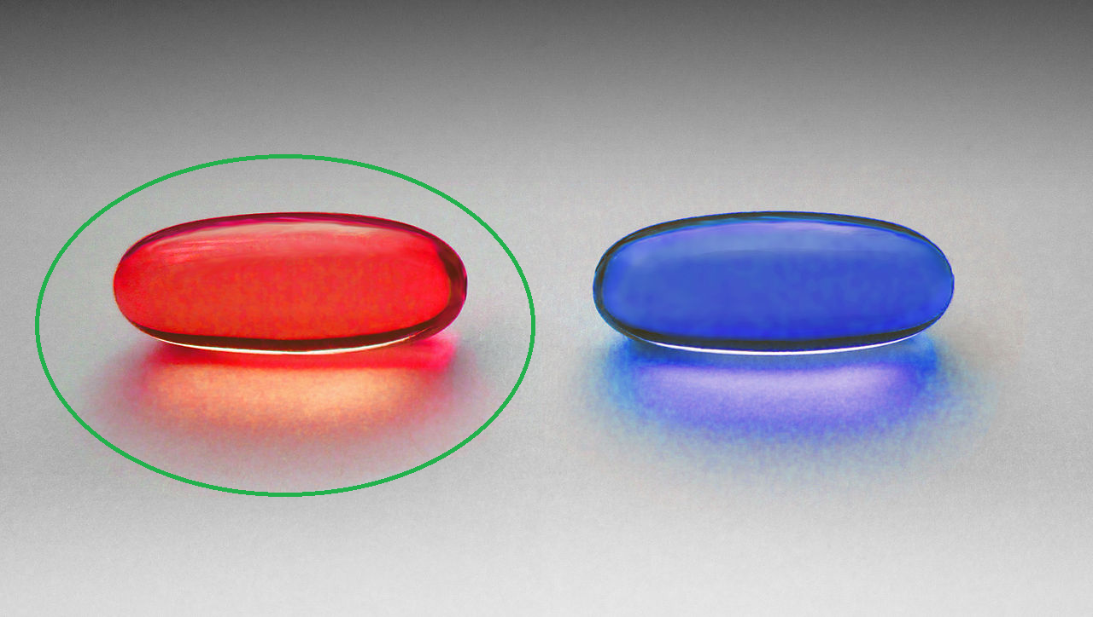
The Singularity
Ray Kurzweil
Immortality by 2045
Rebuttal 1 (Stuart Hammeroff)
Rebuttal 2 (Noam Chomsky)
Wikipedia
Wired
Fallacies
Capacity vs. Performance
Speed vs. Competence

