Slide 1
An Embodied Philosophy of Mind
Cognitive Metaphor and the
Origins of Thought
David J. Stucki
Machine Intelligence, INST 4200

Slide 2
Background
Any philosophy (of mathematics) is part of a larger belief system
Ultimately, one’s philosophy determines and is determined by one’s theology, politics, pedagogy, self-awareness, etc.
Your view of mathematics is as likely to shape your beliefs as the other way around.
All knowledge is contingent on faith
How do you know?
Hollow Earth & Geometric Inversion
Artificial Chatbots (MGonz)
In Mathematics we always take axioms on faith…

Slide 3
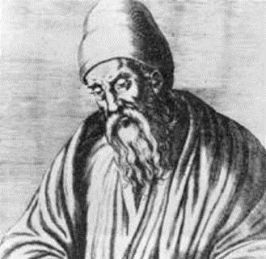
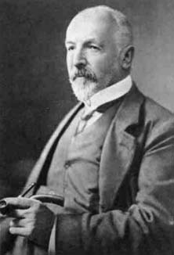
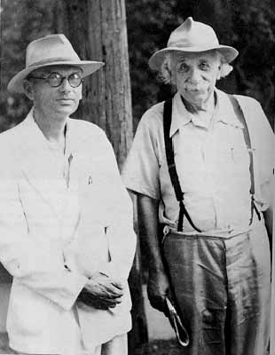
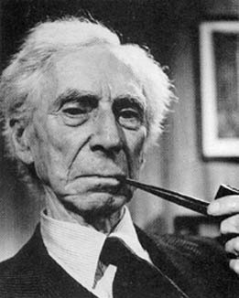
Brief History
Pre-19th Century
Pythagoreans
Platonism
Mathematical Realism (qua natural philosophy)
Crisis (1829 – 1931)
Euclid’s Geometry
Cantor’s Naïve Set Theory
Russell’s Paradox
Gödel’s Incompleteness Theorems

Slide 4
Foundationalism
An attempt to answer questions emerging from the crisis:
Do mathematical objects exist?
How can we know mathematics?
Why is mathematics so effective at explaining the world?
What is mathematical truth?
Is mathematics objective/universal?
What do mathematical statements mean?

Slide 5
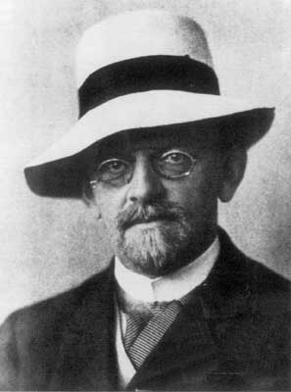
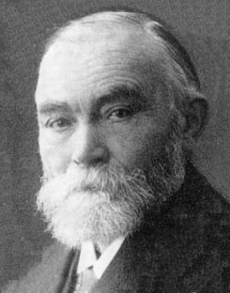
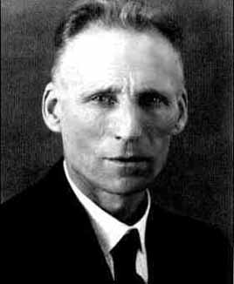
Foundationalism
Formalism (Hilbert)
Manipulation of symbols (playing a game)
Mathematics isn’t “about” anything
Logicism (Frege)
Mathematics is a branch of logic
Mathematical statements are logical truth
Intuitionism (Brouwer)
Mathematics is constructed in the mind
Limited to finite quantities and constructed entities

Slide 6
Beyond Foundations
Foundationalism faltered because it assumed that deduction and logic “go all the way down.”
Turtles
Internal foundations undermined by Gödel
So where are the foundations?
Platonism (absolute, non-material, transcendent, ideal, archetypal, mystical)
Social Constructivism (fallible, humanistic, democratic, constructed, linguistic, conventional)
Embodied Metaphor (neither arbitrary nor absolute, grounded in cognitive science)

Slide 7
Cognitive Science
The inter-disciplinary field devoted to understanding the mind.
It lies at the intersection of five disciplines: Philosophy, Linguistics, Psychology, Neuroscience, and Computer Science
Also related to:
Anthropology Physics Evolutionary Biology
Statistics Genetics Mathematics
Artificial Intelligence Medicine Dynamical Systems

Slide 8
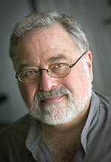
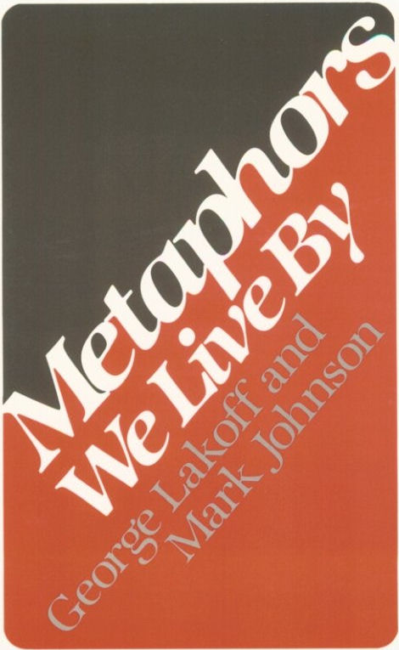
George Lakoff
“A large number of the most basic, as well as the most sophisticated, mathematical ideas are metaphorical in nature.”
1980
1996
1987

Slide 9
Three Major Findings
The mind is inherently embodied.
Descartes was wrong (no dualism)
The computer analogy is wrong.
Thought is mostly unconscious.
Descartes is wrong again (no Cartesian theatre).
Abstract thoughts are largely metaphorical.
The essence of metaphor is describing, understanding, or experiencing one thing in terms of another

Slide 10
So What?
If true, these findings challenge virtually every philosophical perspective from 2500 years of Western Thought.
Our understanding of the most fundamental disciplines, language and mathematics, is revolutionized.
Caution: Lakoff is a new kind of positivist.
Advertisement: The Literary Mind: The Origins of Thought and Language, Mark Turner, (Oxford, 1996).

Slide 11
Basic Ideas
In an embodied mind the structure of thought is shaped by the structure and experience of the body.
Primary metaphors are developed through subjective experience:
Association & Differentiation during development
These associations are realized neurally.
Conceptual blending allows complex metaphors to be constructed.

Slide 12
Primary Metaphors
These connect a Subjective Judgment and a Sensorimotor Domain in an association. (pp. 50-54)
Metaphor SJ SD
Affection is Warmth Affection Temperature
Important is Big Importance Size
Happy is Up Happiness Bodily orientation
Bad is Stinky Evaluation Smell
Difficulties are Burdens Difficulty Muscular exertion
Categories are Containers Perceived kind Space
Intimacy is Closeness Intimacy Being physically close
States are Locations State of Being Bounded regions of space

Slide 13
Complex Metaphors
A Purposeful Life Is a Journey
Primary Metaphors:
Purposes are Destinations
Actions are Motions
Metaphorical Mapping:
Journey → Purposeful life
Traveler → Person living a life
Destinations → Life goals
Itinerary → Life plan
Knowledge of travel informs living of a purposeful life.

Slide 14
Journey → Purpose
I’m trying to find myself.
He has no direction in life.
We’re ahead of schedule.
I’m feeling bogged down in my career.
She’s missed the boat.
His ethnicity is holding him back.

Slide 15
Complex Metaphors
Love Is a Journey
Primary Metaphors:
Intimacy is closeness
A relationship is an enclosure
Complex Metaphors:
A Purposeful Life Is a Journey
An Intimate Relationship Is a Close Enclosure (vehicle)
Metaphorical Mapping:
Journey → Love
Travelers → Lovers
Destinations → Common Life Goals
Vehicle → Relationship
Impediments to Motion → Difficulties
p. 64

Slide 16
Journey → Love
Look how far we’ve come.
It’s been a long, bumpy road.
We can’t turn back now.
We’re at a crossroads.
We’re heading in different directions.
We may have to go our separate ways.
The relationship is not going anywhere.
We’re spinning our wheels.
The marriage is out of gas.
Our relationship is off the track.
The marriage is on the rocks.
We’re trying to keep us afloat.
We may have to bail out.
We’re both trying to sit in the driver’s seat.

Slide 17
More Examples
Time is Moving (stationary observer)
Time is Distance (moving observer)
Time is Money
Time is a Resource
Thinking is Moving
Thinking is Perceiving
Thinking is Object Manipulation
A Cause is a Path
Acquiring Ideas is Eating
Thought is Calculation
Thought is Language
Self is Container
Morality is Strength
Being is Change (Heraclitus)
Being is Number (Pythagoras)
States are Shapes

Slide 18
Mathematical Origins
What mechanisms of the embodied mind allow mathematical thought and reasoning?
How does this account for “the unreasonable effectiveness of mathematics?”
What does this reveal about the nature of mathematics?

Slide 19
Innate Mathematics
Subitizing
Simple numerical computation
Basic symbolic (algebraic) manipulation
See Dehaene (1997) or Butterworth (1999)

Slide 20
Image Schemas
Spatial relations are conceptualized in terms of image schemas.
Example: the English word on
Above Schema: orientational (a book is on the desk)
Contact Schema: topological (the shoe is on the foot)
Support Schema: force dynamic (a sign is on the wall)
Two important image schemas in mathematics:
Container Schema: Interior, Exterior, and Boundary
Source-Path-Goal Schema: Motion

Slide 21
Conceptual Metaphors
There are four Grounding Metaphors
Basic ideas, directly grounded in sensorimotor experience.
These are the building blocks for conceptual blending
There are many Linking Metaphors
These are more sophisticated, or abstract ideas.
They provide a mechanism for connecting different branches of mathematics.

Slide 22
4Gs: Object Collection
Arithmetic As Object Collection
Collections of same size → Numbers
Size of Collection → Size of Number
Bigger → Greater
Smaller → Less
The smallest collection → The unit (one)
Putting collections together → Addition
Taking a smaller collection from a larger collection → Subtraction
Basic truths about collections of objects can be mapped to the domain of numbers.
These become basic truths of arithmetic.

Slide 23
4Gs: Object Construction
Arithmetic as Object Construction
Objects → Numbers
The smallest (whole) object → The unit (one)
The size of the object → The size of the number
Bigger → Greater
Smaller → Less
Putting objects together → Addition
Removing part of an object → Subtraction

Slide 24
4Gs: Measuring Stick
Arithmetic is Using a Measuring Stick
Physical segments → Numbers
The basic segment → One
Length of segment → Size of number
Longer → Greater
Shorter → Less
Arranging segments → Arithmetic operations
A physical segment → Result of an operation

Slide 25
4Gs: Motion
Arithmetic As Motion Along a Path
Point locations on path → Numbers
The beginning of the path (origin) → Zero
Distance from origin → Size of number
Further from the origin → Greater
Closer to the origin → Less
Moving along the path → Arithmetic operations
A point location → Result of an operation

Slide 26
Metaphorical Meaning
We can derive from the Grounding Metaphors all of the varied meanings of One and Zero:
Zero
Collection: emptiness
Construction: nothing, absense, destruction
Measuring: ultimate smallness
Motion: origin
One
Collection: individuality, separateness
Construction: wholeness, unity, integrity
Measuring: standard
Motion: beginning

Slide 27
One and Zero
One small step for a man, one great step for mankind.
E pluribus unum (From many, one)
They danced as one.
That new quarterback is a big zero.
This nullifies all that we’ve done.
I started with zero, and made it to the top.

Slide 28
More Examples
Natural Numbers are Sets
Multiplication by -1 is Rotation by 180°.
One-to-one correspondance is Equality.
A space is a set of points.
Functions are ordered pairs of numbers.
Continuity for a line is numerical gaplessness.
Continuity for a function is preservation of closeness.

Slide 29
Conclusions
Do mathematical objects exist?
How can we know mathematics?
Why is mathematics so effective at explaining the world?
What is mathematical truth?
Is mathematics objective/universal?
What do mathematical statements mean?

