Slide 1
The Struggle is Real

Slide 2
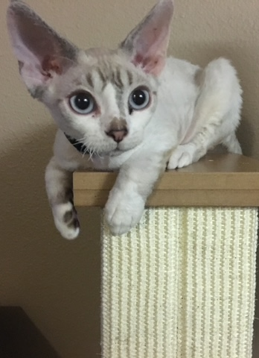
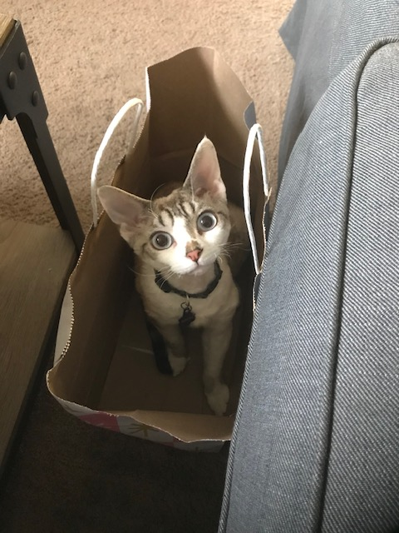
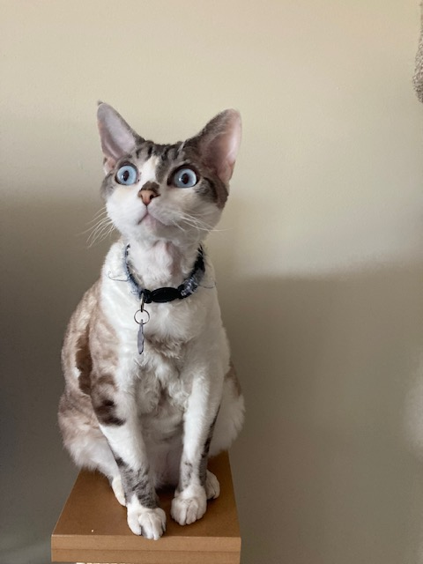
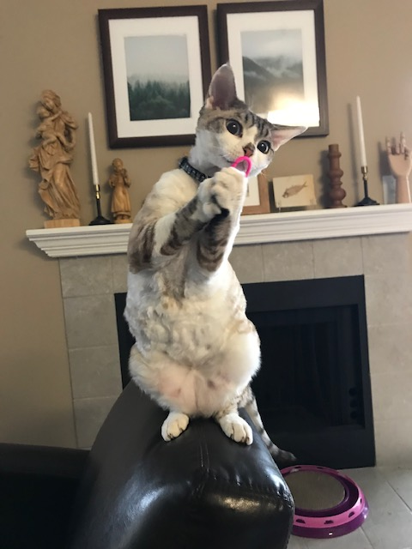
What is your favorite cat?
The Devon Rex!
Dream goal

Slide 3
Angela Duckworth

Slide 4
GRIT Inventory
https://angeladuckworth.com/grit-scale/

Slide 7
Think, Pair, & Share
Consider an area you have or had a fixed mindset.
Consider an area you have a growth mindset.
How did you shift from a fixed to a growth mindset? How might you shift your fixed mindset to a growth mindset?
Discuss with a neighbor.

Slide 8
Case Studies

Slide 9
Free Write
Did you resonate with any of the challenges or struggles presented in the case studies? (This could be you, a friend, etc.)
If not, is there another struggle that you, or a friend, have encountered?
Based on your GRIT inventory, how do you think you will manage a struggle or challenge you encounter?
What resources are in place on Otterbein’s campus that you think will be useful to you or would you be willing to utilize?

Slide 10
Reminders
Complete your FYE Events – www.Otterbein.edu/fye
Continue working on READY Plan
Submit your Exit Ticket

