Slide 1
The Divine Infinite
FYS 1023
David J. Stucki

Slide 2
Alerts
22 of 46 FYE reports (2 days left)
2 per person due by October 11
8 of you have 2 or more done
6 of you have 1 done
10 of you have 0 done
Next two weeks are messy
M 10/14: fall break, W 10/16: normal, F 10/18: team consent
M 10/21: Katie & CB, W 10/23: review, F 10/25: midterm

Slide 3
“Infinity” by Anna Fine Foer
This collage piece explores spiritual and mathematical expressions of infinity. The Hebrew words לעולם ועד l'olam va'ed" ("forever and ever") are part of the Shema, the most basic prayer in Judaism; the globe in the background echoes the use of "olam," which can mean "world," "universe," or "infinity." The Möbius strip is a mathematical symbol for infinity, while the text represents mathe-matical proofs for determining the existence of infinity.
Multimedia collage on archival-quality paper; measures 14” by 20”
(http://annafineart.com)

Slide 4
Eternity
To the Greeks, eternity implied timelessness.
Like material reality, time was imperfect (corrupt).
Eternity was transcendent in the same way as the Forms.
Aristotle himself seems to struggle with this, since despite his emphasis on finiteness, he nevertheless counted time as infinite (contrasted with space and God, which are finite)
Jewish Scripture: עולם (‘ôlām)
“…from everlasting to everlasting you are God.” Psalm 90:2b
The Hebrew word olam literally means "beyond the horizon." The word olam is also used for time for the distant past or the distant future as a time that is difficult to know or perceive.

Slide 5
Eternity
"The pure idea of eternity is too abstract to have been conceived in the early ages of the world, and accordingly is not found expressed by any word in the ancient languages. But as cultivation advanced and this idea became more distinctly developed, it became necessary in order to express it to invent new words in a new sense, as was done with the words eternitas, perennitas, etc. The Hebrews were destitute of any single word to express endless duration. To express a past eternity they said before the world was; a future, when the world shall be no more. . . . The Hebrews and other ancient people have no one word for expressing the precise idea of eternity.“
(Knapp [1830s], quoted from John Wesley Hanson [1875])

Slide 6
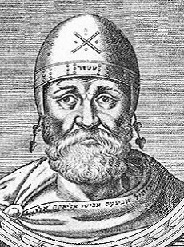
Philo of Alexandria (20 BCE – 50 CE)
Jewish philosopher in Egypt; a contemporary of Jesus
Fused and harmonized Greek Philosophy with Jewish theology and belief.
Referred to God as absolutely transcendent
Consistent with Jewish tradition
Means God cannot be described by any mundane properties
Thus he was the founder of apophatic theology: you can only describe God by what He is not, rather than by what He is
This seems to require infinity as a property of God
He is the first to describe God as timeless, existing outside of time.

Slide 7
Eternity
Inter-Testamental Years (what does that mean?)
Doctrines of heaven/hell, resurrection & after-life, angels & demons are developed
“this age” vs. “the coming age” (endless time)
New Testament: αιων (aión), or age
Time is not viewed as corrupt
Eternal life is in the context of endless time
This notion of eternity is central to Christian theology
As we have seen, around the time of Jesus, Greek philosophy and Jewish literature began to intersect.

Slide 8
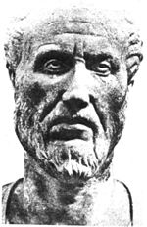
Plotinus (205-270 AD)
Greek philosopher, lived in Egypt
A Neo-Platonist
Author of the Six Enneads, his collected writings
First to claim God was infinite based on philosophy rather than Biblical authority
Had a complex theory of the infinite: an all-encompassing oneness, totality, and transcendent reality inaccessible to the rational mind (except in potentia), but accessible by the soul via religious ecstasy and enlightenment

Slide 9
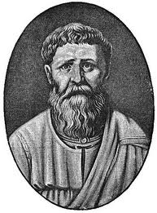
St. Augustine (354-430 ad)
Born to pagan father and Christian mother
Short Bio (video)
Synthesized Plato’s philosophy with Christian theology
On Infinity
Such as say that things infinite are past God's knowledge may just as well leap headlong into this pit of impiety, and say that God knows not all numbers. ... What madman would say so? ... What are we mean wretches that dare presume to limit His knowledge.

Slide 10
St. Augustine (354-430 ad)
“Augustine followed the Neo-Platonists in ascribing the highest place to mathematics for giving order to creation. Mathematical truths are necessary, unchangeable, and universal. God in his wisdom made use of mathematical ideas in structuring the world at the beginning of time. Humans can study the great book of nature to appreciate the order and beauty of God’s handiwork, but care must be taken to worship the Creator and not the creation.”
—Howell & Bradley, Mathematics in a Postmodern Age, pp. 143-4
Notes:
<NEXT SLIDE>

Slide 11
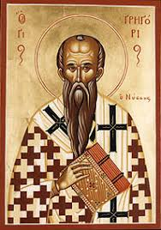
St. Gregory of Nyssa (335-395 AD)
One of the Cappadocian Fathers of the Church
First to argue that God was not only infinite, but theologically was actually infinite
It was actually a necessary step in an argument he wanted to make about the nature of Jesus' divinity
A consequence was that God is essentially incomprehensible to the limited minds of finite creatures

Slide 12
St. Gregory of Nyssa (335-395 AD)
Believed that both in life and in the afterlife man progresses towards the unreachable knowledge of God, continually transcending what has already been accomplished
Three stages of spiritual growth:
initial darkness of ignorance
spiritual illumination
a darkness of the mind in mystic contemplation of the God who cannot be comprehended

Slide 13
St. Gregory of Nyssa (335-395 AD)
An argument based on God's unchangeability
Two assumptions: God is unchangeable & attributes can only be limited by reference to their opposites
Because God is unchangeable, there is no opposite in his essence
If God is superior to the realm of opposites, where nonbeing and evil also are, he must be perfect
Because God cannot be limited in his goodness (or other attributes), he is unlimited
Being without limits is identical with infinity
—Infinity as a Transformative Concept in Science and Theology, by Wolfgang Achtner

Slide 14
St. Gregory of Nyssa (335-395 AD)
In the end, he opened up a number of new horizons (theological, spiritual, ethical, & intellectual) in his theology of the infinite:
A firm conception of God as infinite, overthrowing the finite view of God from Aristotle's metaphysics
He asked how it is that we can relate to this infinite God
He claimed that it is not the mind or intellect, but the ascending and purifying spirit or consciousness and moral virtue that are ways to approach God, but as a limiting process (à la Zeno) that never ends
—Infinity as a Transformative Concept in Science and Theology, by Wolfgang Achtner

Slide 15
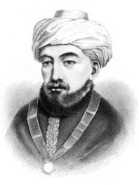
Maimonides (1135-1204 a.d.)
Jewish Scholar, both theological and scientific
Born in Cordova; head of Jewish community in Egypt.
On Infinity
But as for what is infinite in potentia or accidentally, the existence of such an infinite has, in some cases, been demonstrated: thus it has been demonstrated that the division of magnitudes to infinity is possible in potentia, and likewise the division of time to infinity. Another case is an object of speculation: namely, the existence of what is infinite by way of succession. This is what is called the infinite by accident. And it consists in a thing coming to exist after the passing-away of another thing, the latter’s coming to exist after the passing-away of a third thing, and so forth to infinity.

Slide 16
Maimonides (1135-1204 a.d.)
A[n] … argument was put forth…in Islamic culture by the Jewish sage Moses Maimonides…in his Guide for the Perplexed. Unmistakably also basing his physical framework on Aristotle, Maimonides presented the causal argument, noting that “the series does not extend to infinity” because:
impossible is the existence of an infinite series of causes, namely, that a certain thing should be the cause of another thing, but itself the effect of another cause, which again is the result of another cause, and so on to infinity, …[and so we must stop at] the Creator…. He is therefore the ultimate cause.
As with [Aristotle] the fulcrum of the logic for Maimonides was the impossibility of infinity, and this led to his proof of God’s existence.
—Idolatry & Infinity: Of Art, Math, & God, by David R. Topper

Slide 17
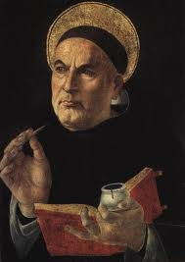
St. Thomas Aquinas (1225-1274 a.d.)
Dominican Priest
Synthesized Aristotle’s philosophy with Christian theology
On Infinity
The existence of an actual infinite multitude is impossible. For any set of things one considers must be a specific set. And sets of things are specified by the number of things in them. Now no number is infinite, for number results from counting through a set of units. So no set of things can actually be inherently unlimited, nor can it happen to be unlimited.

Slide 18
St. Thomas Aquinas (1225-1274 a.d.)
… it should be noted that different ways of knowing (ratio cognoscibilis) give us different sciences. The astronomer and the natural philosopher both conclude that the earth is round, but the astronomer does this through a mathematical middle that is abstracted from matter, whereas the natural philosopher considers a middle lodged in matter. Thus there is nothing to prevent another science from treating in the light of divine revelation what the philosophical disciplines treat as knowable in the light of human reason. (Summa theologiae, Ia, q. 1, a., ad 2)

Slide 19
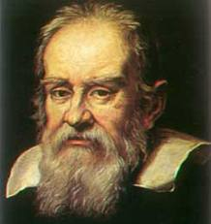
Galileo Galilei (1564-1642 a.d.)
“Mathematics is the language with which God wrote the universe.”
“Philosophy is written in this grand book, the universe ... It is written in the language of mathematics, and its characters are triangles, circles, and other geometric figures;”
“we must say that there are as many squares as there are numbers”

Slide 20
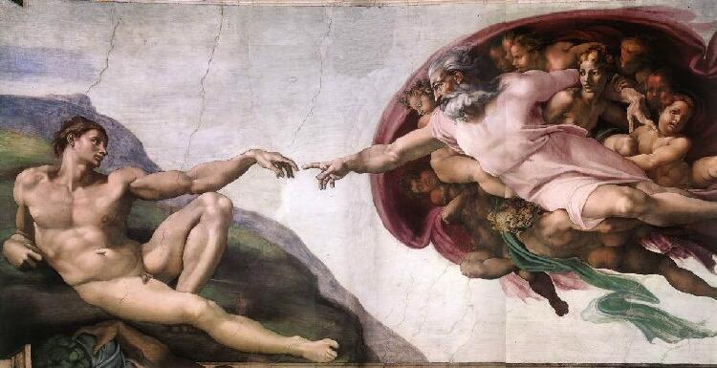
finis… …infini!
Creation of Adam, Michelangelo, 1511

