Slide 1
To
and Beyond...

Slide 2
Rod Serling (The Twilight Zone)
There is a fifth dimension, beyond that which is known to man. It is a dimension as vast as space and as timeless as infinity. It is the middle ground between light and shadow, between science and superstition.

Slide 3
ALERT
FYE Events: 3 of 100
Reflective Journal samples...
After we discuss The Allegory of the Cave (remind me)
Philosophical reprieve:
Wednesday: come with your math hats on...

Slide 4
The Cave
I've been in a cave for forty days Only a spark to light my way I wanna give out, I wanna give in This is our crime This is our sin But I still believe, I still believe Through the pain and through the grief Through the lives, through the storms Through the cries and through the wars
...
I'll march this road. I'll climb this hill Up on my knees if I have to I'll take my place up on this stage
...
I feel like I like I want to go home What do I feel? What do I know? But I still believe, I still believe ... Through the heartache, through the tears Through the waiting, through the years For people like us in places like this We need all the hope that we can get
Platos’ Republic
What is your reaction?
How did you interpret it?
Did you connect it to other things?
How is it a metaphor for your life?
What is reality?
Senses?
Mind?
Matter/Energy & Space/Time?
Spirituality?
Virtual Reality & Cyberspace?
Flat earth & Hollow earth??
I Still Believe
—The Call

Slide 5
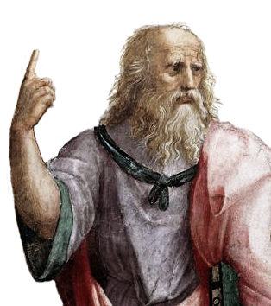
Plato (428-348 BC)
Plato was a Mystic
He was a Pythagorean (although the Brotherhood no longer existed)
He believed in a transcendent reality
The Archetypes, or Forms
Mind over Matter: physical reality was corrupt, perfection was abstract
“Let no one ignorant of geometry enter here”
Mathematics was the foundation of education and society
He was not a mathematician, but thought it extremely important
Aristotle was his student, and they disagreed about almost everything!!

Slide 6
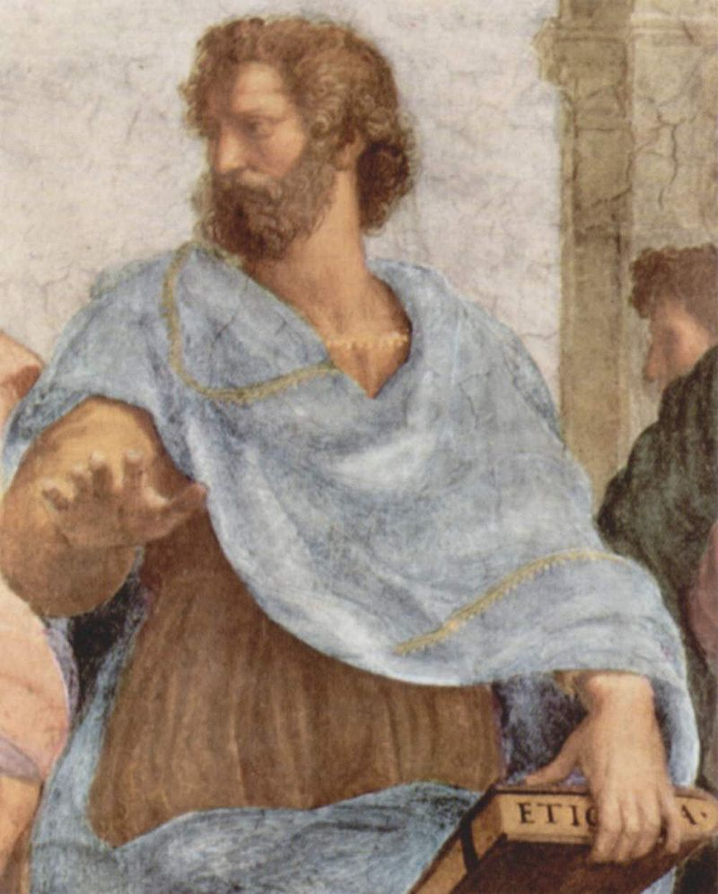
Aristotle (384-322 BC)
Aristotle was an Empiricist
Plato’s most famous student
Founded deductive logic
Syllogisms: If all men are mortal and Socrates was a man, then Socrates was mortal
Matter over Mind: analytic approach to knowledge
Viewed mathematics as more utilitarian
The Infinite
Contemplated Zeno’s paradoxes, and brilliantly thought outside the box
The actual vs. the potential

