Slide 1
To
and Beyond...

Slide 2
Anaximander (Ἀναξίμανδρος) 610 – 546 BC
For there are some who make this (i.e. a body distinct from the elements) the infinite, and not air or water, in order that the other things may not be destroyed by their infinity. They are in opposition one to another —air is cold, water moist, and fire hot— and therefore, if any one of them were infinite, the rest would have ceased to be by this time. Accordingly they say that what is infinite is something other than the elements, and from it the elements arise.

Slide 3
Syllabus
Questions?
Journal
FYE/IS Events
Next Week:
Bring to class Wednesday two paper copies of a typed list of ten (10) important facts that DFW, Maor or Clegg introduce you to at the beginning of their books.
FYE/IS Goals & Objectives
Greek Life

Slide 4
And so it begins...
An amazing century: 6th B.C. (600-500)
Zoroaster (Iran, date uncertain) founded a Persian religion that was dualistic (The world is locked in an epic battle between the forces of Good and Evil)
Confucius (China, 551-479) developed an ethical philosophy centered on the pursuit of a harmonious social order (considered a deity in Taoism)
Nebuchadnezzar II (Iraq, 605-562) King of Babylon, defeated Hebrews in 586, destroying Jerusalem & Solomon’s Temple; Israelites exiled to Babylonia; several prophetic books of the Old Testament are written (Ezekiel, Daniel, Jeremiah)
Gautama (Nepal, 563-483), also known as The Buddha, taught a philosophy of the ‘Middle Way’ between sensual indulgence and severe asceticism
Mahavira (India, 599-527), his teaching form the core foundational principles of Jainism, a religion distinct from Buddhism that includes ethics and the soul
Celtic Druidism (Britain, dates uncertain) a polytheistic religion that worshipped nature spirits & practiced magic

Slide 5
But there’s more!!
An amazing century: 6th B.C. (600-500)
Thales (626-548): from Miletus, a Greek City in Ionia (modern Turkey)
earliest philosopher, mathematician, and scientist in the Greek tradition
one of the Seven Sages of Greece
founded the Ionian School
Anaximander (610-546) : from Miletus
succeeded Thales as the second master of the Milesian school
the first philosophy dealing with the infinite
Pythagoras (580-569) : from Samos, an island in the eastern Aegean Sea

Slide 6
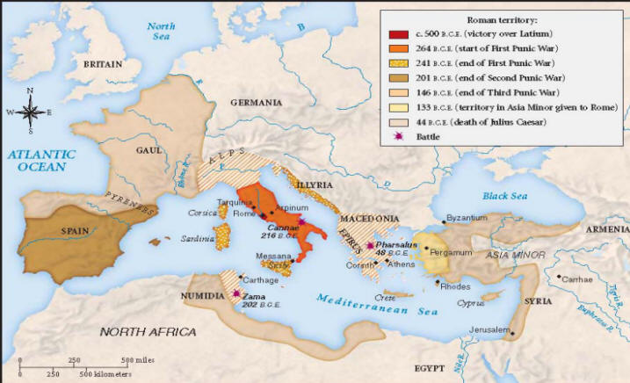

Slide 7
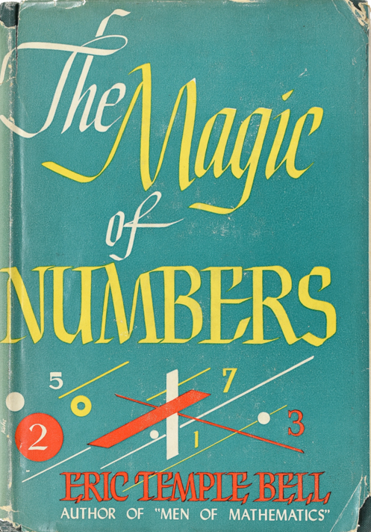
But there’s more!!
An amazing century: 6th B.C. (600-500)
Thales (626-548): from Miletus, a Greek City in Ionia (modern Turkey)
earliest philosopher, mathematician, and scientist in the Greek tradition
one of the Seven Sages of Greece
Anaximander (610-546) : from Miletus
succeeded Thales as the second master of the Milesian school
the first philosophy dealing with the infinite
Pythagoras (b. 580-569) : from Samos, an island in the eastern Aegean Sea
his father was a stonecutter, and his mother was Phoenician (modern Lebanon)
left home at 18, traveled the world until the age of 40
reportedly a student of Anaximander, and perhaps Thales
spent time in Egypt and Phoenicia
roamed east as far as Babylonia, perhaps even India
ventured west as far as Gaul (France), perhaps the British Isles
returned home influenced by widely different religious and philosophical cultures

Slide 8
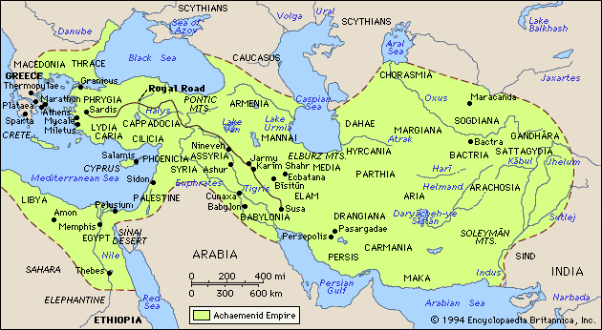

Slide 9
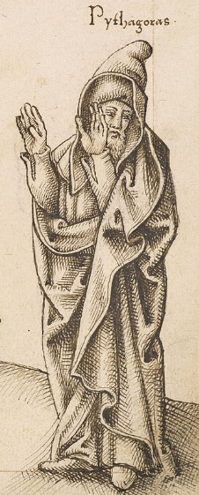
The Brotherhood (Croton, southern Italy)
A school open to men and women
Discipline & asceticism were emphasized
Listeners & Mathematicians
At its peak consisted of 200-300 families
Became a template for secret societies and cults
Adopted a curriculum that is the origin of the Liberal Arts
Primary belief: Everything is number
“Number is the ruler of forms and ideas, and is the cause of gods and daemons.”

Slide 10
Weirdness
Wait, what? “All is number”? What’s that?
What is the nature of REALITY??
Compare:
Thales (626-548): hypothesized that the originating principle of nature and the nature of matter was a single material substance, namely water
Anaximenes (586-526): best known for his doctrine that air is the source of all things
Heraclitus (535-475): believed the world was ultimately made of fire, which is flux or change
Parmenides (515-?): everything exists as one, giant, unchanging thing
Anaximander (610-546): Reality is some, one thing, but we cannot know what—the undefined infinite

Slide 11
Pythagoreans
Their mathematics was metaphysical
Their metaphysics was religious
Their religion was mathematics
But, their understanding of number was very different than ours
For example, numbers begin with 3
“The generation of number series was related to objects of geometry as well as cosmogony. According to Diogenes Laërtius, from the monad evolved the dyad; from it numbers; from numbers, points; then lines, two-dimensional entities, three-dimensional entities, bodies, culminating in the four elements earth, water, fire and air, from which the rest of our world is built up.” –Wikipedia.com
All lengths can be measured as whole numbers or ratios of whole numbers

