Slide 1
Rust: Wrap Up
COMP 4210
David J Stucki

Slide 2


OPerator Overloading
What is Operator Overloading?
  Rust allows custom types to use standard operators by mapping them to trait methods in the standard library.
  Expressions like a + b are translated by the compiler into trait method calls such as Add::add(a, b).
Benefits of Overloading
  This design enhances readability, reduces boilerplate code, and improves expressiveness in mathematical code.
  Operator overloading allows generic functions to work abstractly on types without needing their concrete details.
Safety and Explicitness
  Rust enforces rules (explicit trait bounds) on operator overloading to maintain safety, clarity, and prevent misuse common in other languages.

Slide 3
Arithmetic Operators (the Add Trait)
Rust Arithmetic Traits
  Rust uses traits in std::ops module to implement arithmetic operators like +, -, *, /, and %
  Traits like Add, Sub, Mul, Div, and Rem implement these arithmetic operators with associated output types for flexible results.
Add Trait Functionality
  The + operator is shorthand for Add trait’s add method, defining how values combine in Rust.
Output Type Flexibility
  Add trait supports an associated Output type, allowing results to differ from operand types.
Support for Generic Programming
  This flexibility enables generic programming and complex abstractions with clear operator semantics.

Slide 4


Complex Type Example
// Binary Add Operator (+)
use std::ops::Add;
impl<T> Add for Complex<T>
where T: Add<Output = T>,
{
type Output = Self;
fn add(self, rhs: Self) -> Self {
Complex {
re: self.re + rhs.re,
im: self.im + rhs.im,
}
}
}
// Unary Neg Operator (-)
use std::ops::Neg;
impl<T> Neg for Complex<T>
where T: Neg<Output = T>,
{
type Output = Complex<T>;
fn neg(self) -> Self::Output {
Complex {
re: -self.re,
im: -self.im,
}
}
}

Slide 5
Compound Assignment Operators
Explicit Trait Implementation
  Rust requires explicit implementation of compound assignment traits like AddAssign and SubAssign to avoid ambiguity.
No Automatic Fallback
  Rust does not default to binary operators if compound assignment traits are missing.
Mutation and Unit Return
  Compound assignment operators mutate the left operand and return unit type ().

Slide 6
Complex Type Example
// Compound AddAssign Operator (+=)
use std::ops::AddAssign;
impl<T> AddAssign for Complex<T>
where T: AddAssign<T>,
{
fn add_assign(&mut self, rhs: Complex<T>) {
self.re += rhs.re;
self.im += rhs.im;
}
}

Slide 7
Equality and Ordering Traits
PartialEq Trait
  Enables == and != operations with symmetry and transitivity but excludes reflexivity because the IEEE floating point value NaN has weird behavior.
Eq Trait Guarantees
  Extends PartialEq by adding reflexivity (so that a value is always equal to itself), suitable for keys in collections like HashMap.
PartialOrd Trait
  Supports ordered comparisons that may be partial, returning None for unordered values.
Ord Trait and Total Ordering
  Requires total ordering and enables sorting and binary search structures with strict guarantees.

Slide 8
Complex Type Example
// Binary PartialEq Operator (==)
impl<T: PartialEq> PartialEq for Complex<T> {
fn eq(&self, other: &Self) -> bool {
self.re == other.re &&
self.im == other.im
}
}

Slide 9
Index and IndexMut
Controlled Indexing Customization
  Index and IndexMut traits enable safe customization of the indexing operator [] for custom types.
Immutable vs Mutable Access
  Index returns immutable references, while IndexMut allows mutable references.
Consistent Panic Behavior
  Out-of-bounds indexing panics consistently, ensuring behavior matches built-in containers.
Ergonomic Abstractions
  Custom implementations allow intuitive abstractions like using a flat vector as a 2D image buffer.

Slide 10

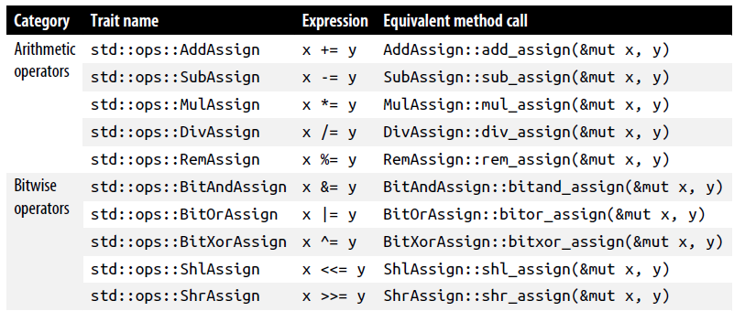
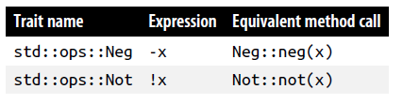
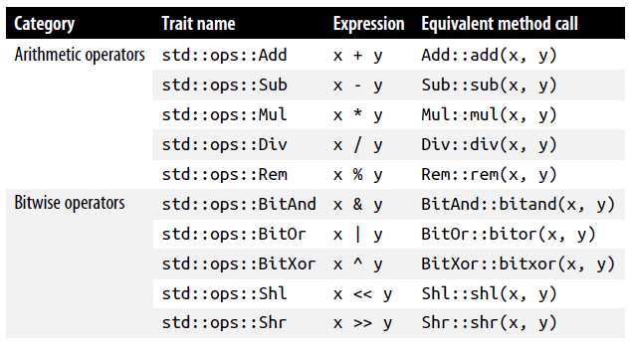
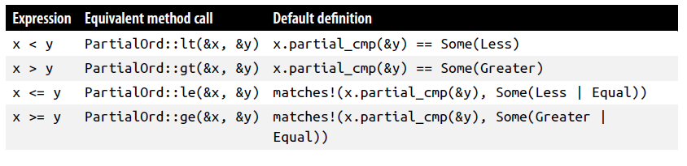

Slide 11
Debrief of Rust

Slide 12
Next Time...
  Project presentations

