Slide 1
ch16. webprogramming

Slide 2
before getting started
i only used the class textbook
  gives us good fundamentals to get started
  quite easy to follow
  cons: they do not go over post requests,delete etc…
  pros: but once you understand get requests it should be easy to learn on own
i cover 16.1, 16.2.
professor Stucki will take over 16.3

Slide 3
basics
server: delivers the content of website to a client
client: usually the web browser
user make request through browser → serves returns the content depending on the request made
but there are protocols they follow

Slide 4
protocols and terms…
tcp : handles how data are transferred between devices, allows reliable communication
http : builds on top of TCP (abstraction), defines request response structure
also
ip: unique identifier that helps identify a device on network
port: identifies specific program that message should go to
all together
socket = ip + port + protocols

Slide 5
implenting server
rust provides module for basic implementation
  std::net
  TcpListener
  TcpStream
Notes:
Go to part1.rs for demo

Slide 6
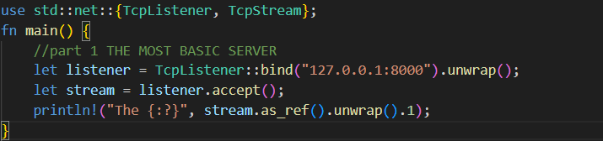
Tvery basic

Slide 7
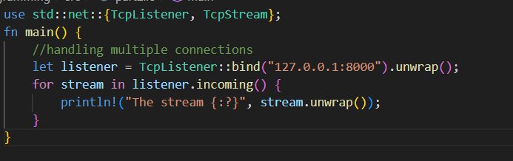
handling multiple connection
Notes:
Go to part2.rs for demo

Slide 8
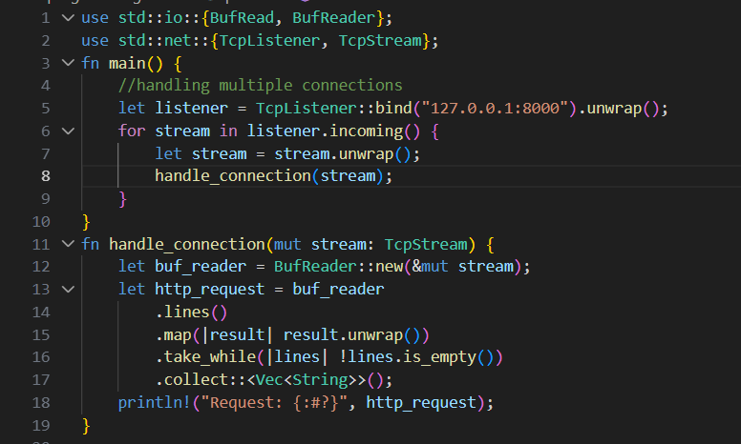
handling connection
Notes:
Go to part3.rs for demo

Slide 9

making response

Slide 10
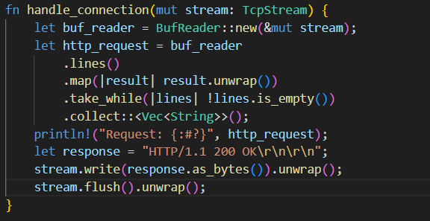
getting some response
Notes:
Go to part4.rs for demo

Slide 11
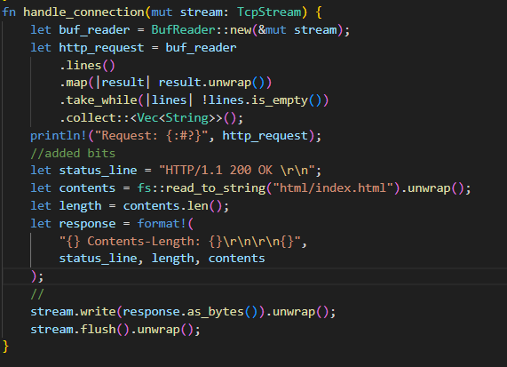
html
Notes:
Go to part5.rs for demo

Slide 12
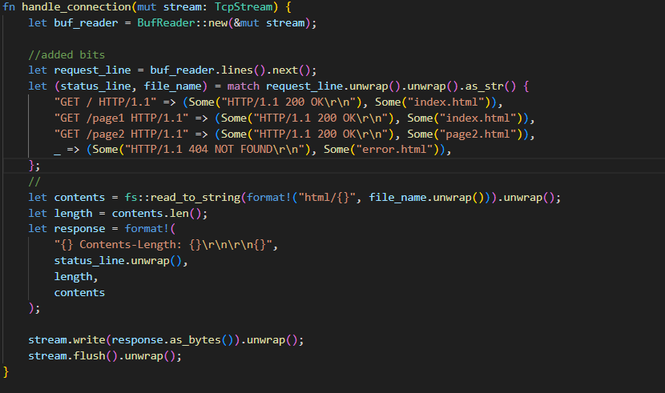
Html different responses
Notes:
Go to part 6.rs for demo

Slide 13
one more problem…handling multiple requests simultaneously
prof.stucki saves the day!

